Slide 1
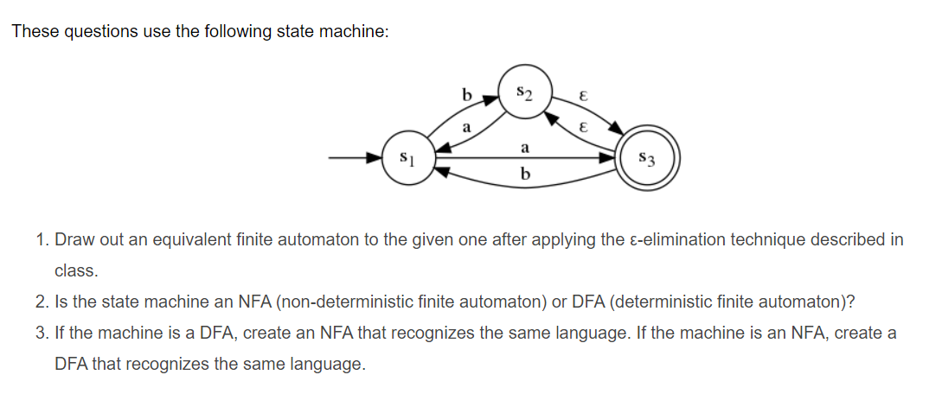
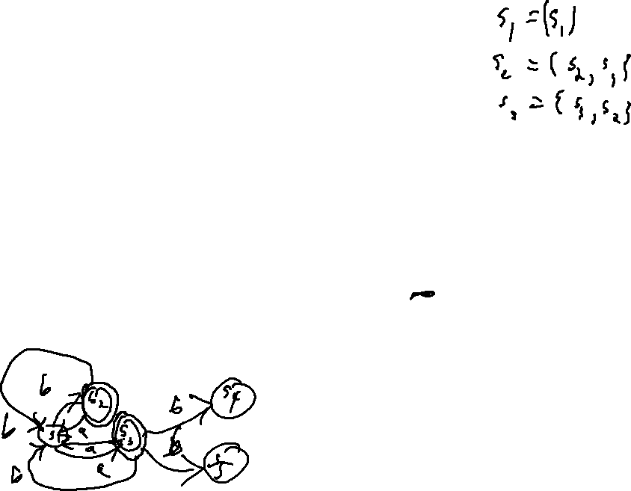
Check-in
Review: Tokenization

Slide 2
Administrivia
Housekeeping
Quiz 1 NEXT Friday
Project 1 due NEXT Wednesday (or that Thursday for 1 late mark or that Friday for 2 late marks)

Slide 3


Slide 4
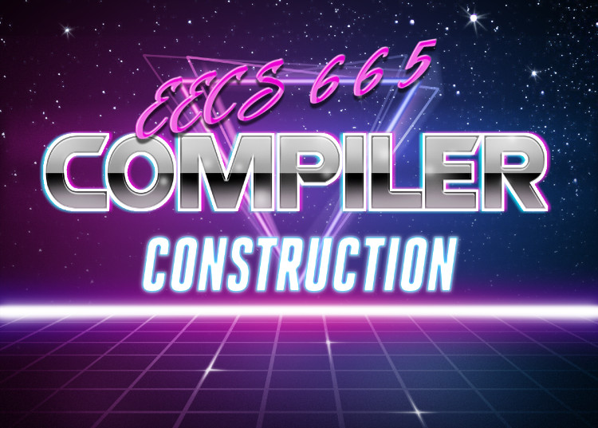
4 – Syntactic Ambiguity
University of Kansas | Drew Davidson

Slide 5
I Think We’re Mostly Done with Review
Lecture 4 – Syntactic Ambiguity

Slide 6
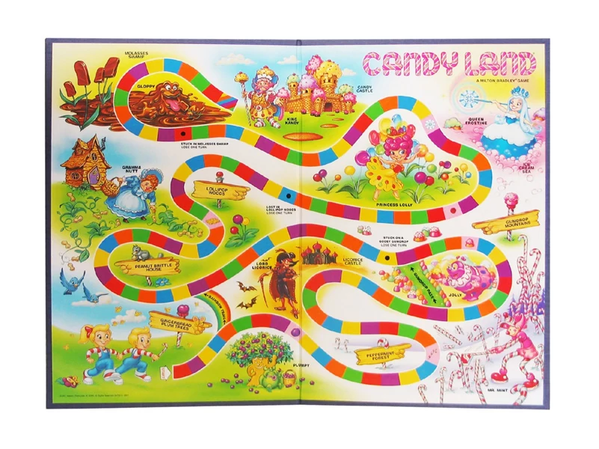
COMPILER
Code Generation
Execution
Runtime Environment
Intermediate
Representation
Optimization
SDD
Parsing
Semantics
Lexical Analysis
Syntactic
Definiton

Slide 7

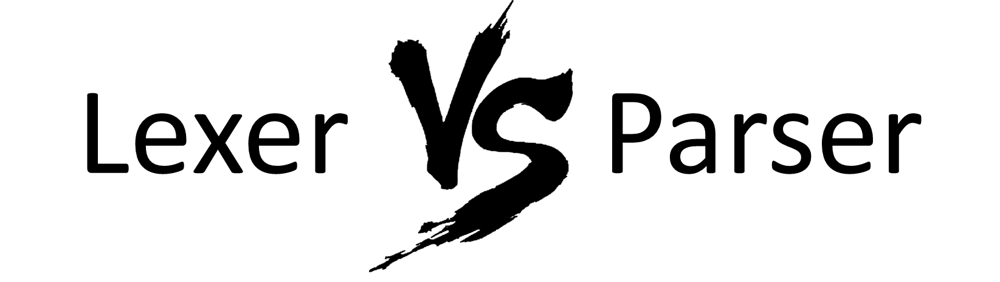
Compiler Construction
Progress Pics
Live Assignments
P1
H2
Source code (sequence of chars)
Quick Comparison
Scanner
Lexical analysis
We are here
Parser
Syntactic analysis
Semantic analysis
IR (Intermediate Representation) code generation
IR optimization
Code generation
Final code optimization
Output target code

Slide 8
Definition: RegExes
Definition: CF Grammar
Input: char stream
Input: token stream
Output: token stream
Output: parse tree
Recognizer: DFA
Recognizer: PDA
Let’s breeze through this
(I bet you’ve seen it already)

Slide 9
Definition: RegExes
Definition: CF Grammar
Input: char stream
Input: token stream
Output: token stream
Output: parse tree
Recognizer: DFA
Recognizer: PDA
Translator: Tokenizer
Translator: Parser

Slide 10
Last Time
Review Lecture 3 – Defining Syntax
Reviewed Context-Free Grammars
  Language Definition via grammar
  BNF notation
  Parse trees
CFGs - usable for syntactic definition
BNF is a good way for
programmers to
communicate syntax

Slide 11
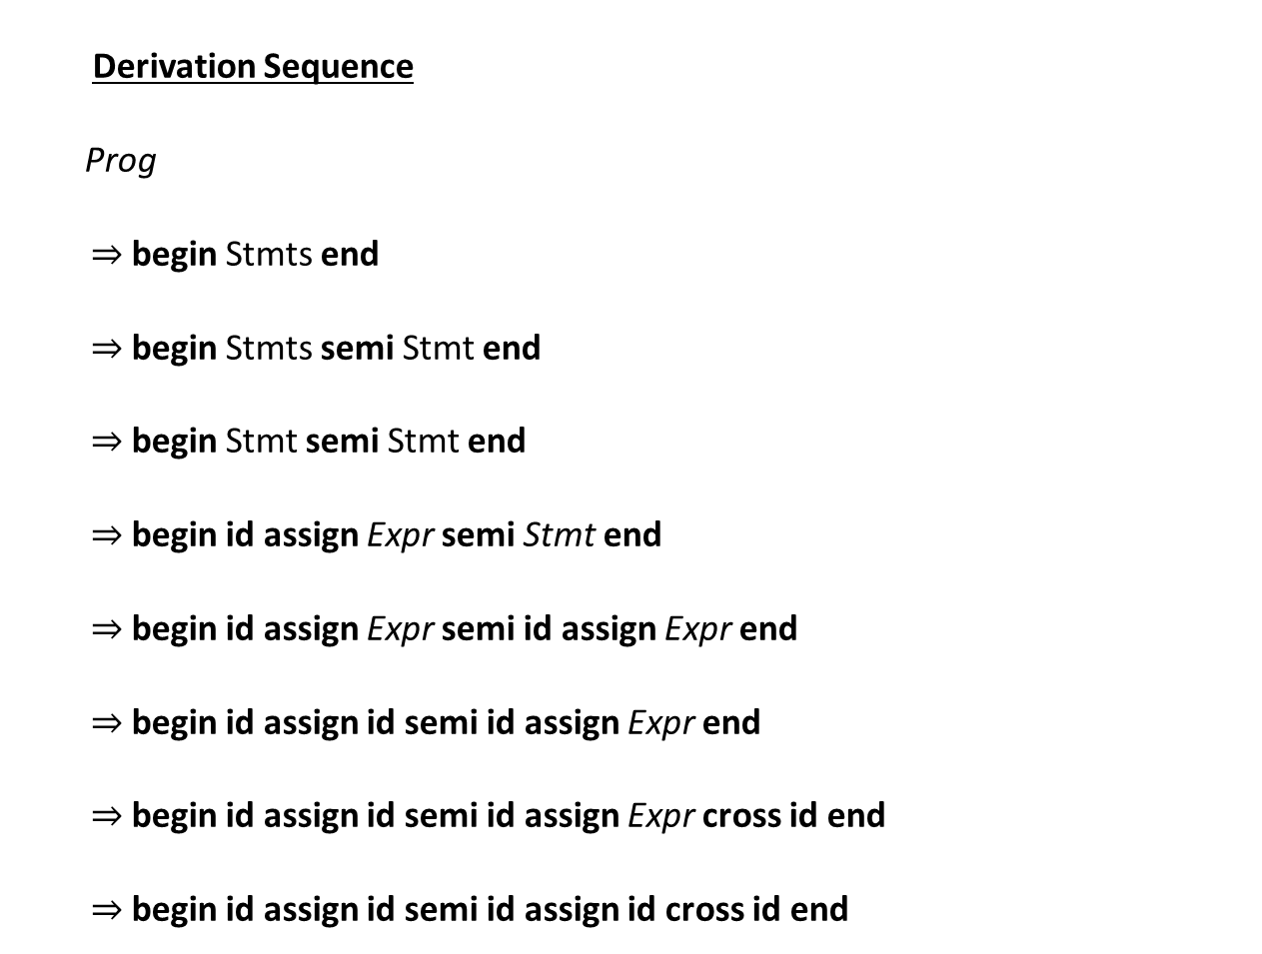
Parse Tree
Prog
Derivation Sequence
Prog
begin Stmts end
begin Stmts semi Stmt end
begin Stmt semi Stmt end
begin id assign Expr semi Stmt end
begin id assign Expr semi id assign Expr end
begin id assign id semi id assign Expr end
begin id assign id semi id assign Expr cross id end
begin id assign id semi id assign id cross id end
begin
Stmts
end
Prod. 1
Stmts
semi
Stmt
Prod. 2
Stmt
id
assign
Expr
Prod. 3
id
assign
Expr
Expr
cross
id
Prod. 4
id
id
Prod. 4
Productions
Prog ::= begin Stmts end
Stmts ::= Stmts semi Stmt
| Stmt
Stmt ::= id assign Expr
Expr ::= id
| Expr cross id
Prod. 5
Prod. 6
Prod. 5

Slide 12
Lecture Outline
Lecture 4 –Syntactic Ambiguity
Live Assignments
P1
H2
Compiler Concerns in Syntactic Analysis
Recognizing CF-Languages
Constraining Derivations
Ambiguous Syntax
  What it is
  How we resolve it

Slide 13

Constraining Derivations
Lecture 4 –Syntactic Ambiguity
Live Assignments
P1
H2
Goal: 1-1 map derivation sequences to sentences
Reason #1: predictable, reliable algorithms
Reason #2: we care about the structure of sentences
Consistency is key

Slide 14
Derivation Order
Syntactic Ambiguity: Constraining Derivations
Grammar
How can we derive the sentence?
Multiple orderings of the same productions to generate sentence
  That’s bad for consistency!
We usually commit to a single ordering
  Leftmost derivation: expand the leftmost nonterminal
  Rightmost derivation: expand the rightmost nonterminal
P1: Li ::= Li dot Li
P2: | id
Token stream
id dot id dot id
Parse Tree
P1
Li
P1
P2
Li
dot
Li
id
P2
Li
dot
Li
P2
id
id

Slide 15
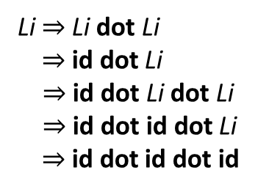
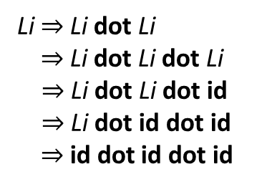
Derivation Order
Syntactic Ambiguity: Constraining Derivations
Grammar
How can we derive the sentence?
Multiple orderings of the same productions to generate sentence
  That’s bad for consistency!
We usually commit to a single ordering
  Leftmost derivation: expand the leftmost nonterminal
  Rightmost derivation: expand the rightmost nonterminal
P1: Li ::= Li dot Li
P2: | id
Token stream
id dot id dot id
Parse Tree
P1
Li
1st
1st
P1
Leftmost derivation
Rightmost derivation
dot
2nd
dot
Li
dot
Li
P2
Li
Li
Li
Li
Li $⇒$Li dot Li
$⇒$id dot Li
$⇒$id dot Li dot Li
$⇒$id dot id dot Li
$⇒$id dot id dot id
Li $⇒$Li dot Li
$⇒$Li dot Li dot Li
$⇒$Li dot Li dot id
$⇒$Li dot id dot id
$⇒$id dot id dot id
5th
3nd
2nd
id
P2
id
id
dot
P2
dot
Li
dot
Li
Li
Li
Li
Li
4th
3rd
4th
5th
id
id
id
id
id
id

Slide 16

Bigger Problems On the Horizon
Syntactic Ambiguity: Constraining Derivations
May be able to produce different parse trees
even under the same derivation order!

Slide 17
The Real Problem
Syntactic Ambiguity: Constraining Derivations
Grammar
P1. Li ::= Li dot Li
P2. | id
Input
id dot id dot id
Parse Tree
Another Parse Tree
1st, P1
1st, P1
Li
Li
3rd, P1
5th, P2
dot
2nd, P1
Li
dot
Li
2nd, P2
Li
Li
4th, P2
Li
dot
Li
id
id
Li
dot
Li
5th, P2
4th, P2
3rd, P2
id
id
id
id
Same (leftmost) derivation order, different productions

Slide 18

The Real Problem
Syntactic Ambiguity: Constraining Derivations
Even with a fixed derivation order, possible to derive the same sentence in multiple ways
Syntactic Ambiguity (Definition):
For Grammar $𝒢$ and string $𝓌$
  $𝒢$ is ambiguous if
    >1 leftmost derivation of $𝓌$
    $≡$
    >1 rightmost derivation of $𝓌$
    $≡$
    > 1 parse tree for $𝓌$
Why is syntactic ambiguity a problem?
Allows inconsistency
Unreliable tree structure
Particularly
troubling

Slide 19
Parse Tree Structure
Syntactic Ambiguity: Constraining Derivations
Maintain the integrity of the underlying operations
Intuitively, parse tree should mimic semantic grouping
-
4
*
7
3
Expr
Expr
minus
Expr
intlit: 4
Expr
times
Expr
intlit: 7
intlit:3

Slide 20
Parse Tree Structure
Syntactic Ambiguity: Constraining Derivations
Grammar
Parse Tree 1
P1. Expr ::= intlit
P2. | Expr minus Expr
P3. | Expr times Expr
Expr
Expr
times
Expr
Expr
minus
Expr
intlit: 3
Char Stream:
4 – 7 * 3
Which tree is correct?
intlit: 4
intlit: 7
Token Stream:
intlit minus intlit times intlit
Parse Tree 2
Expr
Expr
minus
Expr
intlit: 4
Expr
times
Expr
intlit: 7
intlit:3

Slide 21
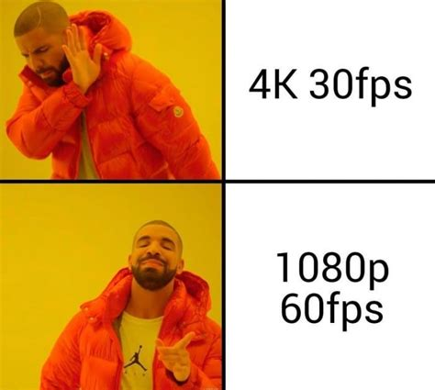

Parse Tree Structure
Syntactic Ambiguity: Constraining Derivations
Grammar
Parse Tree 1
P1. Expr ::= intlit
P2. | Expr minus Expr
P3. | Expr times Expr
Expr
Expr
times
Expr
Expr
minus
Expr
intlit: 3
Char Stream:
4 – 7 * 3
intlit: 4
intlit: 7
Token Stream:
intlit minus intlit times intlit
Parse Tree 2
Expr
Expr
minus
Expr
intlit: 4
Expr
times
Expr
intlit: 7
intlit:3

Slide 22
Parse Tree Structure
Syntactic Ambiguity: Constraining Derivations
Grammar
Parse Tree 1
P1. Expr ::= intlit
P2. | Expr minus Expr
P3. | Expr times Expr
Expr
Expr
times
Expr
Intuitive problem: Depth
Minus subtrees
(can be) produced
beneath times subtrees
Expr
minus
Expr
intlit: 3
Char Stream:
4 – 7 * 3
intlit: 4
intlit: 7
Token Stream:
intlit minus intlit times intlit
Parse Tree 2
Expr
Expr
minus
Expr
intlit: 4
Expr
times
Expr
intlit: 7
intlit:3

Slide 23
Parse Tree Structure
Syntactic Ambiguity: Constraining Derivations
Grammar
P1. Expr ::= intlit
P2. | Expr minus Expr
P3. | Expr times Expr
Intuitive problem: Depth
Minus subtrees
(can be) produced
beneath times subtrees
Fixed Grammar
P1. Expr ::= Expr minus Expr
P2. | Term
P3. Term ::= Term times Term
P4. | Factor
P5. Factor ::= intlit
Solution: Embed precedence “levels” into the grammar
minus level
You can go down a level “for free”
times level
You can’t go up a level
intlit level
Use a new nonterminal for each precedence level

Slide 24
Parse Tree Structure
Syntactic Ambiguity: Constraining Derivations
Fixed Grammar
P1. Expr ::= Expr minus Expr
P2. | Term
P3. Term ::= Term times Term
P4. | Factor
P5. Factor ::= intlit
Char Stream:
4 – 7 * 3
Parse Tree 2
Expr
Token Stream:
intlit minus intlit times intlit
Expr
minus
Expr
intlit: 4
Expr
times
Expr
intlit: 7
intlit:3

Slide 25
Parse Tree Structure
Syntactic Ambiguity: Constraining Derivations
Fixed Grammar
P1. Expr ::= Expr minus Expr
P2. | Term
P3. Term ::= Term times Term
P4. | Factor
P5. Factor ::= intlit
Char Stream:
4 – 7 * 3
Parse Tree 2
Expr
Token Stream:
intlit minus intlit times intlit
Expr
minus
Expr
Term
Term
Factor
Term
times
Term
intlit: 4
Factor
Factor
intlit: 7
intlit:3

Slide 26
Parse Tree Structure
Syntactic Ambiguity: Constraining Derivations
Fixed Grammar
P1. Expr ::= Expr minus Expr
P2. | Term
P3. Term ::= Term times Term
P4. | Factor
P5. Factor ::= intlit
Parse Tree 1
Expr
Expr
times
Expr
Char Stream:
4 – 7 * 3
Expr
minus
Expr
intlit: 3
intlit: 4
intlit: 7
Token Stream:
intlit minus intlit times intlit

Slide 27
Parse Tree Structure
Syntactic Ambiguity: Constraining Derivations
Fixed Grammar
P1. Expr ::= Expr minus Expr
P2. | Term
P3. Term ::= Term times Term
P4. | Factor
P5. Factor ::= intlit
Expr
Parse Tree 1
Term
Term
times
Term
No Expr
Below
Term
Char Stream:
4 – 7 * 3
Factor
intlit: 3
Expr
Token Stream:
intlit minus intlit times intlit
Expr
minus
Expr
intlit: 4
intlit: 7

Slide 28
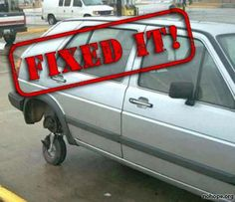
Did We Fix All Ambiguity?
Resolving Syntactic Ambiguity
Fixed Grammar
P1. Expr ::= Expr minus Expr
P2. | Term
P3. Term ::= Term times Term
P4. | Factor
P5. Factor ::= intlit
Nope!
Grammar is still
ambiguous!
Char Stream:
3 – 4 – 7

Slide 29
Did We Fix All Ambiguity?
Resolving Syntactic Ambiguity
Fixed Grammar
Expr
P1. Expr ::= Expr minus Expr
P2. | Term
P3. Term ::= Term times Term
P4. | Factor
P5. Factor ::= intlit
Nope!
minus
Expr
Expr
Term
Expr
minus
Expr
Grammar is still
ambiguous!
Factor
Term
Term
intlit: 3
Factor
Factor
Char Stream:
3 – 4 – 7
intlit: 4
intlit: 7
Expr
Expr
minus
Expr
Expr
minus
Expr
Term
Term
Term
Factor
Factor
Factor
intlit: 7
intlit: 3
intlit: 4

Slide 30
A Second Ambiguity Issue
Syntactic Ambiguity: Constraining Parse Trees
Solved!
enforce depth with
nonterminal “levels”
Precedence
We want correct behavior on 4 – 7 * 9
High-precedence operators deeper in the tree
Idea…
enforce with
production “skew”
Associativity
We want correct behavior on 4 – 7 – 9
Minus should be left associative: a – b – c – d =
(
(
a
-
b
)
-
c
)
-
d
)

Slide 31
A Second Ambiguity Issue
Syntactic Ambiguity: Constraining Parse Trees
Idea…
enforce with
production “skew”
Associativity
We want correct behavior on 4 – 7 – 9
Minus should be left associative: a – b – c – d =
(
(
a
-
b
)
-
c
)
-
d
)
–
Deeply nested parens
=
Deep in the tree
–
d
–
c
a
b

Slide 32

Enforcing Associativity
Resolving Syntactic Ambiguity
Recognize left-associative operators with left-recursive productions
Recognize right-associative operators with right-recursive productions
A grammar is recursive in (nonterminal) X if
  $X\underset{⇒}{+}αXγ$ for arbitrary strings of symbols $α$ and $γ$

Slide 33
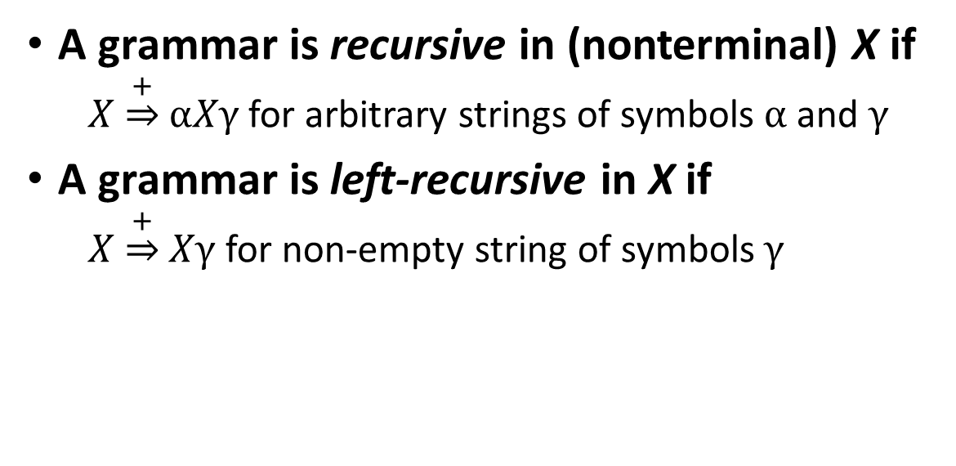
Enforcing Associativity
Resolving Syntactic Ambiguity
Recognize left-associative operators with left-recursive productions
Recognize right-associative operators with right-recursive productions
A grammar is recursive in (nonterminal) X if
  $X\underset{⇒}{+}αXγ$ for arbitrary strings of symbols $α$ and $γ$
A grammar is left-recursive in X if
  $X\underset{⇒}{+}Xγ$ for non-empty string of symbols $γ$

Slide 34
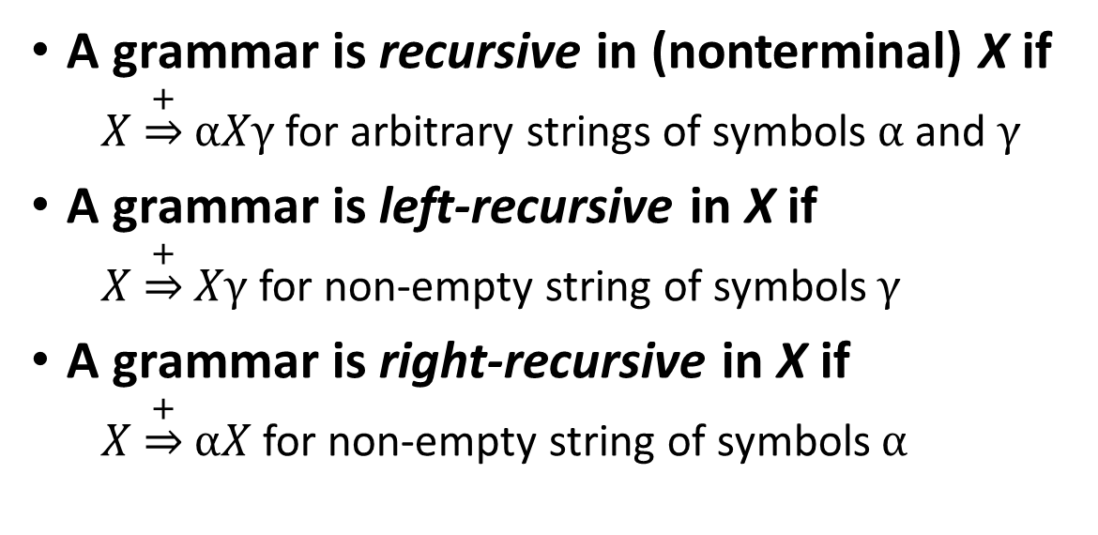
Enforcing Associativity
Resolving Syntactic Ambiguity
Recognize left-associative operators with left-recursive productions
Recognize right-associative operators with right-recursive productions
A grammar is recursive in (nonterminal) X if
  $X\underset{⇒}{+}αXγ$ for arbitrary strings of symbols $α$ and $γ$
A grammar is left-recursive in X if
  $X\underset{⇒}{+}Xγ$ for non-empty string of symbols $γ$
A grammar is right-recursive in X if
  $X\underset{⇒}{+}αX$ for non-empty string of symbols $α$

Slide 35
Enforcing Associativity
Resolving Syntactic Ambiguity
Recognize left-associative operators with left-recursive productions
Recognize right-associative operators with right-recursive productions
Term
Example: 4 – 7 – 9
Expr → Expr minus Expr
| Term
Term → Term times Term
| Factor
Factor → intlit | lparen Expr rparen
E
E
-
T
Factor
T
F
E
-
T
F
intlit
F
intlit
9
7
intlit
4

Slide 36
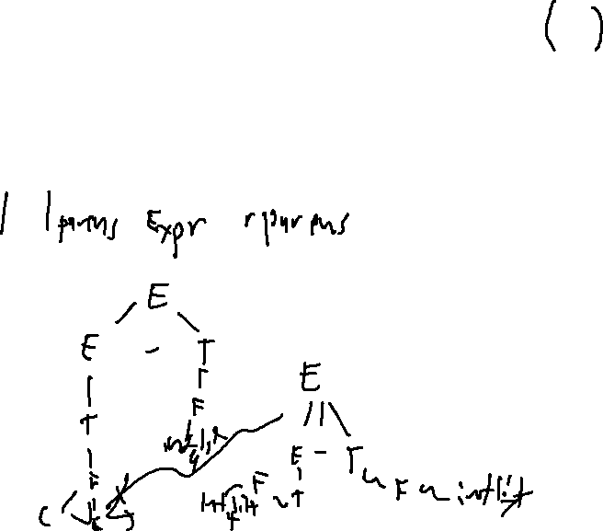
Enforcing Associativity
Resolving Syntactic Ambiguity
Expr → Expr minus Term
| Term
Term → Term times Factor
| Factor
Factor → intlit
Example: 4 – 7 – 9
Let’s try to re-build the wrong parse tree again
E
E
-
T
T
We’ll never be able to derive minus
without parens
F
intlit
4

Slide 37
End of Lecture
Syntactic Ambiguity
Summary
We set out to make derivations and parse trees map 1-1 with any string in a grammar
We note several forms of ambiguity and consider fixes:
  Derivation order: use a fixed strategy
  Syntactic ambiguity (precedence) – “stratify” the grammar
  Syntactic ambiguity (associativity) – “lean” the grammar
Next Time
Parse tree translation: ascribing meaning to parse trees

