Slide 1

Flipped Wednesday!
University of Kansas | Drew Davidson

Slide 2
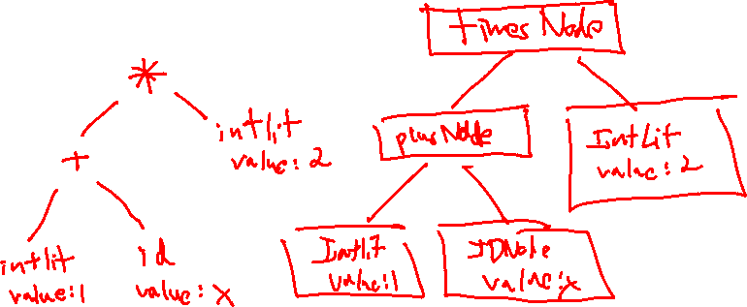
Check-In #7
Warm-up
Show the AST for the expression
(1 + x) * 2

Slide 3
Agenda
Wednesday
Check-in
Announcements
Written Work #2
Open Discussion / Questions
✓

Slide 4
Announcements
Wednesday
Quiz 1 is Friday, in class
Quiz 1 review is tonight at 5:00 at my Office hours link: https://kansas.zoom.us/j/6894602792
Grades for Written Work were placed incorrectly, now fixed (??)
Reminder: laptops/naps are for the back row
Reminder: “drop date” is Monday night

Slide 5
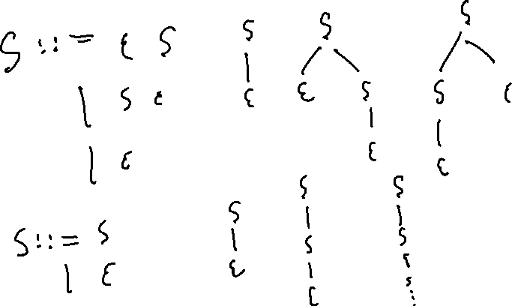
Question #1
Written Work #2
Create a Context Free Grammar that only accepts the empty string, but is still ambiguous

Slide 6
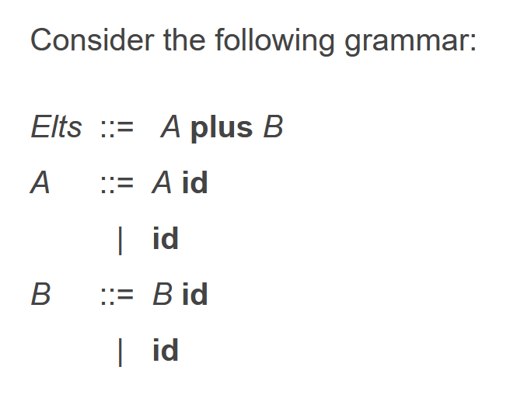
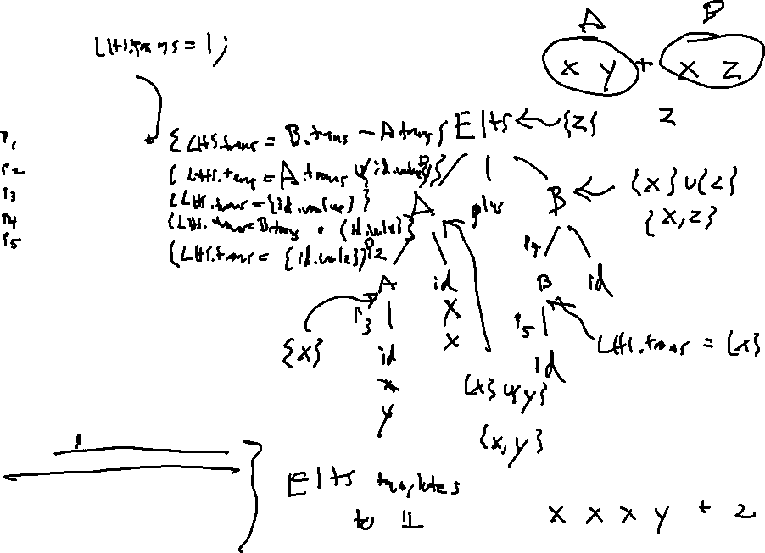
Question #2
Written Work #2
Assume that a tokenizer has already imbued each id with a value field that contains the name of the identifier. Write an SDD that sets the Elt translation to be set of identifier names mentioned under a B nonterminal, but never mentioned under an A nonterminal.

Slide 7
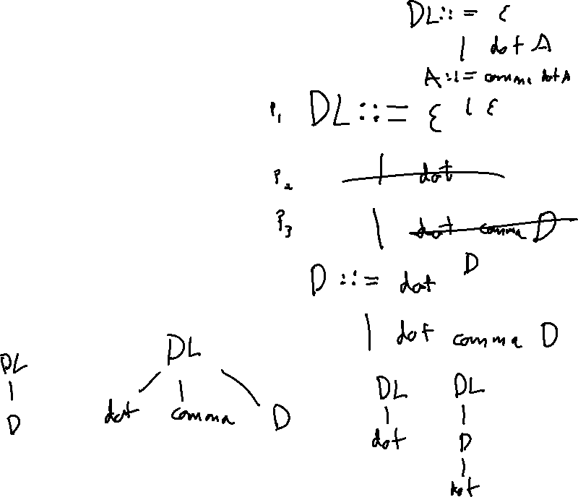
Question #3
Written Work #2
Let DotList be a language such that:
The empty string is in the language
The single terminal dot is in the language
Sequences of more than 1 dot terminal separated by the comma terminal are in the language. e.g.:
  dot comma dot
  dot comma dot comma dot
No other strings are in the language
Write an unambiguous grammar that recognizes DotList

Slide 8
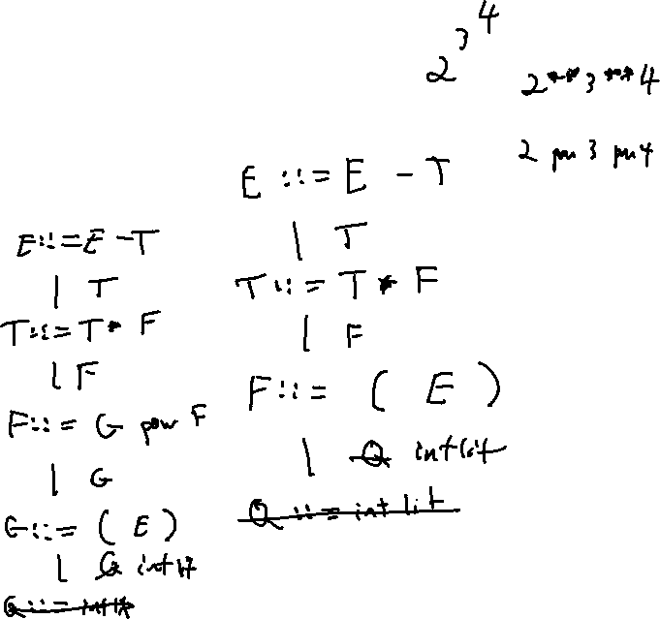
Question #4
Written Work #2
Alter the expression grammar to recognize expressions with explicit parentheses, e.g. allows the expression 1 - (2 - 3)
E ::= E - T
| T
T ::= T * F
| F
F ::= intlit

