Slide 1
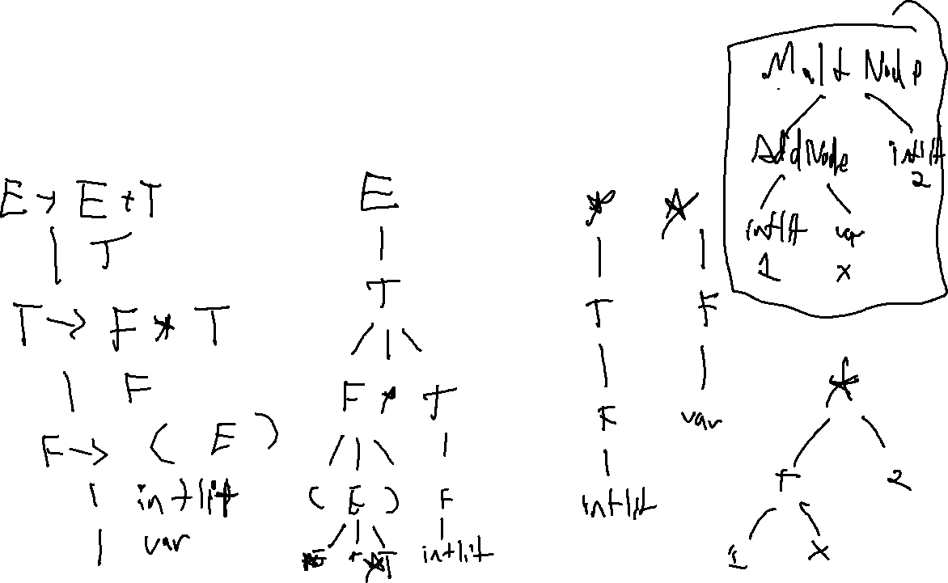
Checkin 7
Show the AST for (1 + x) * 2

Slide 2
Administrivia
P1 due “tonight”
P2 out Friday

Slide 3
Administrivia
Optional lab posted

Slide 4
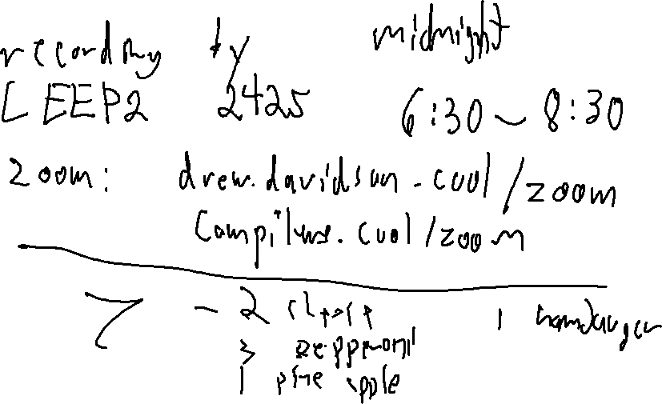
Administrivia
The Quiz!

Slide 5

Flipped Wednesday

Slide 6
Written Work #2
Topics:
Frontend stuff

Slide 7
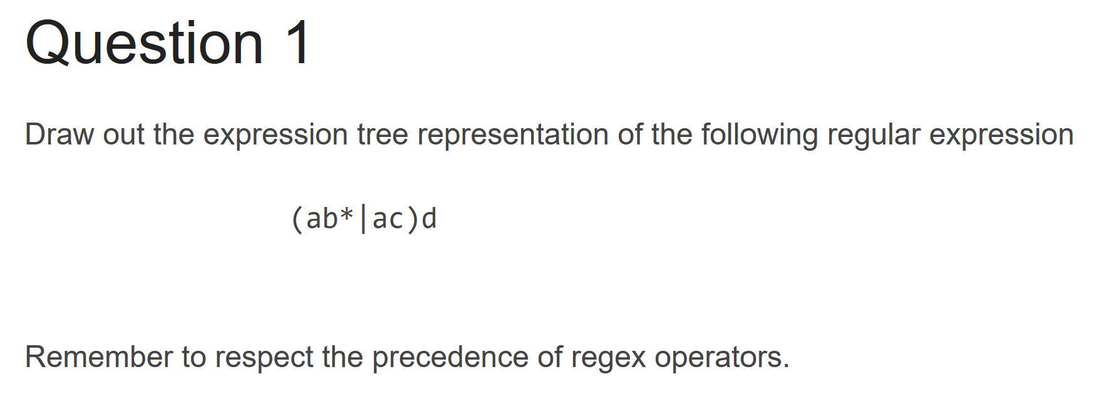
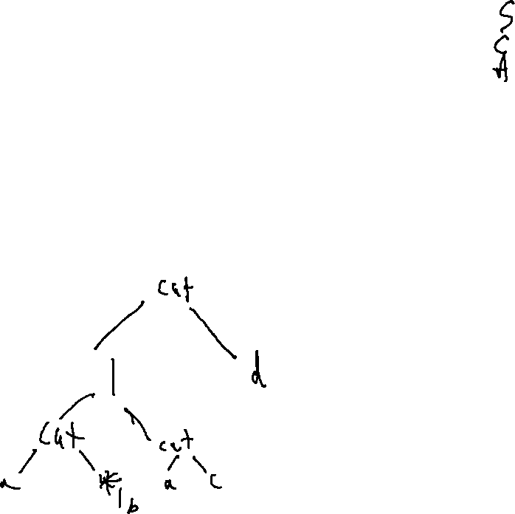

Slide 8
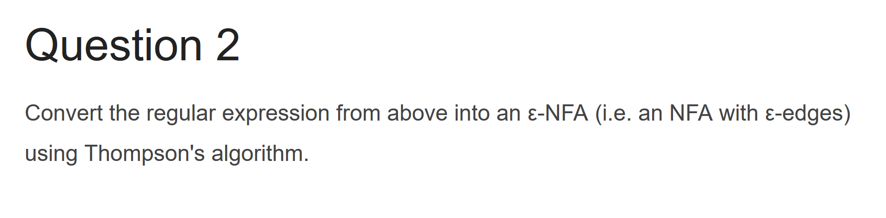
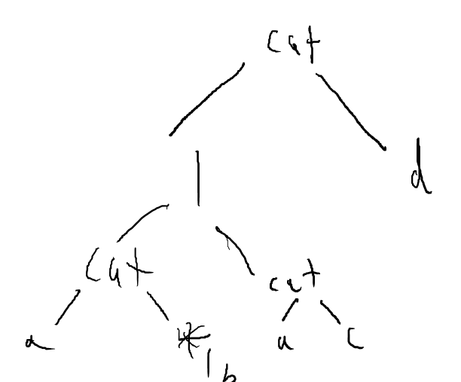
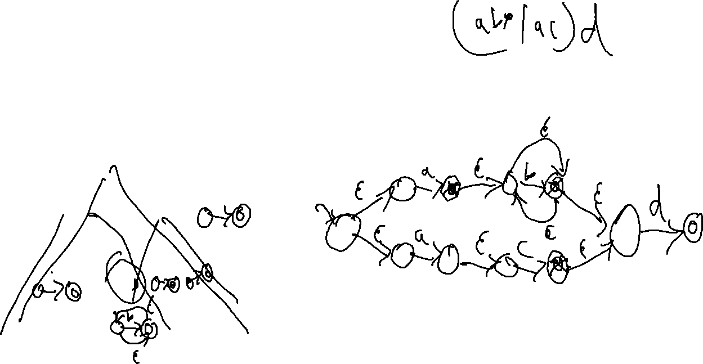

Slide 9
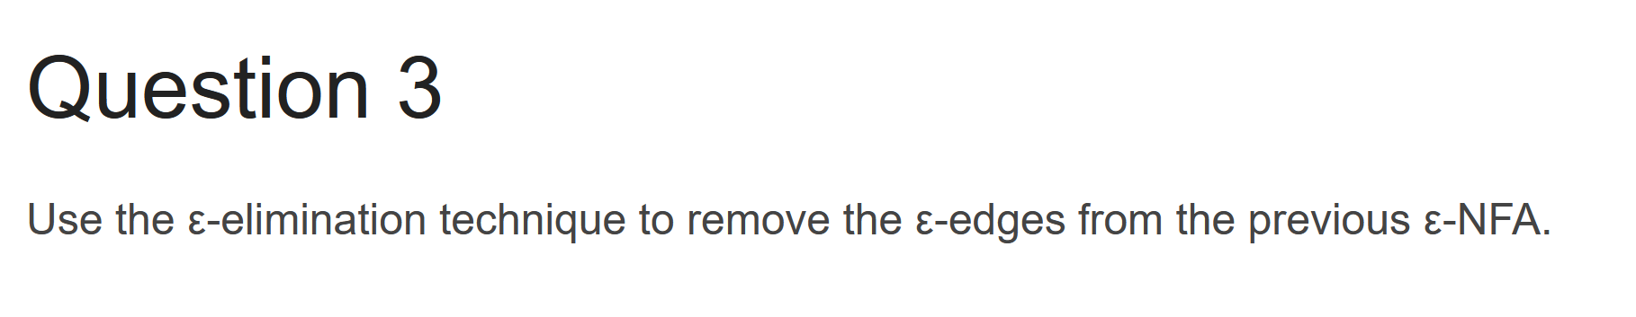
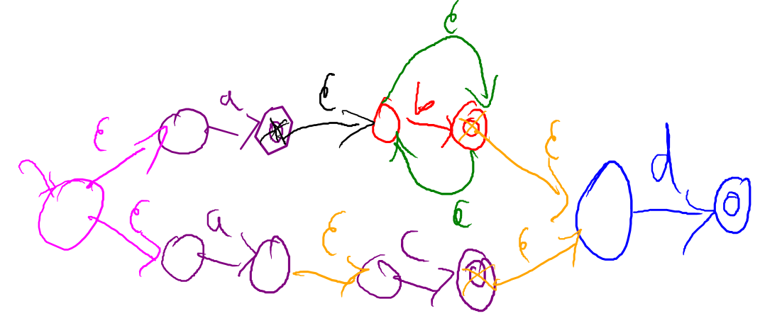
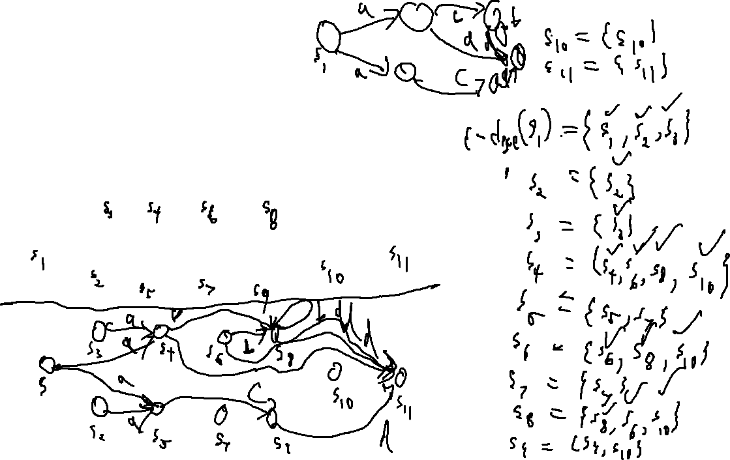
(ab*|ac)d

Slide 10
(ab*|ac)d
b
s₃
b
s₈
d
a
s₁
s₁₁
d
s₁₁
a
s₅
s₉
d
c

Slide 11
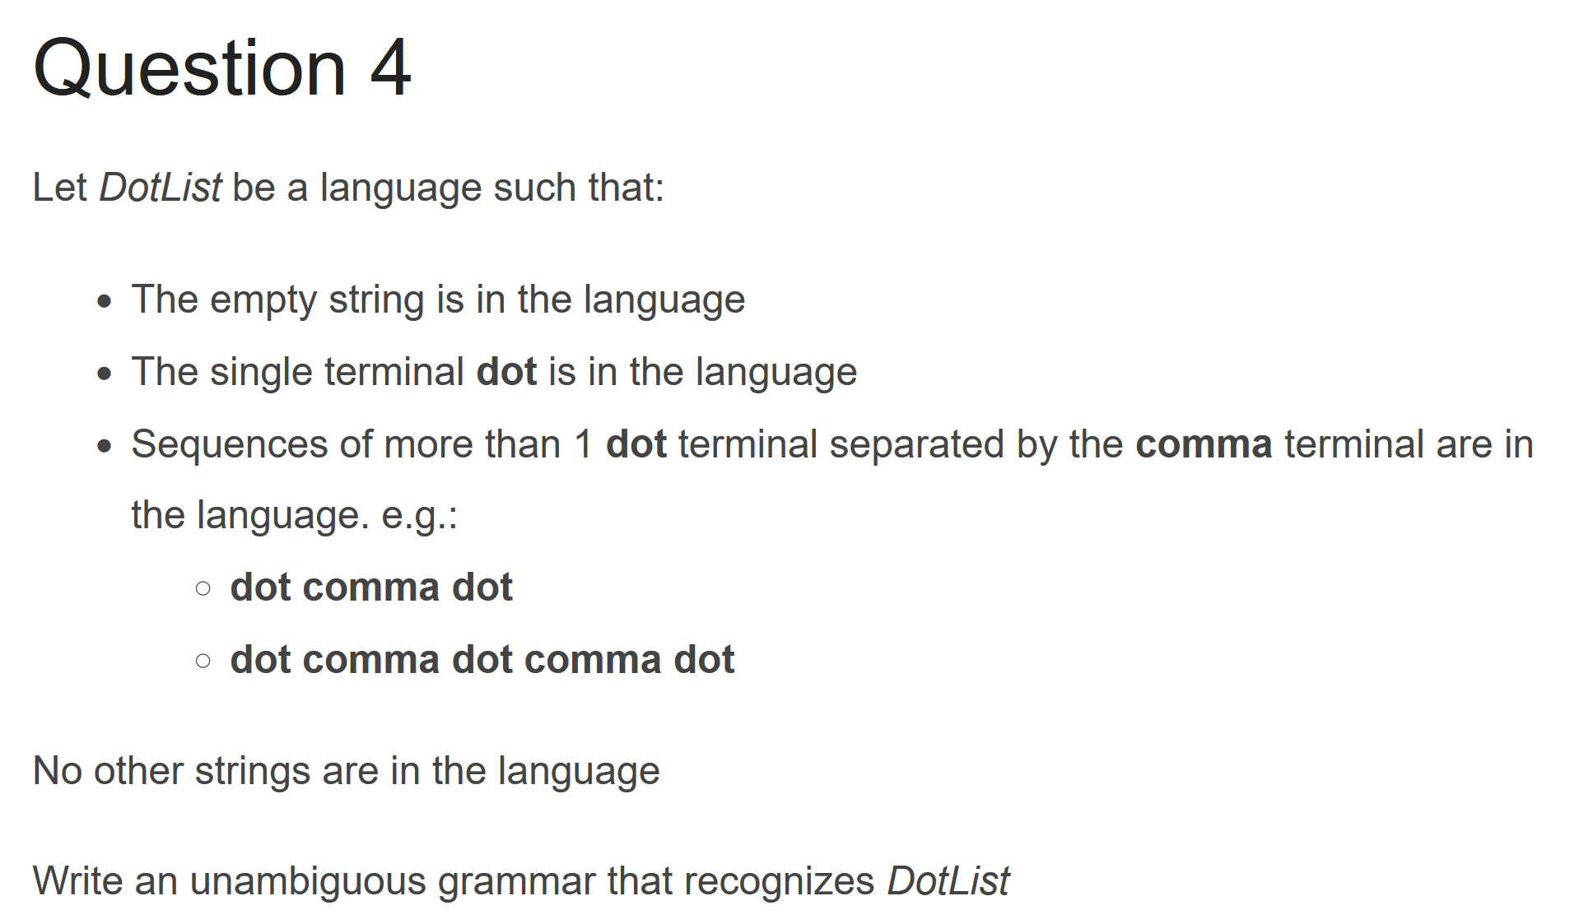
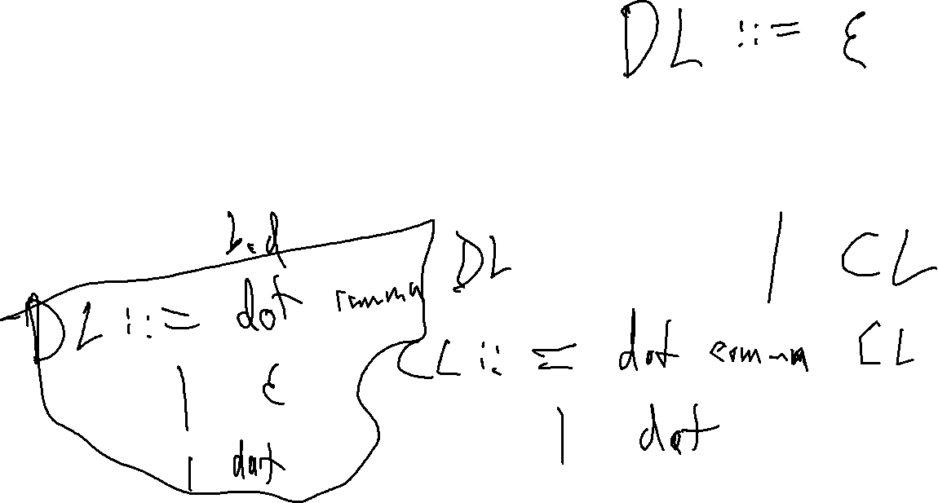

Slide 12
Written Work #1: Question 2
What is the purpose of the syntactic analysis component of a compiler? Give an example of an input that GCC would flag for a syntactic error.

Slide 13
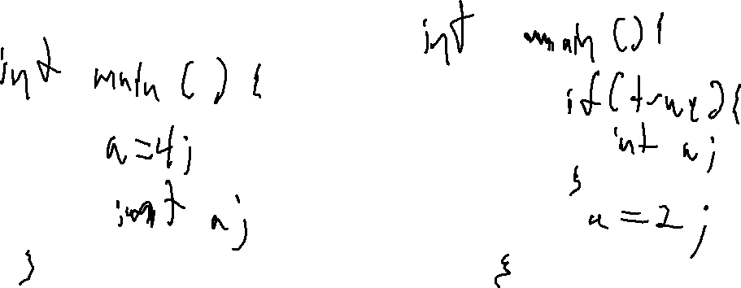
Written Work #1: Question 3
What is the purpose of name analysis in a compiler? Give an example of an input that GCC would flag for failing name analysis.

Slide 14
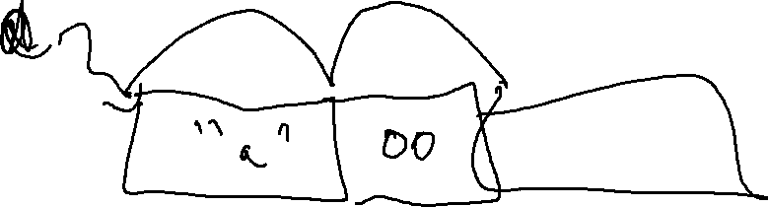
Written Work #1: Question 4
What is the purpose of type analysis in a compiler? Give an example of an input that GCC would flag for failing type analysis.

Slide 15
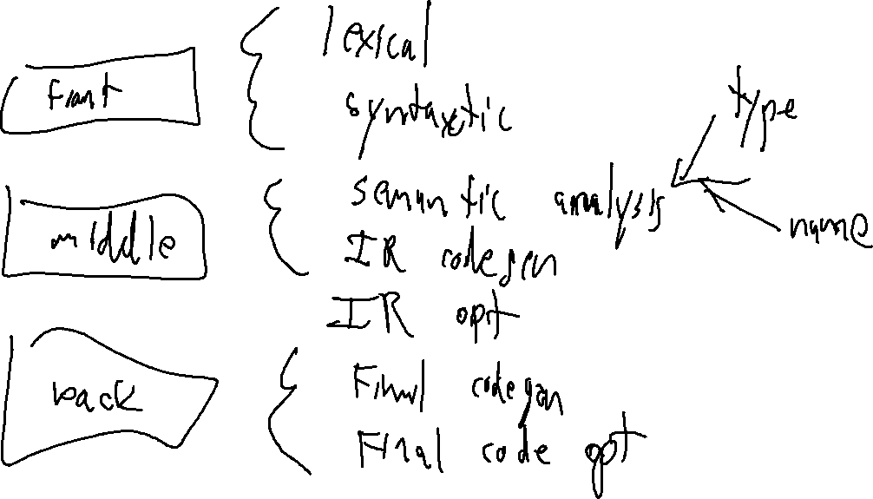

Slide 16
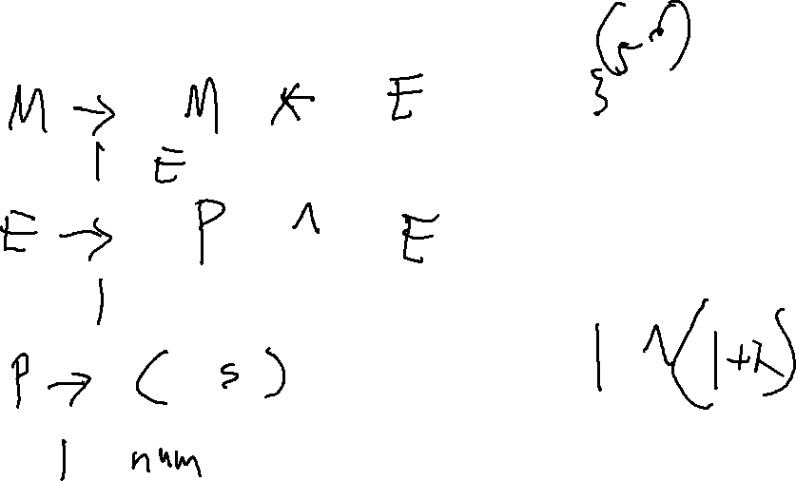
Create the full PEMDAS grammar

