Slide 1
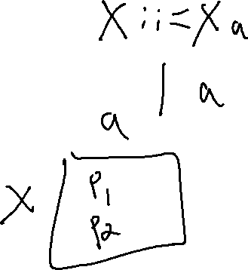
Checkin 13
Explain why an LL(1) parser has trouble with immediate left recursion but an SLR does not

Slide 2
Checkin 13
Explain why an LL(1) parser has trouble with immediate left recursion but an SLR does not

Slide 3

Scope
University of Kansas | Drew Davidson

Slide 4
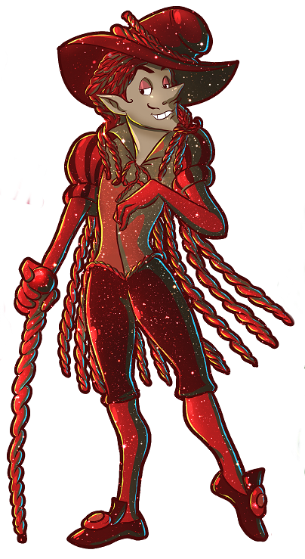
Last Time
Lecture Review - LR Parsing
LR Parser Construction
LR Parsers
Building SLR Parser tables
You Should Know
How to build an SLR Parser
  Item Closure Set
  Item Set GoTo
Creating an SLR Parser Table
  Action Table
  Goto Table
  Accept / Reject
Parsing

Slide 5
Building FSM
LR Parser Construction
I₀
P
I₁
S’ → ● P
P → ● ( L )
S’ → P ●
Grammar G
❶ S’ ::= P
❷ P ::= ( L )
❸ L ::= id
❹ L ::= L id
I₅
(
P → ( L ) ●
I₂
)
P → (● L )
L → ● id
L → ● L id
L
I₃
P → ( L ● )
L → L ● id
id
id
I₄
I₆
L → id ●
L → L Id ●

Slide 6
Convert FSM to Table
LR Parser Construction
Action Table
GoTo Table
 | ( | ) | id | eof
I₀
I₁
I₂
I₃
I₄
I₅
I₆
P | L
I₀
P
I₁
S’ → ● P
P → ● ( L )
S’ → P ●
S I₂
I₁
Grammar G
❶ S’ ::= P
❷ P ::= ( L )
❸ L ::= id
❹ L ::= L id
I₅
☺
(
P → ( L ) ●
S I ₄
I₃
I₂
)
P → (● L )
L → ● id
L → ● L id
L
I₃
S I₅
S I₆
P → ( L ● )
L → L ● id
R❸
R❸
id
id
R❷
I₄
I₆
R❹
R❹
L → id ●
L → L Id ●

Slide 7

Outline
Today’s Lecture - Scope
Finish up Parsers
Running the SLR Parser
LL(1) and SLR Language limits
Semantics
Program meaning
Scope
Name analysis
Parsing

Slide 8
Running the SLR Parser
LR Parser Construction
Grammar G
❶ S’ ::= P
❷ P ::= ( L )
❸ L ::= id
❹ L ::= L id
Input String
( id ) eof
Action Table
GoTo Table
 | ( | ) | id | eof
I₀
I₁
I₂
I₃
I₄
I₅
I₆
P | L
S I₂
I₁
☺
S I ₄
I₃
S I₅
S I₆
R❸
R❸
R❷
R❹
R❹
R❸ to L
I₄
I₃
I₂
I₂
I₂
I₂
I₀
T₁
(
I₀
T₂
I₀
T₃
)
I₀
T₃
I₀
T₃
id
)
)
Item Stack
Next Token
Item Stack
Next Token
Item Stack
Next Token
Item Stack
Next Token
Item Stack
Next Token

Slide 9
Running the SLR Parser
LR Parser Construction
Grammar G
❶ S’ ::= P
❷ P ::= ( L )
❸ L ::= id
❹ L ::= L id
Input String
( id ) eof
Action Table
GoTo Table
 | ( | ) | id | eof
I₀
I₁
I₂
I₃
I₄
I₅
I₆
P | L
S I₂
I₁
☺
S I ₄
I₃
S I₅
S I₆
R❸
R❸
R❷
R❹
R❹
I₅
R❷ to P
I₃
I₃
I₂
I₂
I₁
I₀
T₃
I₀
T₄
eof
I₀
T₄
eof
I₀
T₄
eof
)
Item Stack
Next Token
Item Stack
Next Token
Item Stack
Next Token
Item Stack
Next Token

Slide 10
Running the SLR Parser
LR Parser Construction
Grammar G
❶ S’ ::= P
❷ P ::= ( L )
❸ L ::= id
❹ L ::= L id
Input String
( id ) eof
L
(
(
id
(
id
R❸ to L
I₄
I₃
I₂
I₂
I₂
I₂
I₀
T₁
(
I₀
T₂
I₀
T₃
)
I₀
T₃
I₀
T₃
id
)
)
Items
Next T
Items
Next T
Items
Next T
Items
Next T
Items
Next T
P
L
L
(
id
)
(
id
)
I₅
I₃
I₂
I₁
I₀
T₄
eof
I₀
T₄
I₀
T₄
eof
eof
Items
Next T
Items
Next T
Items
Next T

Slide 11
Outline
Today’s Lecture - Scope
Finish up Parsers
Running the SLR Parser
LL(1) and SLR Language limits
Semantics
Program meaning
Scope
Name analysis
Parsing

Slide 12

When Does the Parser Fail?
LL(1) and SLR Language Limits
For both the LL and LR parsers, two types of failure:
Running the parser fails: The input isn’t in the language
Building the parser fails: The language is too expressive

Slide 13
When Running The Parser Fails
LL(1) and SLR Language Limits
The input string is rejected
Happens whenever either parser table indexes an empty cell
Happens whenever either parser gets to the end of input without the accept condition
This is the parser working as intended
Just means the user is at fault with bad input

Slide 14
When Does the Parser Fail?
LL(1) and SLR Language Limits
How building the parser fails
Happens whenever two entries are in a cell
For LR parsers, multiple types of collision:
  Shift/Reduce: a reduce and a shift action in the same cell
  Reduce/Reduce: reduce by two different productions
This is a problem!
Means the language isn’t captured by the formalize (e.g. it’s not LL(1), not SLR, whatever)

Slide 15
Bottom-Up SDT
LL(1) and SLR Language Limits
Fairly intuitive
Add a translation type to each item
Like LL(1) parser, items are popped right-to left
Terminals translations
Read lexeme value during a shift
Nonterminal translations
Read translations of popped RHS symbols

Slide 16

Bottom-Up SDT
LL(1) and SLR Language Limits
❹
W ::= X + Z { $$ = AddNode($1 + $3); }
Z
(Z.trans)
IDNode
Reduce by
❹
+
(Y.trans)
N/A
X
W
(Z.trans)
IDNode
(X.trans)
IDNode
Item Stack
Semantic Stack
Item Stack
Semantic Stack

Slide 17
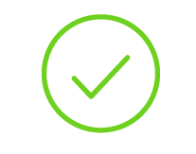
That’s all for parsers!
Frontend Finished
ABET Course Outcomes
Understanding the role and structure of compilers, and its various phases
Constructing an unambiguous grammar for a programming language
Generating a lexer and parser using automatic tools
Constructing machines to recognize regular expressions (NFA, DFA) and grammars (LL and LR parsers)
Generating intermediate form from source code
Type checking and static analysis
Assembly/binary code generation
Source code (sequence of chars)
Scanner
Lexical analysis
Frontend
Parser
Syntactic analysis
Semantic analysis
Intermediate code generation
IR optimization
Final Code generation
Final code optimization
Output code in T

Slide 18
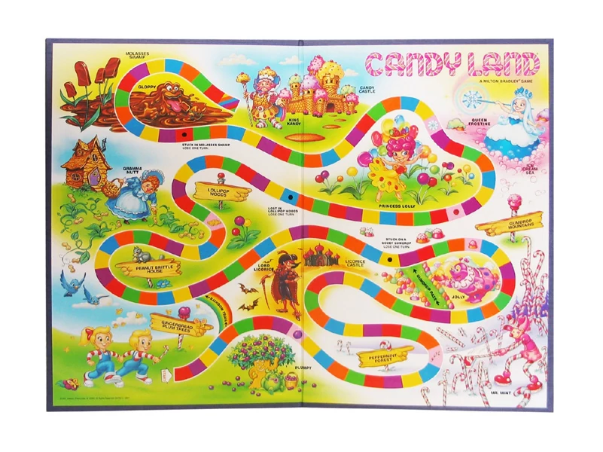
COMPILER
Code Generation
Execution
Runtime Environment
Intermediate
Representation
Optimization
SDD
Parsing
Semantics
Lexical Analysis
Syntactic
Definiton

Slide 19

Outline
Today’s Lecture - Scope
Finish up Parsers
Running the SLR Parser
LL(1) and SLR Language limits
Semantics
Program meaning
Scope
Name analysis
Parsing
Semantics

Slide 20

Compilers: A Delicious Medley of CS
Today’s Lecture - Scope
Learning compilers is kinda like a tasting menu of other CS domains
Front end – Automata theory / discrete structures
Middle end – Software Engineering / PL
Back end – Architecture / Assembly code
frontend
backend
middle end

Slide 21

Language Design
Today’s Lecture - Scope
Things are about to get a lot more code-y
Maybe also a bit more cerebral
Making a compiler empowers you to make a language!
  How should a language be built?

Slide 22

Syntax vs Semantics
Semantic Analysis
Program Syntax
Does the program have a valid structure?
Program Semantics
Does the program have a valid meaning?

Slide 23
Goals
Semantic Analysis
Error Checking
Is the program’s meaning sensible?
Program “Understanding”
To what does an identifier refer?
To what operator does a program refer?
Example Program Snippet
a + b
Is this addition?
String concatenation?
User-defined operation?

Slide 24

Respecting Program Semantics
Semantic Analysis
Compiler must facilitate language semantics
Prerequisite: Infer the intended program behavior w.r.t. semantics
Approach: Take multiple passes over the completed AST
One example: scope

Slide 25

Scope
Semantic Analysis
A central issue in name analysis is to determine the lifetime of a variable, function, etc.
Scope definition: the block of code in which a name is visible/valid

Slide 26
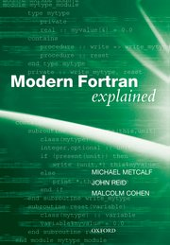
Scope: A Language Feature
Semantic Analysis
Some languages have NO notion of scope
  Assembly / FORTRAN
Most familiar: static / most deeply nested
  C / C++ / Java
  There are several decisions to make, we’ll overview a couple of them

Slide 27
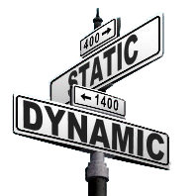
Scope Style
Scope Decisions
Based on
nesting
Static Scope
– Check syntactic blocks
(bind at compile time)
Dynamic Scope
– Check calling context
(bind at runtime)
Based on
execution
stack

Slide 28
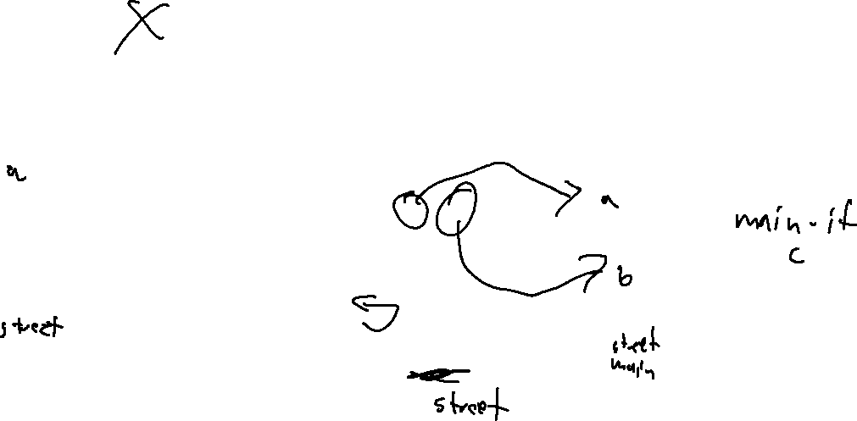
Scope Style
Scope Decisions
Based on
nesting
Based on
execution stack
Static Scope
– Check syntactic blocks
(bind at compile time)
Dynamic Scope
– Check calling context
(bind at runtime)
street
1. int street (){
2. int a = 1;
3. return a + b;
4. }
5. int main(){
6. int b = 2;
7. if (b){
8. int c = 3;
9. return hip();
10. }
11. }
street
main
main
global
global

Slide 29

Other Scope-Related Choices
Scope Decisions
Many other decisions beyond scope type
We’ll go through some of these together

Slide 30
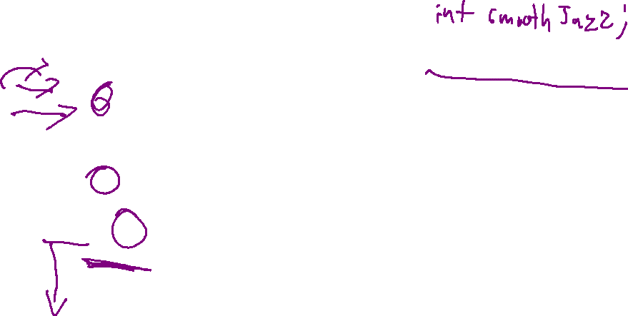
Variable Shadowing
Scope Decisions
Do we allow names to be re-used?
void func(){
int a;
int a;
}
void smoothJazz (int a){
int smoothJazz;
}
Allowed in Rust!
Disallowed in C
void funk(){
int a;
if (a){
int a;
if (a){
int a;
}
}
}
Allowed in C

Slide 31
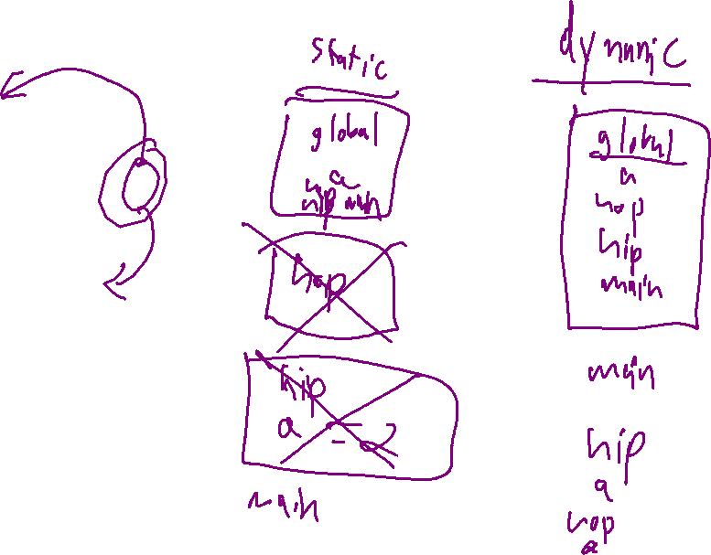
Scope Kind & Shadowing
Scope Decisions
int a = 1;
int hop(){
return a;
}
int hip(){
int a = 2;
return hop();
}
int main(){
return hip();
}

Slide 32

Forward Reference
Scope Decisions
Do we allow use before name is (lexically) defined?
If not, compiler may require 2 passes over the program
  1 to fill symbol table
  1 pass to use symbols
void country() {
western();
}
void western() {
country();
}

Slide 33
Overloading
Scope Decisions
Do we allow same names, same scope, different types?
int techno(int a){ … }
bool techno(int a){ … }
bool techno(bool a){ … }
bool techno(bool a, bool b){ }

Slide 34

Our Scope Decisions
Scope Decisions
What scoping rules will we employ?
What info does the compiler need?

Slide 35
Our Language: Scope Scheme
Scope Decisions
Static scoping scheme
  Programs use their lexical nesting to determine their scope

Slide 36
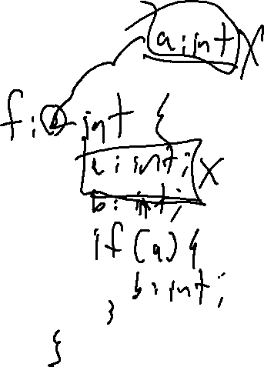
Our Language: Shadowing
Scope Decisions
Shadowing
C-like rules:
Shadowing between scopes is allowed
Shadowing within a scope is disallowed

Slide 37

The Sink statement
Scope Decisions
Remove a name from current and enclosed scopes
house : () void {
a : int;
a = 1;
… a;
a = 2;
}
industial : () void {
a : int;
a = 1;
… a;
a : int;
}

Slide 38
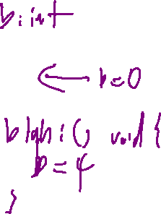
The Sink statement
Scope Decisions
Remove an in-scope name from current and enclosed scopes
house : () void {
a : int;
a = 1;
… a;
a = 2;
}
industial : () void {
a : int;
a = 1;
… a;
a : int;
}
edm : () void {
a : int;
a = 1;
… a;
if (true){
a = 2;
}
}
trap : () void {
… b;
}
disco : () void {
b : int;
if (true) {
… b;
}
b = 3;
}

Slide 39
Our Language: Others
Scope Decisions
Overloading
Nah
Forward Declaration
Nah

