Slide 1
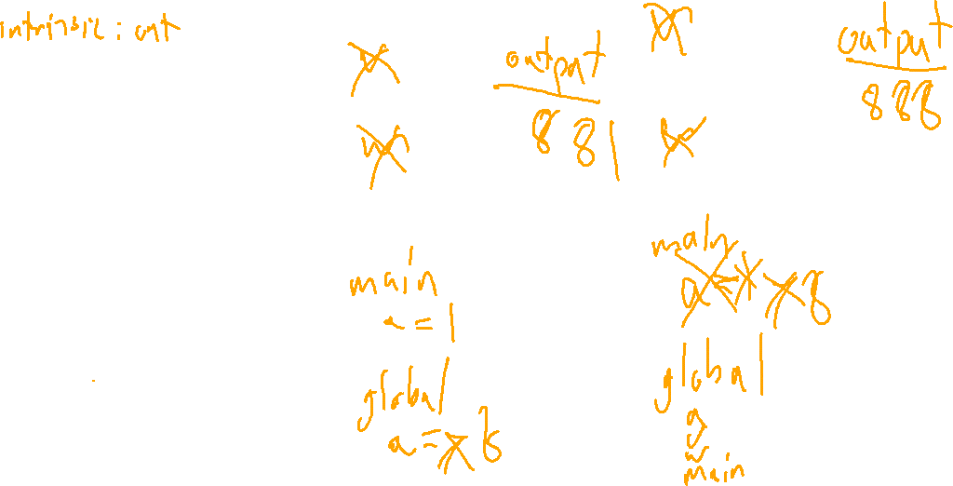
Check-In
Scope Review
Levi
Consider the following program in
Is this program well-named in a static scoping scheme? In a dynamic scoping scheme? What is the output for each scheme in which it compiles?
a : int;
v : () void {
a = a + 1;
out << a;
}
w : () void {
a = 7;
v();
out << a;
}
main : () void {
a : int = 1;
w();
out << a;
}

Slide 2

Semantic Analysis
University of Kansas | Drew Davidson

Slide 3
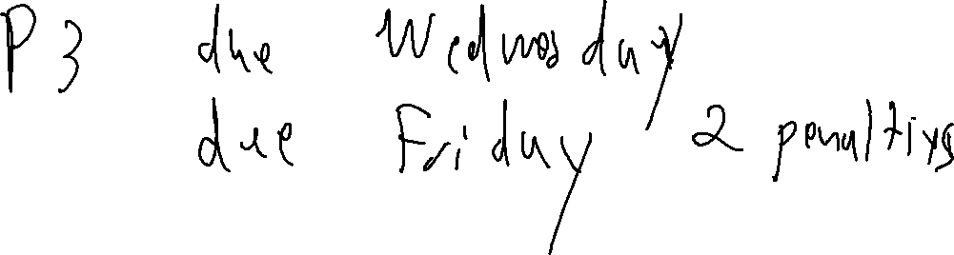
Housekeeping
Administrivia + Announcements

Slide 4

Last Lecture
Lecture Review – Scope
Issues of Scope
Scheme
Shadowing
Overloading
You Should Know
Scope properties
How scope affects semantics
High-level scope rules for our language
Semantics

Slide 5
Lecture Outline
Lecture Overview – Semantic Analysis
Name Analysis
Enforcing scope
Symbol Table
What it is
What it does
Semantics

Slide 6
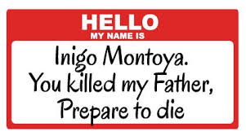
Name Analysis
Semantic Analysis
Idea:
Associates IDs with their uses in the program
  i.e. Emplace symbol table entries
Implemented as an AST pass
Purpose:
Needed for code generation
Catch some obvious errors
  (undeclared IDs)

Slide 7

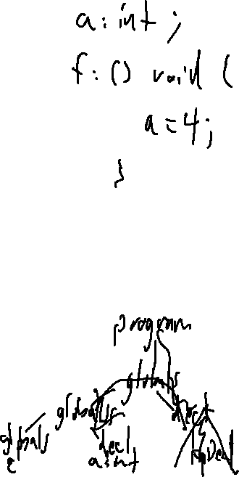
Recognizing Identifier Context
Semantic Analysis
A node needs information from outside of its subtree
The definition of a identifiers needs to be connected to its occurrences
We need a data structure to propagate such context
A Context-Free Grammar is… context free
There’s lots of ways to do this!
We’ll just cover 1 way

Slide 8
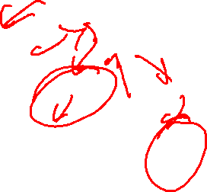
The Compiler’s Symbol Table
Semantic Analysis
Repository of semantic symbol information
Populated during a walk of the AST
Propagates context-sensitive information
Program Snippet
if(true){
int a;
a = 1;
}
AST Snippet
IfStmt
true
[stmts]
Symbol
Table
add info
VarDecl
AssignStmt
int
ID
a
ID
a
IntLit
1
lookup
info

Slide 9
The Compiler’s Symbol Table
Semantic Analysis
What’s in the symbol table:
Depends on the language
Kinds of entries we need:
Variable Declarations
Function Declarations
Program Snippet
if(true){
int a;
a = 1;
}
AST Snippet
IfStmt
true
[stmts]
Symbol
Table
add info
VarDecl
AssignStmt
int
ID
a
ID
a
IntLit
1
lookup
info

Slide 10

The Compiler’s Symbol Table
Semantic Analysis
What’s in the symbol table:
Depends on the language
Kinds of entries we need:
Variable Declarations
Function Declarations
Sink declaration
Program Snippet
if(true){
int a;
a = 1;
}
AST Snippet
IfStmt
true
[stmts]
add info
VarDecl
AssignStmt
$$\left(\begin{aligned}Current \\ Scope\end{aligned}\right)$$
kind: var
type: int
int
ID
a
ID
a
IntLit
1
a |
lookup
info

Slide 11
Symbol Table: A “Snapshot” of Scope
Types – Name Analysis
At any (static) program point
Symbol table shows what’s in scope
Symbol table shows which scope contains the entry
Implementation:
A list of hashmaps (1 map per scope)
Symbol table after line 4
Global Scope
kind: var
type: int
a |
v |
kind: fn
type: ()->void
v body Scope
1. int a;
2. void v(){
3. if (a){
int b;
}
}
if stmt Scope
b |
kind: var
type: int
Here

Slide 12

Symbol Table: Scopes “Sub-tables”
Semantic Analysis - Name Analysis
Create one hashmap per scope
Symbol table after line 1
Symbol table after line 4
Global Scope
Code
Global Scope
1. int a;
2. void f(){
3. int a;
4. int b;
5. }
kind: var
type: int
kind: var
type: int
a |
a |
f |
kind: fn
type: ()->void
Symbol table after line 5
Global Scope
F Body Scope
kind: var
type: int
kind: var
type: int
a |
a |
b |
kind: var
type: int
f |
kind: fn
type: () -> void

Slide 13
Implementation
Semantic Analysis - Name Analysis
Walk the AST, much like the unparse() method
  Augment AST nodes with a link to the relevant name in the symbol table
  Build new entries into the symbol table when a declaration is encountered
  Connect AST nodes to the entry they add or reference in the symbol table

Slide 14
Example
Name Analysis
int b;
int f(int r){
int a;
if (true){
int b;
}
b = 1;
}
Program
[ ]
VarDecl
FnDecl
int
ID
b
int
ID
f
[ ]
[ ]
FormalDecl
Int
ID
r
IfStmt
VarDecl
AssignStmt
globals
b |
int
ID
a
true
[ ]
f |
name: f
kind: fn
type: (int) -> int
VarDecl
AssignExp
f body
name: b
kind: var
type: int
int
ID
b
r |
name: r
kind: var
type: int
ID
b
IntLit
1
a |
name: a
kind: var
type: int
mySymbol
if stmt
name: b
kind: var
type: int
b |
14

Slide 15
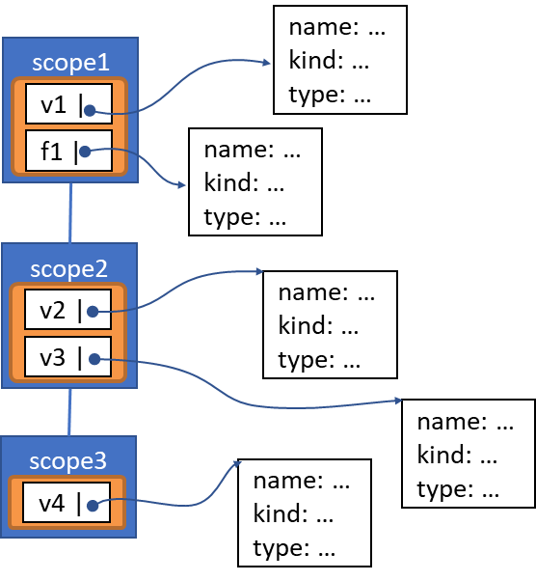
(My) Terminology
Name Analysis - Implementation
Symbol Table – the whole structure
Scope Table – A single map
Symbol Table Entry (AKA “Semantic Symbol”)
name: …
kind: …
type: …
scope1
v1 |
f1 |
name: …
kind: …
type: …
scope2
v2 |
name: …
kind: …
type: …
v3 |
name: …
kind: …
type: …
scope3
name: …
kind: …
type: …
v4 |
name: …
kind: …
type: …
15

Slide 16
Implementation Suggestions
Name Analysis - Implementation
Two approaches
A nameAnalysis method for each ASTNode subclass
  Override as appropriate
The use of the visitor pattern
16

Slide 17
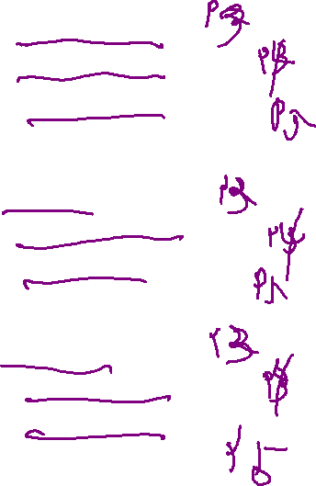
The Visitor Pattern
Name Analysis - Implementation
class ASTNode {
public void unparse(…) = 0;
public bool nameAnalysis(…) = 0;
public void typeAnalysis(…) = 0;
};
class PlusNode : public ExpNode {
public void unparse(…){ … }
public bool nameAnalysis(…){ … }
public void typeAnalysis(…){ … }
};
class FnDeclNode : public ASTNode {
public void unparse(…){ … }
public bool nameAnalysis(…){ … }
public void typeAnalysis(…){ … }
};
class ASTNode {
public void visit(Visitor * v){ … }
};
class PlusNode : public ASTNode {
public void visit(Visitor * v){ … }
};
class FnDeclNode : public ASTNode {
public void visit(Visitor * v){ … }
};
17

Slide 18

The Visitor Pattern
Name Analysis - Implementation
class PlusNode {
void visit(Visitor * v) {
myLHS->visit(v);
v->visitPlus(this);
myRHS->visit(v);
}
}
class PlusNode : public ExpNode {
public void unparse (…){
myLHS->unparse();
out << “+”;
myRHS->unparse();
}
};
class UnparseVisitor {
void visitPlus(PlusNode * n) {
out << “+”;
}
}
18

Slide 19
Example
Name Analysis - Implementation
int b;
int f(int r){
int a;
if (true){
int b;
}
b = 1;
}
Program
[ ]
VarDecl
FnDecl
int
ID
b
int
ID
f
[ ]
[ ]
FormalDecl
Int
ID
r
IfStmt
VarDecl
AssignStmt
globals
b |
int
ID
a
true
[ ]
f |
name: f
kind: fn
type: (int) -> int
VarDecl
AssignExp
f body
name: b
kind: var
type: int
int
ID
b
r |
name: r
kind: var
type: int
ID
b
IntLit
1
a |
name: a
kind: var
type: int
mySymbol
if stmt
name: b
kind: var
type: int
b |
19

Slide 20
The Symbol Class Hierarchy (Drew’s Version)
Name Analysis – Implementation
class Symbol
class FnSymbol
class VarSymbol
class SinkSymbol
20

Slide 21
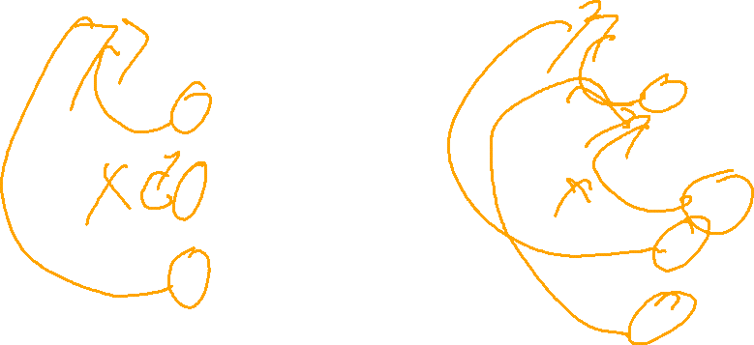
The Sink Statement
Name Analysis – Implementation
A sort-of-unique situation
a : int;
f () void {
a = 1;
a : int;
a = 2;
… a;
a = 3;
}
a : int;
f () void {
a = 1;
a : int;
if (true){
… a;
a = 2;
}
a = 3;
}
21

Slide 22
Accommodating Sink (Drew’s Version)
Name Analysis – Implementation
class Symbol {
SinkSymbol * sunkBy;
};
class FnSymbol
class VarSymbol
class SinkSymbol {
Symbol * sinks;
};
22

Slide 23
The Sink Statement: Suggestion
Name Analysis – Implementation
a : int;
f () void {
a = 1;
a : int;
if (true){
… a;
a = 2;
}
a = 3;
}
23

Slide 24
Summary
Name Analysis – Wrap-Up
Described an analysis for enforcing static scoping
Demonstrated a way to implement the analysis as a walk over the AST
24

Slide 25
Next Time
Name Analysis – Wrap-Up
Type Systems
What type systems are
Why we use them
The type system for our language
25

