Slide 1
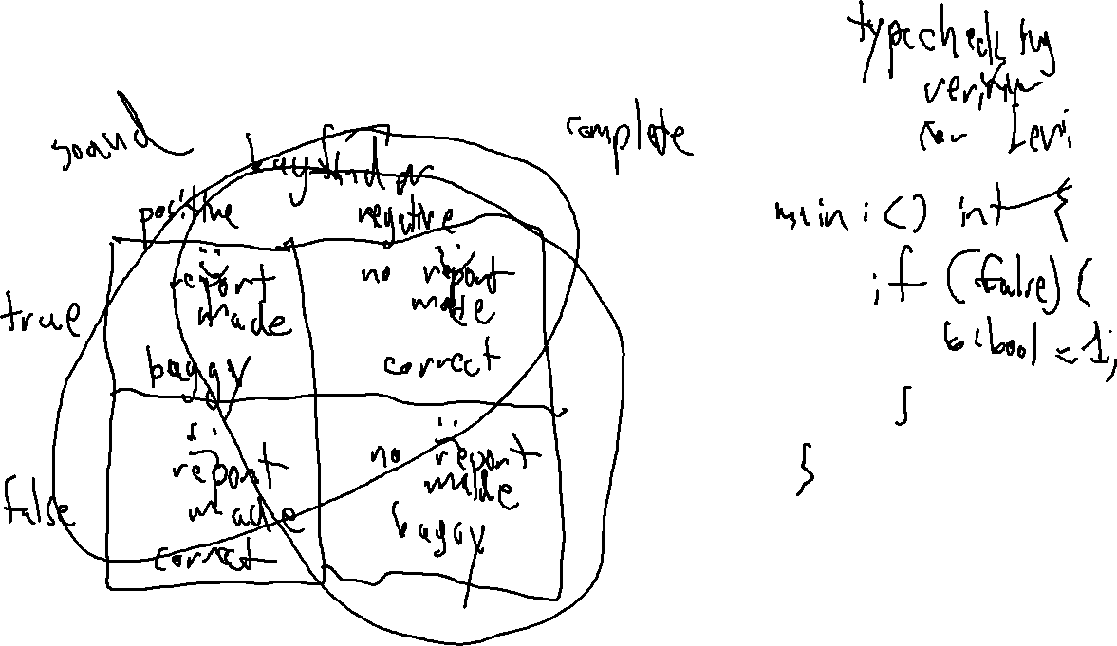
Checkin 18
Give an example of a program analysis method which is sound but not complete.

Slide 3
Administrivia

Slide 4

Flipped Wednesday

Slide 5
Written Work #5
Topics:
Saying farewell to parsers (LR)
Name Analysis
Type Analysis

Slide 6
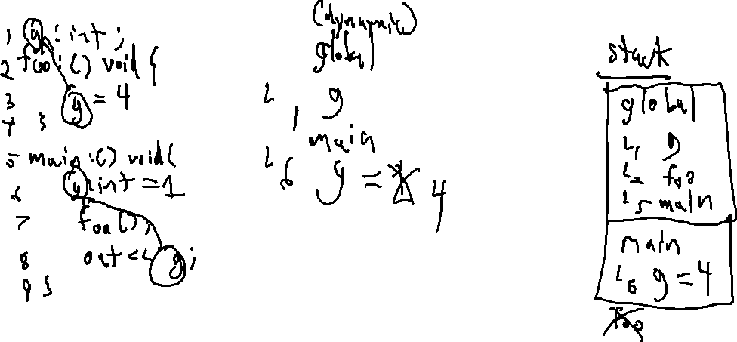
Written Work #5: Question 1
Recall that Levi is a statically-scoped language. Assume a new variant of Levi, called Levi', that uses the exact same syntax as Levi but is dynamically-scoped. Provide an input file that would be valid in both Levi and Levi', but prints a different result based on which scoping system is used. Show what the output would be either under scheme.

Slide 7
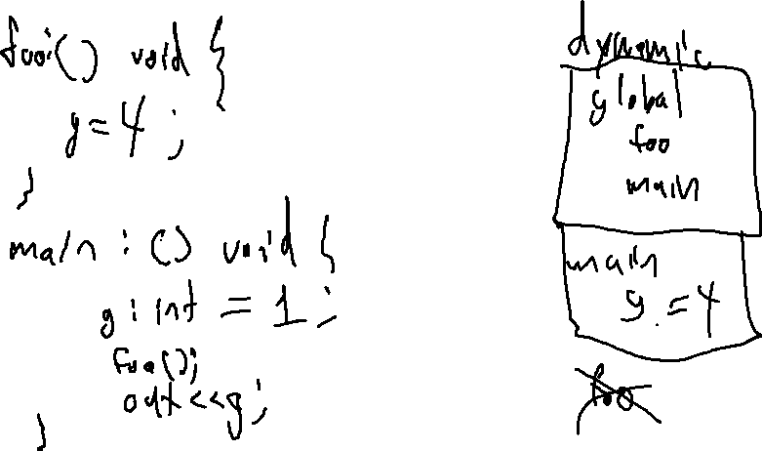
Written Work #5: Question 2
Provide an input file that would be valid in Levi', but not in Levi.

Slide 8
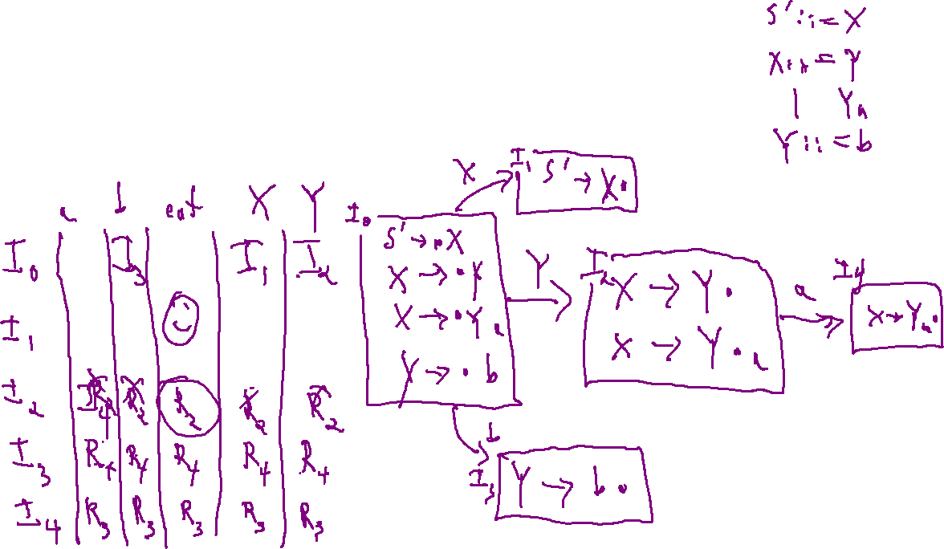
Written Work #5: Question 3
Explain the difference between an SLR and an LR(0) parser. Provide an example grammar that is SLR-parseable but not LR(0) parseable.

Slide 9
Written Work #5: Question 3
Explain the difference between an SLR and an LR(0) parser. Provide an example grammar that is SLR-parseable but not LR(0) parseable.
Always reduces
in a reduce state

Slide 10
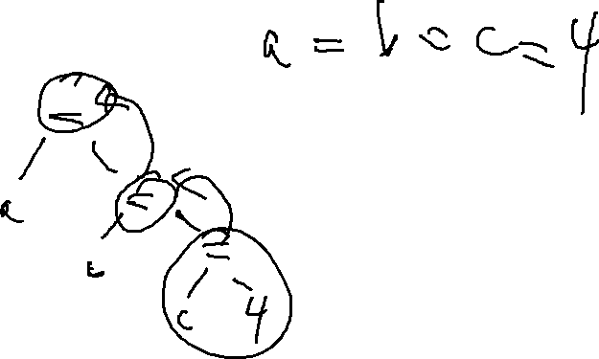
Written Work #5: Question 4 (bonus!)
Explain how a type analysis that propagates an error type reduces cascading error reports.
Give an example of a program where propagating an error type might reduce the number of reports
Give an example of a program where propagating the error type still results in multiple reports within the same expression

