Slide 1
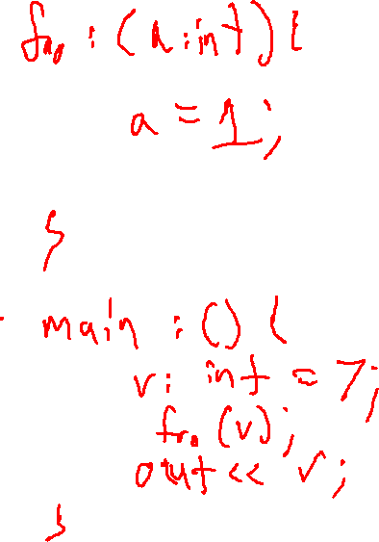
Check-In
Review - Parameters
Give an example of a program that would compile under both a pass-by-value and pass-by-reference scheme but gives different output under both.
Or
How does Rice’s Theorem generalize the result of the Halting Problem to show that any non-trivial semantic property of a program is undecidable?

Slide 2
Check-In 19 Solution
Review - Parameters

Slide 3
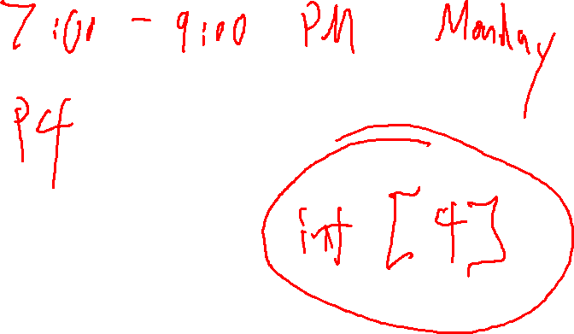
Announcements
Administrivia

Slide 4
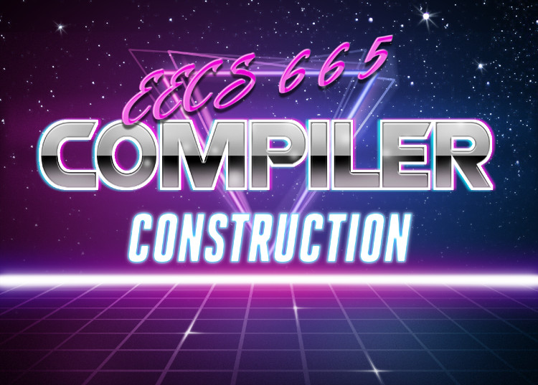
Runtimes
University of Kansas | Drew Davidson

Slide 5

Previous Lecture
Review - Parameters
You Should Know
What the vocab terms are, how they’d appear in error messages
The difference between formal arguments and actual arguments
The semantic effect of call-by-value and call-by-reference parameter passing schemes
Vocabulary:
lval/rval
Memory references
Arguments
Parameter Passing
Call by value
Call by reference
Call by value-result
Call by name
Semantics

Slide 6
Lecture Outline
Runtimes
Runtimes
Runtime Environments
The semantic gap (again)
Interpreters
Semantics

Slide 7
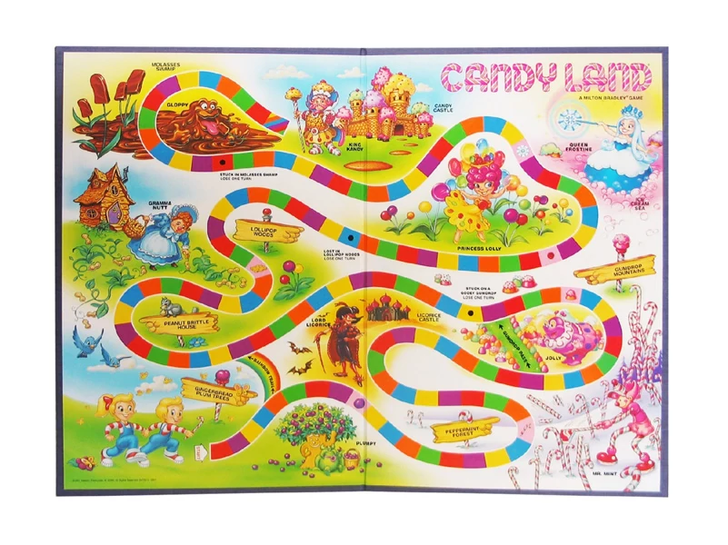
COMPILER
Optimization
Execution
Code Generation
Runtimes
Intermediate Representation
Syntactic
Definition
Parsing
Semantics
Regular
Languages
Lexical Analysis
7

Slide 8

Switching Gears: Targets
Runtime Environments – Setup
Time to look at how code is actually run
For this we’ll need to understand execution systems (runtimes)

Slide 9

Compilers: A Tasty Mix of Disciplines
Runtime Environments - Setup
Front-end:
Automata theory
Algorithms
Middle-end:
Software engineering
Program semantics
The compiler
Back-end:
Emulation
Architecture

Slide 10

Relation to Compilers
Overview
Compilers job (roughly):
turn something from a non-executable format into
that same thing in an executable format
Hard to pin down!

Slide 11
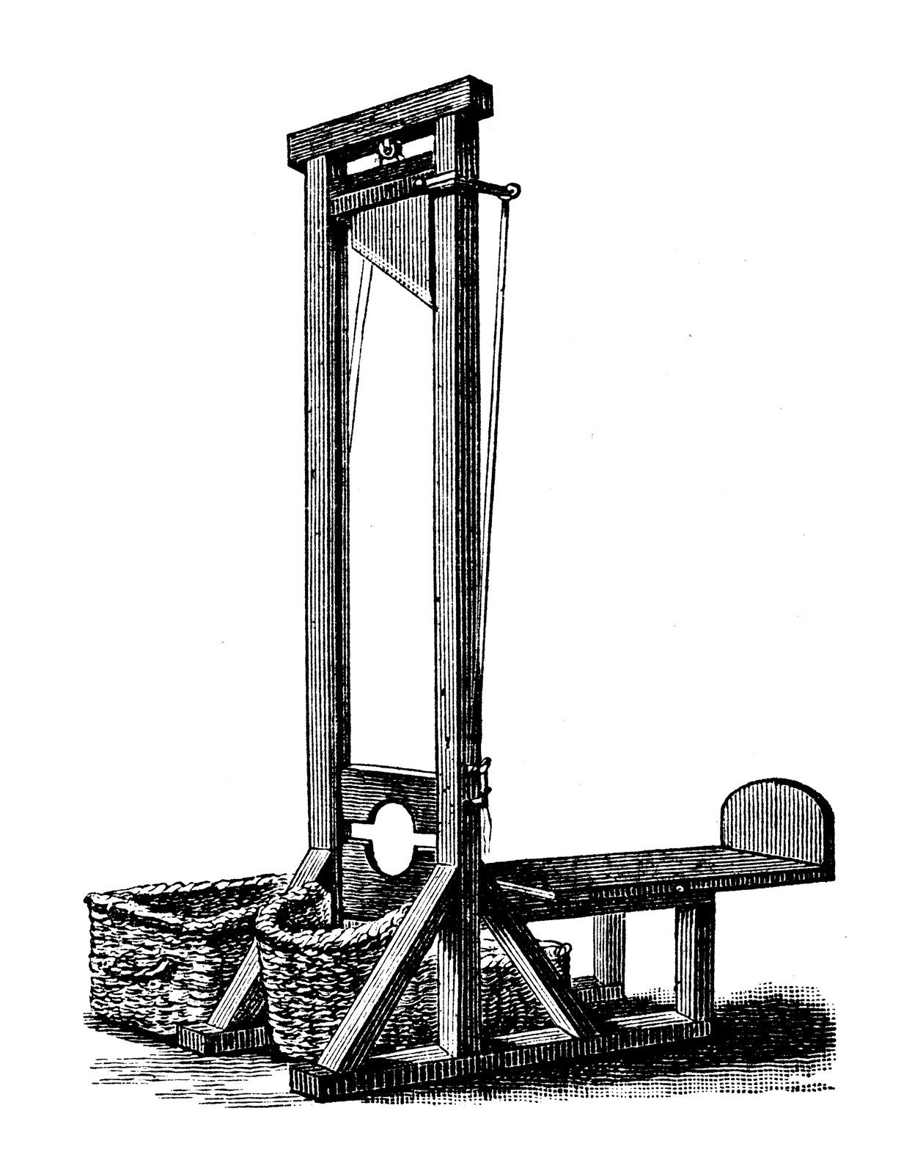
The Tools of Execution
Overview
Stepping back from compilers
What do we need for execute code?
Not this kind of execution!

Slide 12

Runtime Environment Working Defn.
Runtime Environments
Underlying software and hardware configuration assumed by the program
May include an OS (may not!)
May include a virtual machine
May be co-designed with the programming language
Get it? “Run time”

Slide 13
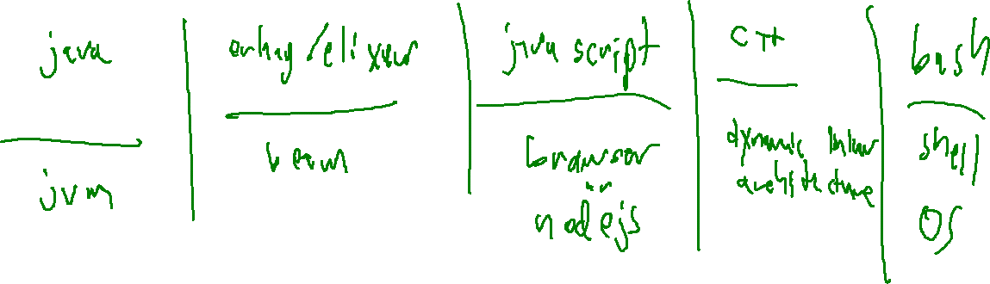
Some Example Runtime Environments
Runtime Environments
Audience Participation: What are some example languages / runtime environments they provide?

Slide 14

Wait, why DO we need a Compiler?
Runtime Environments
“Obvious” Answer
To implement a programming language
To avoid dealing with target language directly
But is compilation the only option?
Depends on your definition
A strawman

Slide 15

“Alternatives” to “Compilation”
Runtime Environments
Compiling
Interpreting
Scripting
Source code text
Source code text
Input
Source code text
Frontend
Frontend
Runtime
Env.
Frontend
SDT
SDT
SDT
Symbol Table
Symbol Table
IR code gen
result
IR code gen
Machine code gen
Input
bytecode
Specialized Platform
e.g. shell or browser
Input
Machine code
Specialized Platform
e.g. Interpreter or VM
Minimal Platform
e.g. OS or bare metal

Slide 16
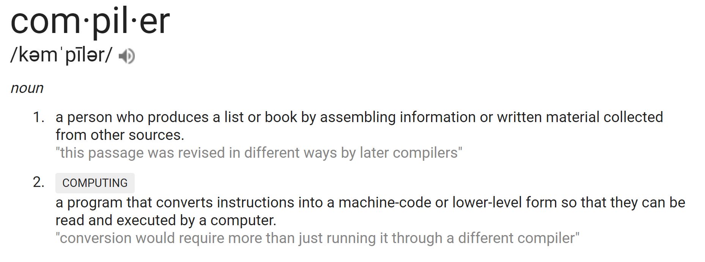
Defining Compilers
Introduce IRs
Oxford languages dictionary
Rely on
scripting,
skip compilation

Slide 17
Then Why Compile at All?!?!?!?
Introduce IRs
Commence Existential Crisis?
(y/n)
>

Slide 18
Then Why Compile at All?!?!?!?
Introduce IRs
Analysis
Error checking: predict bugs before they strike
Optimization: generate better code statically
Rely on
scripting,
skip compilation
Commence Existential Crisis?
(y/n)
>
Abstraction
Allow some distance from the target language
Write target
code directly

Slide 19
“Alternatives” to “Compilation”
Runtime Environments
Compiling
Interpreting
Scripting
Writing target code
Source code text
Source code text
Input
Source code text
Input
Machine code
Frontend
Frontend
Frontend
Minimal Platform
e.g. OS or bare metal
Runtime
Env.
SDT
SDT
SDT
Symbol Table
Symbol Table
IR code gen
result
IR code gen
Machine code gen
Input
bytecode
Specialized Platform
e.g. shell or browser
Input
Machine code
Specialized Platform
e.g. Interpreter or VM
Limitations that make large system building impractical
Minimal Platform
e.g. OS or bare metal
Not really an alternative

Slide 20
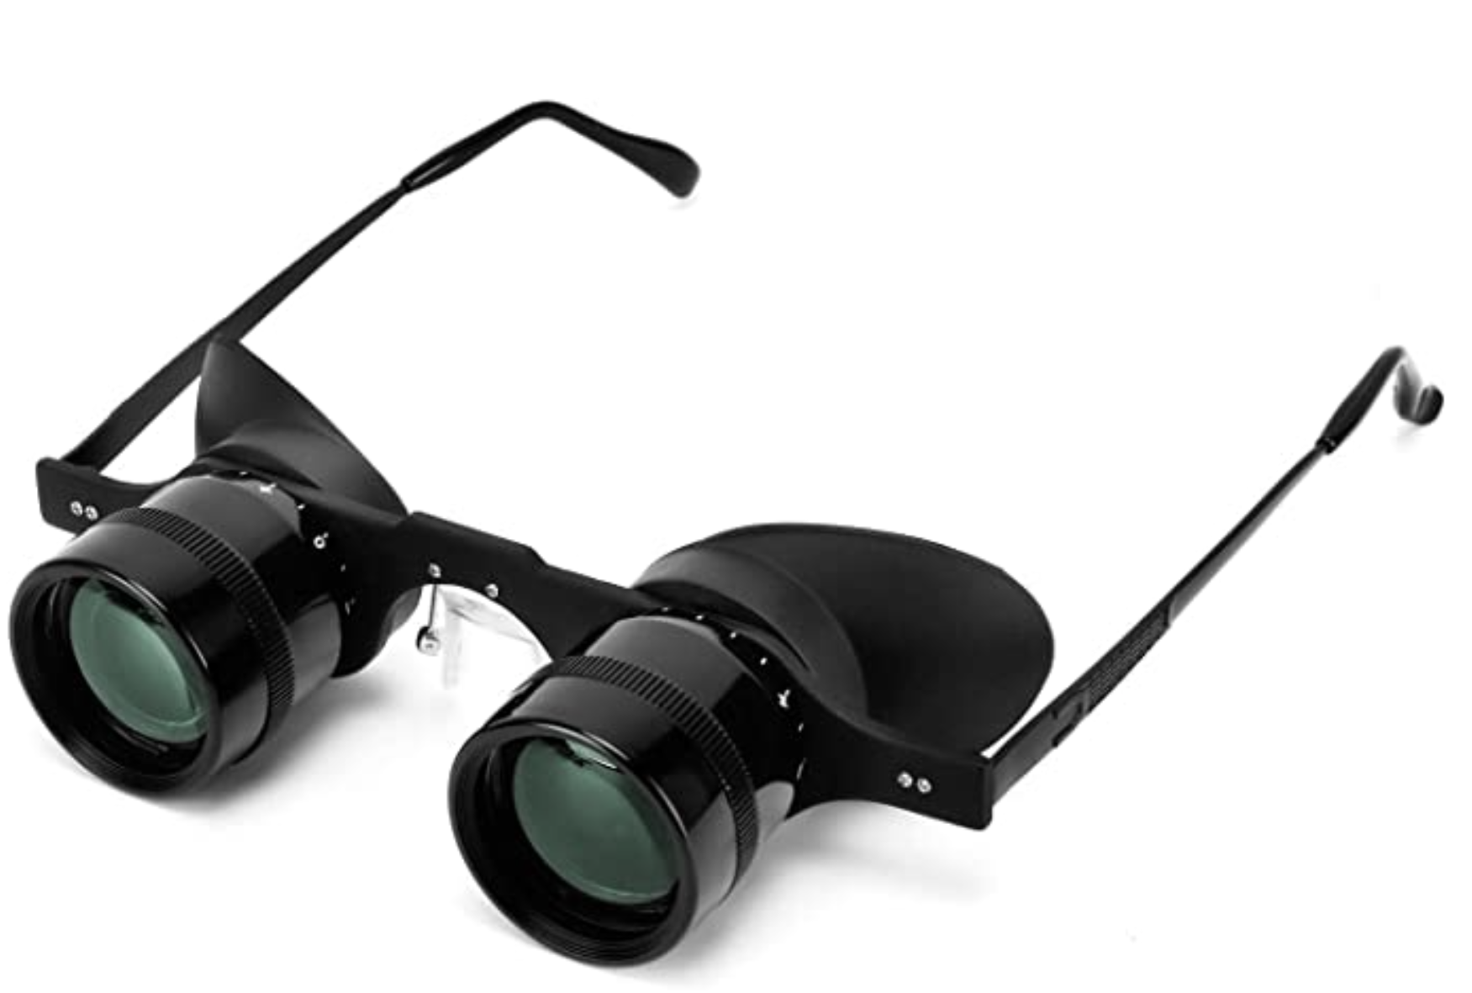
A Wider View of Compilation
Runtime Environments
Our definition
“A translator from source code to target code”
May alter the source language for tractability
May (or may not!) manipulate the target runtime for a variety of purposes

Slide 21

Another Semantic Gap
Runtime Environments
Difference between the specification in IR and executable
Usually means shedding abstractions to concretize runnable code
“raise” / abstract
“lower” / concretize
Source Code
Intermediate
Representation
Target Code

Slide 22

Bridging the Semantic Gap
Runtime Environments
We need code that is…
Easy for humans to understand
Easy for computers to run
There are various approaches to span this divide
Build a translator (compiler)
Move the target (interpreter)
Compilation
Source
code
Target
code
Interpretation

Slide 23

Target Platforms
Runtime Environments
Static workload depends on the platform we target
Real hardware
Virtual hardware
Shell
It’s a platform!

Slide 24

Heavyweight Runtimes
Runtime Environments
Interpreted languages often relegate a lot of work to their runtime
Why?
Runtime

Slide 25

Bytecode
Runtime Environments
An executable format that doesn’t target hardware!
Interpreter
Bytecode
instructions

Slide 26

Mediation Means Checking
Runtime Environments
Many safety checks cannot be done until runtime

Slide 27



Virtual Machines
Runtime Environments
Provide a runtime environment for the abstract instruction set!
Less ambitious than whole-system virtualization

Slide 28

Lightweight Runtimes
Runtime Environments
Compiled languages often minimize their runtime
Why?
Runtime
Lighter than a feather!

Slide 29

Mediation is Slow
Runtime Environments
For the most part, OS does not control program
Compiler’s job to use the environment as best as possible
  This often means interfacing with the hardware architecture
Cuttin’ out the middle-man

Slide 30
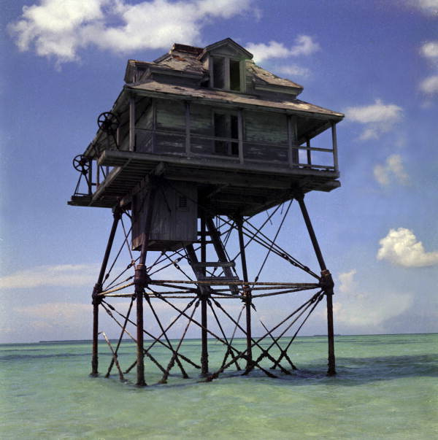
The Role of the OS/VM
Runtime Environments
Provides a platform for program
System calls to access hardware
“Illusion of uniqueness”
Protects processes and system from each other
Program
OS

Slide 31
Our Language
Runtime Environments
We target machine code for two reasons (beyond the classic reasons)
Discharge the obligation of writing a virtual machine
Get to learn how X64 code works

Slide 32

Many Steps Towards Target Code
Runtime Environments
Rather than bridging the semantic gap in one step, transform the code in many baby steps
Encourages modularity
Accommodate analysis goals
Target code
control
flow
graph
3ac
ast

Slide 33
Summary
Runtime Environments – Wrap-up
Defined runtime environments
  The implicit dependencies of a program
  May not be real hardware
The compilers job is to support program abstractions in the runtime
  For hardware platforms, these abstractions need to be simulated from memory, registers, and instruction sets
  For software platforms, the abstractions of the software may be designed to support the language

Slide 34
Next Time
Runtime Environments – Wrap-up
Talk about intermediate representations more generally
Begin discussing our next intermediate representation, three-address code

