Slide 1

3AC Translation
University of Kansas | Drew Davidson

Slide 2

Last Time
Intermediate Representations
Intermediate Representations
3AC
What you should know:
Rational of intermediate representations
The basic idea of 3AC
  The instruction set
  What each instruction more-or-less does
Intermediate
Representations

Slide 3
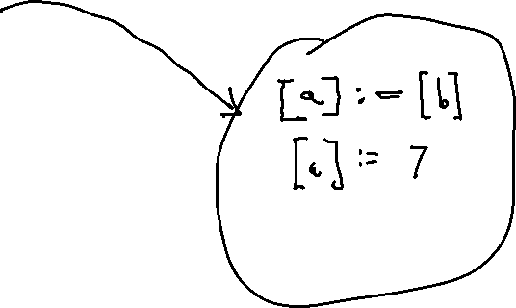
The List of Instruction Templates
Review: Our 3AC Instructions
<opd> := <opd>
<opd> := <opr> <opd>
<opd> := <opd> <opr> <opd>
<lbl>: <INSTR>
goto <lbl>
ifz <opr> goto <lbl>
nop
call <name>
enter <proc>
leave <proc>
setarg <int> <opd>
getarg <int> <opd>
setret <opd>
getret <opd>

Slide 4
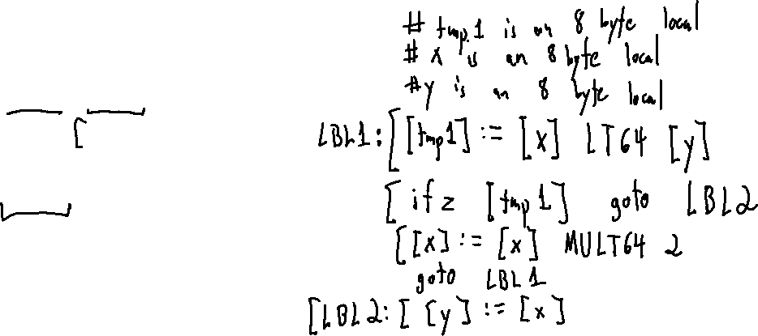
3AC: Exercise
Another Example
int x;
int y;
while (x < y) {
x = x * 2;
}
y = x;

Slide 5

Compiler Construction
Progress Pics
Scanner
Lexical analysis
Done
We’ve captured the semantics of the input
We’ve checked the program for correctness
Next Steps
Prepare the program for output
Parser
Syntactic analysis
Semantic analysis
In progress
Intermediate code generation
IR optimization
Final Code generation
Final code optimization

Slide 6
Today’s Outline
3AC Translation
The basic idea:
Traversing the AST
Some example nodes
Node to quad translations
Implementation details:
From nodes to Operations/Operands
Intermediate
Representations

Slide 7
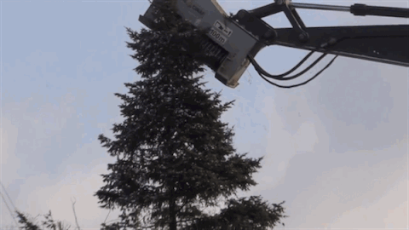
Flattening the Tree
AST Translation to 3AC

Slide 8

Flattening the Tree
AST Translation to 3AC

Slide 9

Flattening the Tree
AST Translation to 3AC
Consider two major task categories:
What we…
Generate
  (i.e. the 3AC operations for the current node)
Propagate
  (i.e. the 3AC operands used in parent nodes)

Slide 10
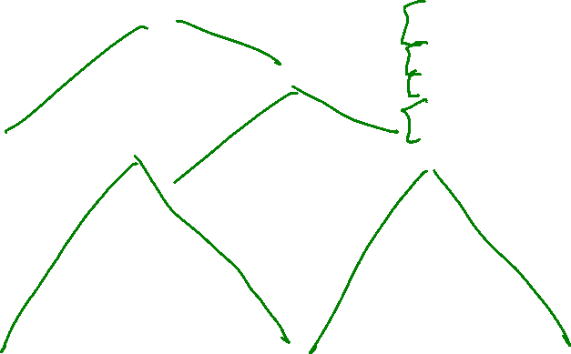
Flattening The Tree: Example
Traversing the AST
Traverse AST, performing two tasks
Generate 3AC operations
Propagate 3AC operands
a = (v – 7) + a * v
1
AssignStmt
20
a
opd
[t1] := [v] SUB64 7
AssignExp
[t2] := [a] MULT64 [v]
2
19
t3
opd
[t3] := [t1] ADD64 [t2]
a
opd
5
18
[a] := [t3]
3
ID
a
4
Plus
t2
opd
6
Sub
11
t1
opd
12
Mult
17
7
opd
v
opd
v
opd
a
opd
7
ID
v
8
9
IntLit
7
10
13
ID
a
14
15
ID
v
16

Slide 11
A Brief Aside on Sequencing
Traversing the AST
What if we walked the tree in a different order?
Take the RHS of the Plus before the LHS
[t2] := [a] MULT64 [v]
[t1] := [v] SUB64 7
[t3] := [t1] ADD64 [t2]
[a] := [t3]
a = (v – 7) + a * v
1
AssignStmt
20
a
opd
[t1] := [v] SUB64 7
AssignExp
[t2] := [a] MULT64 [v]
2
19
t3
opd
[t3] := [t1] ADD64 [t2]
a
opd
5
18
[a] := [t3]
3
ID
a
4
Plus
t2
opd
12
Sub
17
t1
opd
6
Mult
11
7
opd
v
opd
v
opd
a
opd
13
ID
v
14
15
IntLit
7
16
7
ID
a
8
9
ID
v
10

Slide 12
A Brief Aside on Sequencing
Traversing the AST
What if we walked the tree in a different order?
Take the RHS of the Plus before the LHS
C and C++ leave this choice to the compiler!
[t2] := [a] * [v]
[t1] := [v] - 7
[t3] := [t1] + [t2]
[a] := [t3]
Participation
Does traversal order matter?
In this AST?
For all ASTs?
[t1] := [v] - 7
[t2] := [a] * [v]
[t3] := [t1] + [t2]
[a] := [t3]
Example code
int foo(){ cout << “hi”; return 0; }
int bar(){ cout << “class”; return 0; }
int main(){
cout << foo() + bar();
}

Slide 13
A Brief Aside on Sequencing
Traversing the AST
What if we walked the tree in a different order?
Take the RHS of the Plus before the LHS
C and C++ leave this choice to the compiler!
[t2] := [a] * [v]
[t1] := [v] - 7
[t3] := [t1] + [t2]
[a] := [t3]
Order DOES matter
Can change the program’s semantics!
For our language, always go left to right (when possible)
[t1] := [v] - 7
[t2] := [a] * [v]
int g;
[t3] := [t1] + [t2]
int foo() { return g; }
[a] := [t3]
int bar() { g++; return g; }
int main(){ g = 0; return foo() * bar(); }

Slide 14
Today’s Outline
3AC Translation
The basic idea:
Traversing the AST
Example Nodes:
Node to quad translations
Implementation details:
Operations and operators
Intermediate
Representations

Slide 15
Example Nodes
Node to Quad Translations
This generate + propagate idea is powerful!
Basically worked for previous traversals:
  Name analysis
  Type analysis
  Syntax-directed translation
Let’s see how it works for some various node types

Slide 16
Translating AST Leaves (IDs and Lits)
AST Translation to 3AC
Generate:
Nothing!
Propagate:
The value for use in parent
AST Snippet
a
4
ID
a
IntLit
4

Slide 17
Translating AssignExp
AST Translation to 3AC
Generate:
Code for the LHS (recurse)
Code for the RHS (recurse)
The actual assignment instruction
Propagate:
The LHS of the assignment
a = 4
b = (a = 4)
AssignExp
a
b
a
AssignExp
ID
b
AssignExp
a
4
a
4
ID
a
IntLit
4
ID
b
IntLit
4
[a] := 4
[a] := 4
[b] := [a]

Slide 18
Translating BinaryOp Nodes
AST Translation to 3AC
Generate:
Code for LHS, RHS (recurse in order)
Node’s operation kind, assigning to new temp
Propagate:
The new temp value (for use in parent)
7 * v
7 * v + a
tmp2
tmp1
Plus
Mult
tmp1
a
7
v
Mult
ID
a
IntLit
7
ID
v
7
v
IntLit
7
ID
v
[tmp1] := 7 MULT64 [v]
[tmp1] := 7 MULT64 [v]
[tmp2] := [tmp1] ADD64 [a]

Slide 19

Translating CallExpNodes
AST Translation to 3AC
Generate:
(Recurse over args, left to right)
setarg instrs for each argument
call instr for function
getret instr for the result
Propagate:
The getret symbol
AssignExp
k
tmp9
ID
vaL k
CallExp
$$\left\langle 7,\text{varX},\text{tmp}\text{8}\right\rangle$$
foo
ID
val: foo
(Args)
7
tmp8
varX
(Arg evaluation)
src code snippet
setarg 1, 7
k = foo(7,varX,a+b)
setarg 2, [varX]
setarg 3, [tmp8]
call fn_foo
getret [tmp9]
[k] := [tmp9]

Slide 20


Translating FnDeclNodes
AST Translation to 3AC
Generate:
enter quad to begin scope
A label for function’s end
getarg quads for each argument
(recurse into body)
leave quad to end scope
Propagate:
Nothing
FnDecl
fn
$$\left\langle \text{a}\text{1},\text{a}\text{2}\right\rangle$$
ID
val: fn
(Formals)
body
a1
a2
ID
val: a1
ID
val: a2
enter fn
getarg 1, [a1]
src code snippet
getarg 2, [a2]
void fn(int a1, int a2){
…
}
(body code)
L_fn_end:
leave fn

Slide 21
Translating ReturnStmtNodes
AST Translation to 3AC
Generate:
(recurse into expression)
setret quad for expression tmp
goto for the function end
Propagate:
Nothing
ReturnStmt
tmp1
Plus
a
2
ID
a
IntLit
2
src code snippet
return a+2;
[tmp1] := [a] ADD64 2
setret [tmp1]
goto L_fn_end

Slide 22
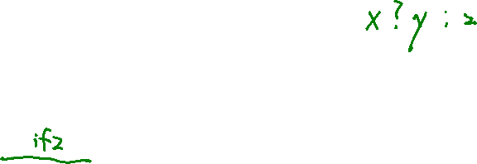
Translating IfStmtNodes
AST Translation to 3AC
Generate:
(recurse into conditional)
An “after the body” label
ifz to after the body label
(recurse into body)
nop with the new label
Propagate:
Nothing
IfStmt
tmp0
LessThan
(body)
9
var
[tmp0] := 9 LT64 [var]
ifFalse [tmp0] goto L_a
src code snippet
(body code)
if (9 < var){
(body code)
}
L_a:
nop

Slide 23

Translating While Loops
AST Translation to 3AC
Generate:
Label for loop head
nop for loop head label
(recurse into conditional)
ifz to “after the body”
(recurse into body)
Jump back to head
Propagate:
Nothing
WhileLoop
tmp0
Cond
(9 < var)
(body)
9
var
L_head: nop
[tmp0] := 9 LT64 [var]
ifz[tmp0] goto L_a
(body code)
src code snippet
goto L_head
while (9 < var){
(body code)
}
nop
L_a:

Slide 24
Translating Index
AST Translation to 3AC
Generate:
Assign address of expression to a new temp
Propagate:
New temp
AST snippet
tmp2
IndexExp
tmp1
ID
a
ID
b
src code snippet
record R{
int a;
}
…
R r;
r.a = 1;
3AC snippet
[tmp1] := [b]
tmp2 := r @ a

Slide 25
Today’s Outline
3AC Translation
The basic idea:
Traversing the AST
Example Nodes:
Node to quad translations
Implementation details:
Operations and operators
Intermediate
Representations

Slide 26

3AC Data Structures
AST Translation to 3AC: Implementation
One class per 3AC node type
  Often referred to as “Quads” – has at most 4 fields (+ label)
  Each procedure maintains a list of its quads
lbl
dst
src1
opr
src2
L1
tmp1
a
-
2

Slide 27



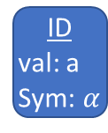






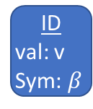



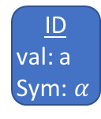

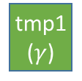
Translation Implementation
AST Translation to 3AC
src code snippet
AST
Quads
a = 7 + (a – v)
AssignStmt
lbl
dst
src₁
opr
src₂
tmp1
$$(γ)$$
a
($α$)
SUB 64
v
($β$)
AssignExp
AssignExp
$$α$$
tmp2
$$(δ)$$
7
ADD 64
tmp1
($γ$)
ID
val: a
Sym: $α$
Plus
Plus
LIT64: 7
IntLit
7
Sub
a
$$(α)$$
tmp2
($δ$)
ASG
64
Sub
$$α$$
$$β$$
ID
val: a
Sym: $α$
ID
val: v
Sym: $β$
$$α$$
$$δ$$
Symbol:
Kind: var
Type: int
Name: a
$$β$$
$$γ$$
Symbol:
Kind: tmp
Type: int
Name: tmp2
Symbol:
Kind: var
Type: int
Name: v
Symbol:
Kind: tmp
Type: int
Name: tmp1

Slide 28







Translation Implementation
AST Translation to 3AC
At this point, we can discard the AST
New data structures for the 3AC representation:
  Quad class (with subclasses for each quad type)
  Procedure class
    Contains list of quads
  Operand abstraction (symbols)
Quads
lbl
dst
src₁
opr
src₂
tmp1
$$(γ)$$
a
($α$)
SUB 64
v
($β$)
tmp2
$$(δ)$$
7
ADD 64
tmp1
($γ$)
a
$$(α)$$
tmp2
($δ$)
ASG
64

Slide 29
Lecture End
3AC Translation
We’ve successfully flattened the AST
Got a nice target for final code generation
Removed the nesting
Make execution order explicit
Next time
Start exploring the compiler targets
src
C
Rust
Haskell
IR
tgt
X64
MIPS
WebASM
The multicompiler concept
One IR for many sources, many targets

Slide 30
3AC in Summary
AST Translation to 3AC
A Nice Linear IR
Gets us close to real hardware
Abstract enough to be used in a variety of backends

