Slide 1
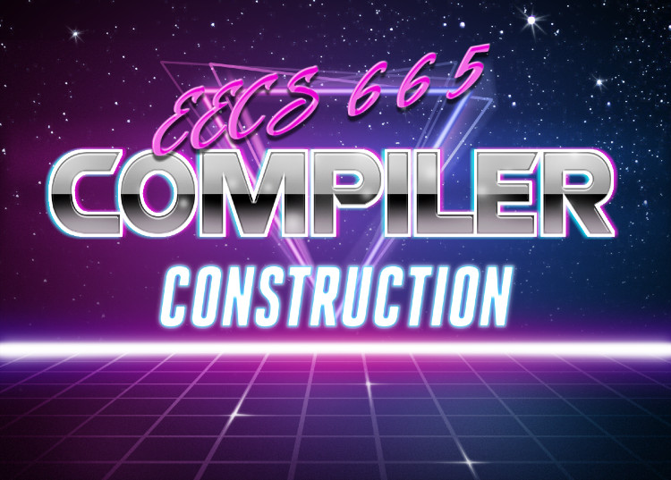

Last Time
Lecture Review - Runtimes
Drew Davidson | University of Kansas
Runtimes
Runtime Environments
Tradeoff between what’s done
dynamically vs statically
Hardware Intuition
Memory is a big 1D array
Runtime
Environments
Instruction Set Architectures
You Should Know
Different runtime environment types
  Advantages/Disadvantages
Compiling vs Interpreting

Slide 2
Last Time
Lecture Review - Runtimes
Runtimes
Runtime Environments
Tradeoff between what’s done
dynamically vs statically
Hardware Intuition
Memory is a big 1D array
Runtime
Environments
You Should Know
Different runtime environment types
  Advantages/Disadvantages
Compiling vs Interpreting

Slide 3
This Time
Lecture Outline – ISAs
Instruction-Set Architectures
What an ISA does
Our target ISA: x64
Writing x64
Runtime
Environments

Slide 4

Hardware Capabilities
ISAs - Intro
Computers can store binary sequences in memory
An entire program thus needs to be mapped to binary sequences
Computer
Scientists
0s and 1s
Electrical
Engineers

Slide 5

Programs as Numeric Sequences
ISAs - Intro
We gotta encode the whole dang program into
this sucker!
Encode data as binary sequences
Encode instructions as binary sequences
Address
Address
Address
Address
Address
Address
Address
Address
Address
Address
Address
0x0000
0x0001
0x0002
0x0003
0x0004
0x0005
0x0006
0x0007
0x0008
0x0009
0x000A
0x44
0x01
0x02
0x44
0x01
0x03
0x07
0x00
0x00
0x00
0x03
Need to use the
same space for
many things

Slide 6

The ISA Contract
ISAs - Intro
An ISA specifies
How data is encoded
Instructions that can transform data
Opcodes for how instructions are encoded
Program state
Software
Hardware
ISA: A contract of hardware aspects

Slide 7

Instruction Set Architectures
ISAs - Intro
Hypothetical ISA
An ISA specifies
How data is encoded
Instructions that can transform data
Opcodes for how instructions are encoded
Program state
-2 is encoded as 1110
-1 is encoded as 1111
8 is encoded as 1000
12 is encoded as 1100
The INC_ADDR <X> instruction
increments the value at
memory address <X>
INC_ADDR 8 is encoded
as 10101010 00010000
Next instruction to execute
is stored in register I

Slide 8
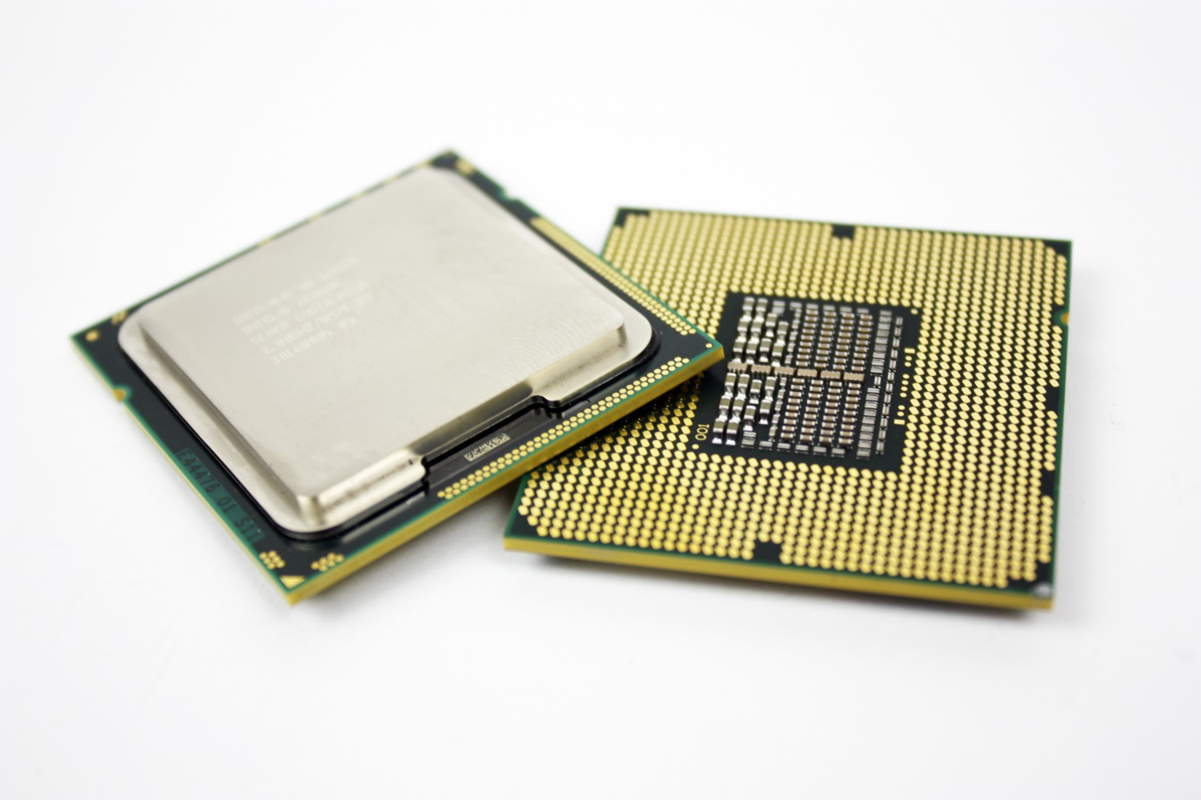
Processors Conform to ISAs
ISAs - Intro
You’re speakin’ my language!
Upon encountering a byte sequence an ISA-conformant “knows” how to interpret the sequence
Still has some flexibility on how to execute it, specified via the microarchitecture

Slide 9

Completely Hypothetical ISA Example
ISAs - Intro
-2 is encoded as 1110
-1 is encoded as 1111
8 is encoded as 1000
12 is encoded as 1100
The INC_ADDR <X>
increments the value at
memory address <X>
INC_ADDR 8
encoded as
1010
Next instruction
to execute
stored in register I
Execute the instruction at address 12
The instruction at address 12 is INC_ADDR 8
Register I:
1110
The value at
address 8 is -2
Address
Address
Address
Address
Address
Address
Address
Address
8
9
10
11
12
13
14
15
…
1
1
1
0
1
0
1
0
…
1
1
1
1

Slide 10

More Realistic Encodings
ISAs - Intro
The previous ISA uses unrealistic encodings
Let’s consider some more likely choices

Slide 11
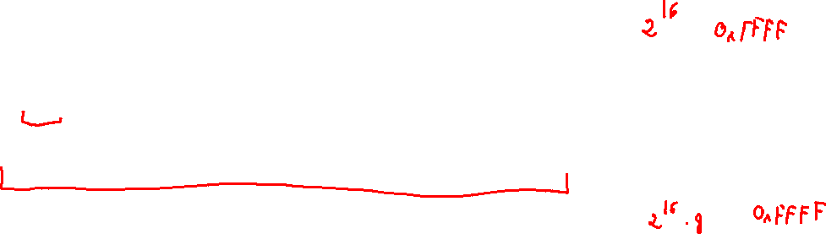
Encoding Data: Granularity of Access
ISAs - Intro
How “big” is a memory cell?
Let’s say we’re storing the byte 0x61 = 01100001
Bit-addressable
Address
Address
Address
Address
Address
Address
Address
Address
Address
Address
Address
0x0000
0x0001
0x0002
0x0003
0x0004
0x0005
0x0006
0x0007
0x0008
0x0009
0x000A
0
1
0
0
0
1
0
0
0
0
0
Byte-addressable
Address
Address
Address
Address
Address
Address
Address
Address
Address
Address
Address
0x0000
0x0001
0x0002
0x0003
0x0004
0x0005
0x0006
0x0007
0x0008
0x0009
0x000A
0x44
0x01
0x02
0x44
0x01
0x03
0x07
0x00
0x00
0x00
0x03
Could even go bigger?
But why (and why not)?

Slide 12
Data Encodings
ISAs - Intro
You should already know the basic idea here
Type dictates numeric representation
Devote a certain size (in bits) to representation
Use binary hardware to store the numeric value
Bit Sequence (binary)
0100 0011
0100 1111
0100 1111
0100 1100
Byte Sequence (Hex)
0x43
0x4F
0x4F
0x4C
ASCII Value: char type (8 bits, i.e. 1 byte)
‘C’
‘O’
‘O’
‘L’
Integer Value: int32 type (32 bits, i.e. 4 bytes)
0x434F4F41
1,129,271,105‬

Slide 13
Convention: Memory Regions
ISAs - Intro
Portions of memory “zoned” by purpose
Simplest form:
  Code region
  Data region
  The rest is free space
Memory
Address
Address
Address
Address
Address
Address
Address
Address
Address
Address
Address
0x0000
0x0001
0x0002
0x0003
0x0004
0x0005
0x0006
0x0007
0x0008
0x0009
0x000A
code
data
free

Slide 14
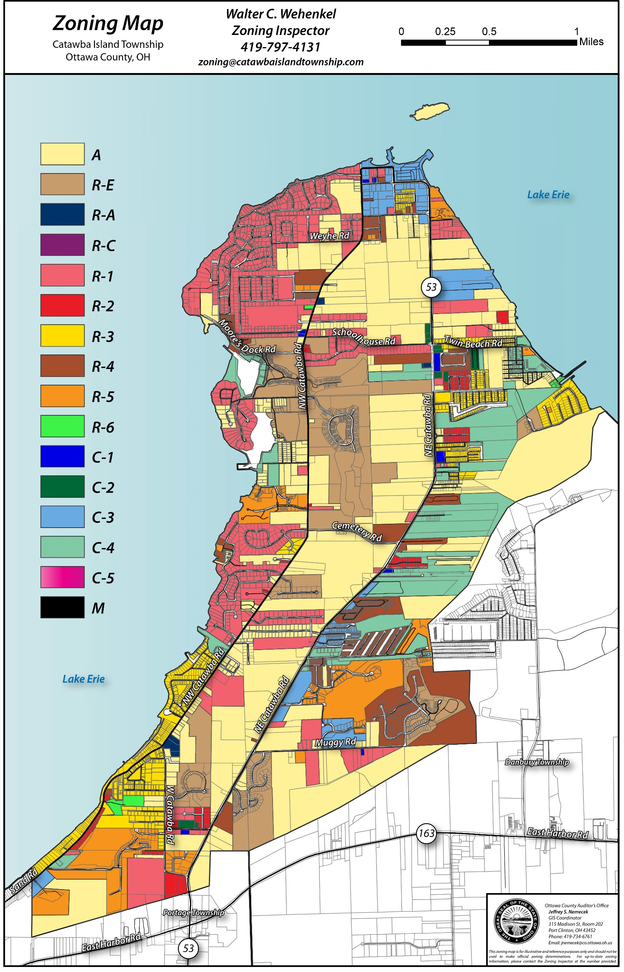
Data Sub-Regions
ISAs - Intro
Further break up data region for different kinds of data
Global variables
Local variables
Objects

Slide 15
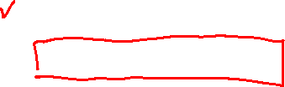
This Time
Lecture Outline – ISAs
Instruction-Set Architectures
What an ISA does
Our target ISA: x64
Writing x64
Runtime
Environments

Slide 16
Our ISA: x64
Intro to Assembly: About
Probably the most popular architecture in modern use
Almost certainly what your computer is running
Definitely what the cycle servers are running

Slide 17

x86 and x64: A Reputation for Difficulty
Intro to Assembly: About
Highly complex instruction set
~1000 different instructions via the most conservative count*
Some instructions context-sensitive (i.e. work differently based on preceding instructions)
*that we don’t have a canonical
instruction count
is already a pretty bad sign

Slide 18
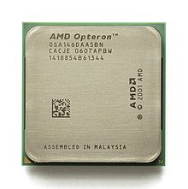
Why is it called x64?
Intro to x64: About
Short for x86-64
The 64-bit extension of the x86 instruction set
So then what is x86?
A dang mess!

Slide 19
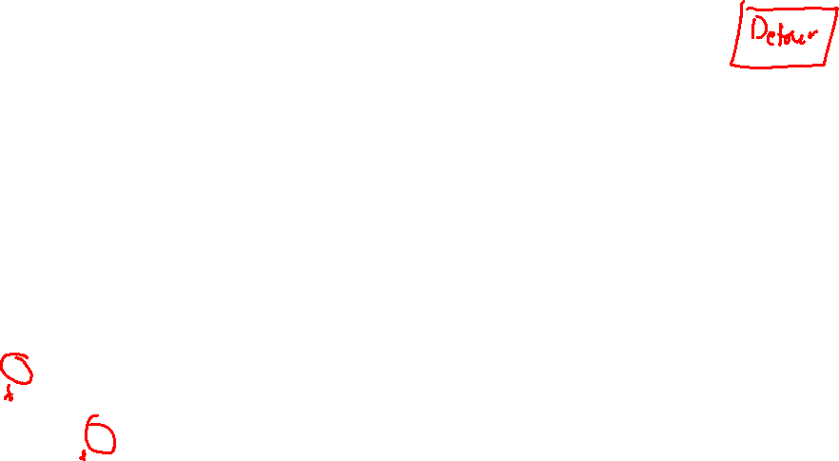
Some Architecture History: x86
Intro to x64: About
1978
1982
1985
1989
1993
1995
1997
1999
2000
Pentium
Pentium Pro
Pentium II
Pentium III
Pentium IV
8086 (16 bit)
80386 (32-bit)
i486 (32-bit)
80186 and 80286
“five” + science-y sounding
Intel attempts to trademark
the number 486, gets denied

Slide 20
Itanium: A Fresh Start?
Intro to x64: About
2001: Itanium released by Intel
non-backward-compatible 64-bit architecture
A new architecture philosophy heavily reliant on compiler optimization
Ditches much of the messiness of x86
Highly anticipated
Development of MIPS and DEC Alpha halted in anticipation

Slide 21

Itanium: How Did it Go?
Intro to x64: About
“one of the greatest fiascos of the last 50 years”
- John C. Dvorak
“a joke in the chip industry”
- Ashlee Vance
“it turned out the wished-for compilers were basically impossible to write”
- Donald Knuth

Slide 22

AMD Swoops In
Intro to x64: Background
2003: AMD64
AMD’s backwards-compatible 64-bit x86 extension
Intel eventually catches up with compatible Intel 64 architecture
X64 used to denote the vendor-neutral intersection of AMD64 and Intel 64
amd
intel

Slide 23

The Upshot: A Patchwork
Intro to x64: Background
x86 carries many features that lack modern salience
x64 avoids a lot of these
Still has some WTF features
  Many to do with register-poorness

Slide 24
x64 Registers
Intro to Assembly: About
Name | Number | Nominal Purpose
rax | 0 | Computation Accumulator
rbx | 1 | Computation Base
rcx | 2 | Computation counter
rdx | 3 | Data for I/O
rsi | 4 | String source address
rdi | 5 | String destination address
rbp | 6 | Base pointer (base of the stack)
rsp | 7 | Stack pointer (edge of the stack)
r08 – r15 | 8 - 15 | True general purpose registers
rip | - | Instruction pointer
rflags | - | Status flags
Can be used in
Instruction opcodes
Cannot be used in
instruction opcodes

Slide 25
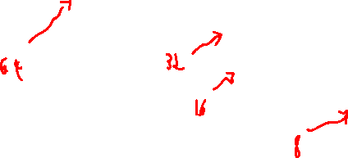
x64 Register Compatibility
Intro to Assembly: About
Register #0 – the “A” register
byte 8
byte 7
byte 6
byte 5
byte 4
byte 3
byte 2
byte 1
rax
eax
ax
ah
al

Slide 26

This Time
Lecture Outline – ISAs
Instruction-Set Architectures
What an ISA does
Our target ISA: x64
Writing x64
Runtime
Environments

Slide 27
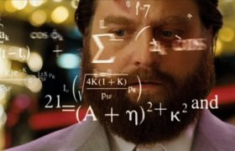
Stepping Back From Binary
Encoding Programs
Dealing with binary directly is tedious and error-prone
Laying out code / data is super difficult to do manually
Remembering the binary opcode sequence for every instruction is difficult
Fortunately, we don’t have to do that

Slide 28

The Assembler
Intro to Assembly: About
Write low-level textual mnemonics (assembly code)
Assembly code isn’t directly executable
Nearly 1-1 with the binary encoding
Different assemblers, different syntax
Compiler
Code
Assembler

Slide 29
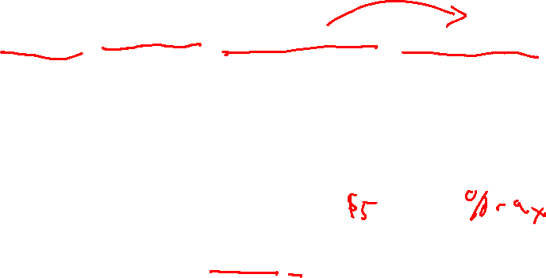
ASM Instruction Syntax x64 syntax
As with everything x86-related, it’s complicated
We’ll use the AT&T Syntax:
  <opcode><sizesuffix> <src operand(s)> <dst operand>
Immediates (i.e. constant values) prefixed by $
Registers prefixed by %
Memory lookup (i.e. dereference) in parens
movq $5, (%rax)
mov the 64-bit value 5 into the 64-bit
memory address specified by register rax

Slide 30
Directives x64 syntax
Indicates a command to the assembler
  Layout, program entrypoint, etc.
Example:
.globl X
Indicates that symbol X is visible outside of the file

Slide 31
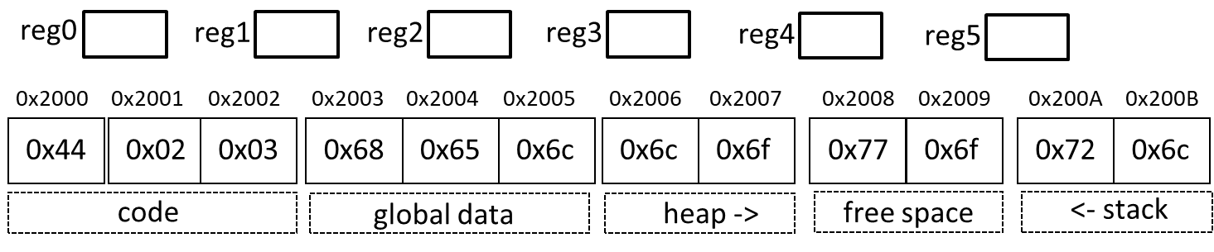
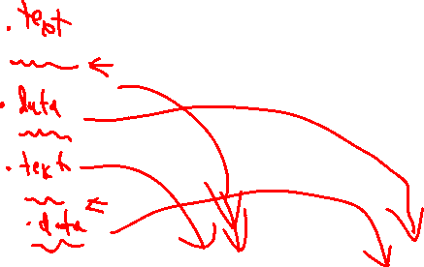
Segment Directives
Intro to x64: Writing Assembly
.text
Lay out items in the user text segment
.data
Lay out items in the data segment
Instructions go here
Globals go here

Slide 32
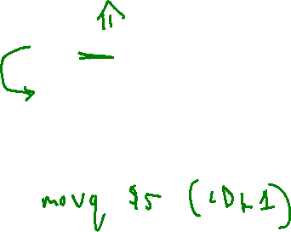
Labels x64 syntax
The assembler allows us to specify “placeholder” addresses that will be used later
  Translated to “real” addresses by a utility called the linker
Valid for both data and code locations
jmp 0x12d34a5678a
jmp LBL1
…
LBL1: movq $5 (%rax)

Slide 33
System calls
Intro to x64: A program
To interact outside program memory, need the help of the OS
syscall
%rax # Which system call (60 is exit)
%rdi # Set syscall arg – (exit takes the return code)

Slide 34

Time to put it all together!
Intro to X64
Photo Credit: Tim Klein - https://puzzlemontage.crevado.com

Slide 35

A Complete Program
Intro to x64: A program
.text
.globl _start _start: movq $60, %rax # Choose syscall exit movq $4, %rdi # Set syscall arg - return code
syscall

Slide 36
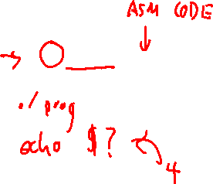
Actually Running a Program
Intro to x64: A program
Invoking the assembler and linker
as –o start.o start.s
ld start.o –o prog

