Slide 1

Practical x64
University of Kansas | Drew Davidson

Slide 2

Previously…
Review – x64 Memory
Memory Layout
Static Allocation
The heap and the stack
You should know
What a static allocation scheme is (and its limitations)
How to do static allocation in x64 assembly
The concepts of the stack and heap
Architecture
2

Slide 3
Today’s Lecture
Practical x64
Create more capable programs
More (Linux) syscalls
Library linking
Library shims
Practicing basic x64 instruction use
Architecture
3

Slide 4

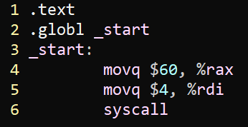
Syscalls
Practical x64 – More Capable Programs
You’re already familiar with sys_exit
Put 60 in %rax
Put the value to return in %rdi
There’s are many syscalls
Officially documented in syscall_64.tbl in the Linux source git
They adhere to a protocol
Lots of documents on the web
I like one by Ryan A. Chapman
4

Slide 5
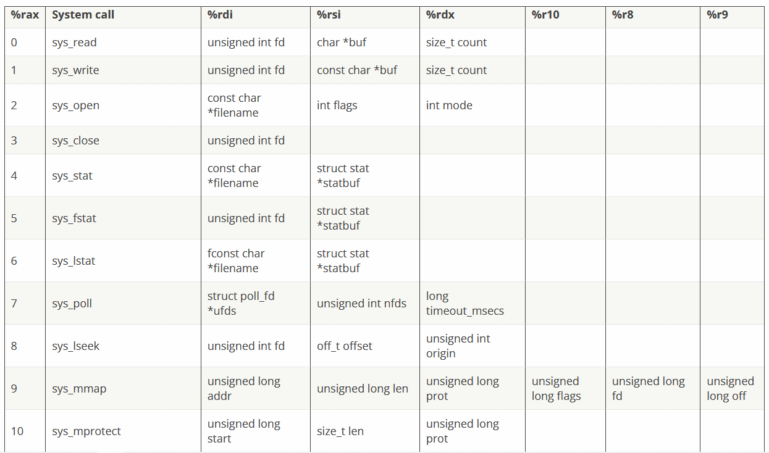
Syscall Reference
Practical x64 – More Capable Programs
https://blog.rchapman.org/posts/Linux_System_Call_Table_for_x86_64/
…
…
5

Slide 6
Syscall Example: Write to Console
Practical x64 – More Capable Programs
https://blog.rchapman.org/posts/Linux_System_Call_Table_for_x86_64/
…
…
6

Slide 7
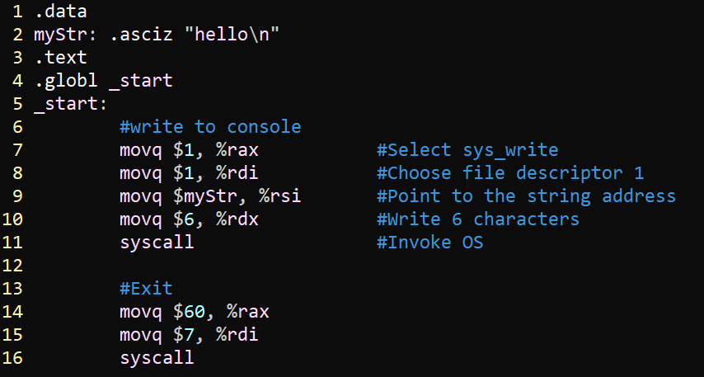
Syscall Example: Write to Console
Practical x64 – More Capable Programs
fd 1 is stdout
7

Slide 8
Syscall Reference
Practical x64 – More Capable Programs
https://blog.rchapman.org/posts/Linux_System_Call_Table_for_x86_64/
…
…
8

Slide 9
Syscall Example: Write to File
Practical x64 – More Capable Programs
https://blog.rchapman.org/posts/Linux_System_Call_Table_for_x86_64/
…
…
9

Slide 10
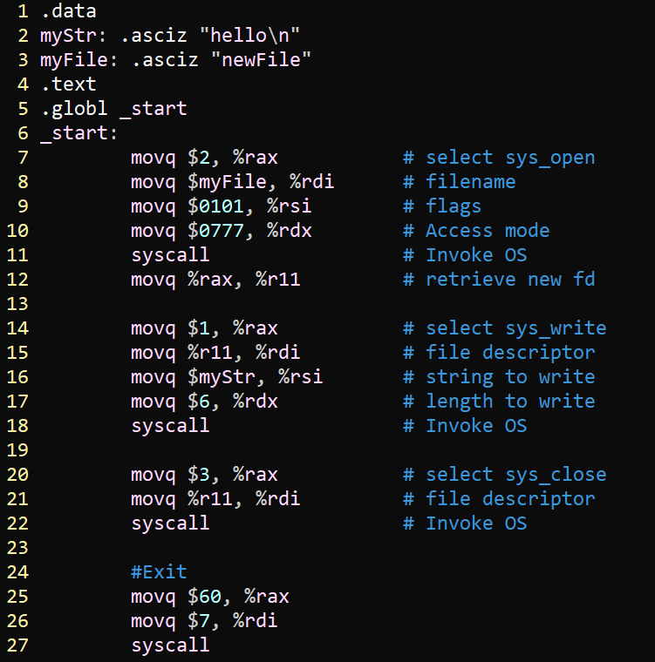
Syscall Example: Write to File
Practical x64 – More Capable Programs
O_CREAT | O_WRONLY
wrx for all
10

Slide 11

Don’t Invoke Syscalls Directly!
Practical x64 – More Capable Programs
Programmers are discouraged from directly invoking syscalls
Prefer to interact with the OS through the language runtime library
But we don’t have that option…
OR DO WE?!?!?!?!
(yes, we do)
syscalls
11

Slide 12
Today’s Lecture
Practical x64
Create more capable programs
More (Linux) syscalls
Library linking
Library shims
Practicing basic x64 instruction use
Architecture
12

Slide 13
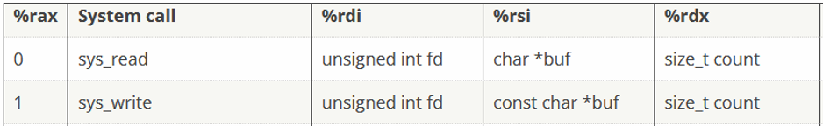
Why Use a Standard Library?
Practical x64 – More Capable Programs
How
Handle tedious, error-prone functionality
Example: printf
libc contains native string handling functions for C programs
our
x64
13

Slide 14

Why Use a Standard Library?
Practical x64 – More Capable Programs
How
Be compatible with the System V ABI
1. “Masquerade” as a C program
Follow the conventions of the libc native code:
Adhere to the Application Binary Interface
2. Combine object code we write with compiled C code
Good news: linking is already a well-supported operation
Compiled C
object code
Our custom
object code
executable
14

Slide 15
Cross-language linking
Practical x64 – More Capable Programs
linking workflow
prog.calc
Key
calculonc
user input
prog.s
components we write
artifacts
as
existing
components
prog.o
ld
executable

Slide 16
Cross-language linking
Practical x64 – More Capable Programs
linking workflow
prog.calc
Key
calculonc
user input
prog.s
Reuse existing native code
for common functionality
(i.e. string printing)
components we write
artifacts
as
existing
components
prog.o
libc.so
ld
executable

Slide 17
Basing our runtime on C’s
Practical x64 – More Complicated Programs
enable dynamic linking
SYSPATH=/usr/lib/x86_64-linux-gnu
ld \
-dynamic-linker /lib64/ld-linux-x86-64.so.2 \
$SYSPATH/crt1.o \
$SYSPATH/crti.o \
-lc \
prog.o \
$SYSPATH/crtn.o \
-o prog.exe
entrypoint code
_start: exit(main)
link the libc library
init runtime data structures
release runtime data structures
17

Slide 18
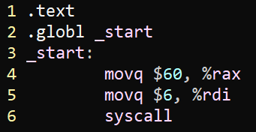

Basing our runtime on C’s
Practical x64 – More Complicated Programs
Standalone
Using libc
Source code (prog.s)
Assembler command
as prog.s –o prog.o
Clever C code disguise
Linker command
ld prog.o –o prog
18

Slide 19
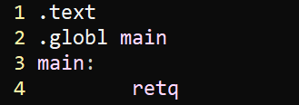
Basing our runtime on C’s
Practical x64 – More Complicated Programs
Standalone
Using libc
Source code (prog.s)
Source code (prog.s)
*
caveat: we’ll create a more
elaborate main function in later
lectures
Assembler command
Assembler command
as prog.s –o prog.o
as prog.s –o prog.o
Linker command
Linker command
ld prog.o –o prog
SYSPATH=/usr/lib/x86_64-linux-gnu
ld -dynamic-linker /lib64/ld-linux-x86-64.so.2 $SYSPATH/crt1.o $SYSPATH/crti.o –lc prog.o $SYSPATH/crtn.o -o prog.exe
19

Slide 20
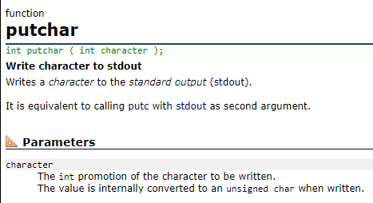
Calling a C library function
Practical x64 – More Complicated Programs
Some System V ABI Facts:
First argument is in %rdi
Second argument is in %rsi
Return value is in %rax
20

Slide 21
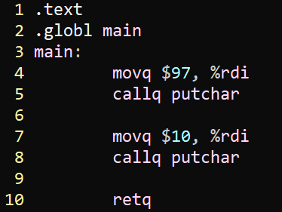
Calling a C library function
Practical x64 – More Complicated Programs
Assembly code
as prog.s –o prog.o
output
SYSPATH=/usr/lib/x86_64-linux-gnu
ld -dynamic-linker /lib64/ld-linux-x86-64.so.2 $SYSPATH/crt1.o $SYSPATH/crti.o –lc prog.o $SYSPATH/crtn.o -o prog.exe
a
21

Slide 22
Today’s Lecture
Practical x64
Create more capable programs
More (Linux) syscalls
Library linking
Library shims
Practicing basic x64 instruction use
Architecture
22

Slide 23
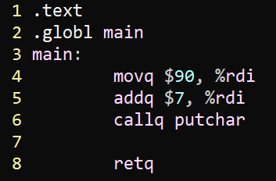
Shimming the C library
Practical x64 – More Complicated Programs
How would we print an int?
Sure would love to call printf!
Calling printf seems… complicated
output
a
23

Slide 24
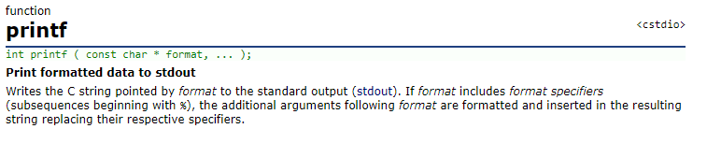
Shimming the C library
Practical x64 – More Complicated Programs
How would we print an int?
Sure would love to call printf!
Calling printf seems… complicated
Maybe we could create a simpler interface to printf?
24

Slide 25
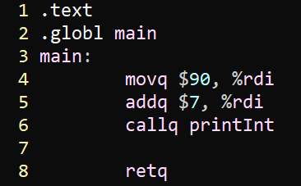
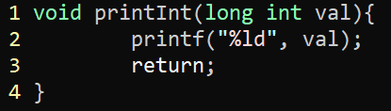
Shimming the C library
Practical x64 – More Complicated Programs
prog.s
How would we print an int?
Sure would love to call printf!
Calling printf seems… complicated
Maybe we could create a simpler interface to printf?
shim.c
libc
25

Slide 26
Cross-language linking
Practical x64 – More Complicated Programs
linking workflow
prog.calc
Key
calculonc
user input
prog.s
Reuse existing native code
for common functionality
(i.e. string printing)
components we write
artifacts
as
existing
components
prog.o
libc.so
ld
executable

Slide 27
Cross-language linking
Practical x64 – More Complicated Programs
linking workflow
prog.calc
shim.c
Key
Code new functionality
in existing source languages
(i.e. intrinsics)
calculonc
user input
prog.s
Reuse existing native code
for common functionality
(i.e. string printing)
components we write
artifacts
as
gcc -c
existing
components
prog.o
shim.o
libc.so
ld
executable

Slide 28
Today’s Lecture
Practical x64
Create more capable programs
More (Linux) syscalls
Library linking
Library shims
Practicing basic x64 instruction use
Architecture
28

Slide 29
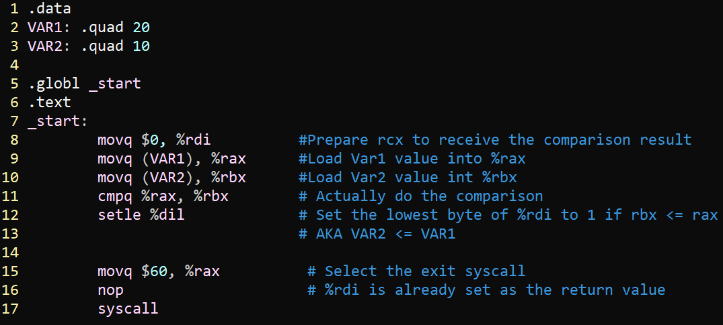
Using cmpq and set<CC>
Practical x64 – Basic instruction use
29

Slide 30
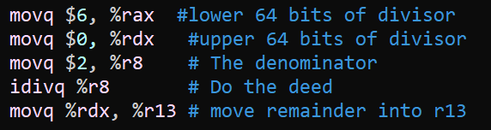
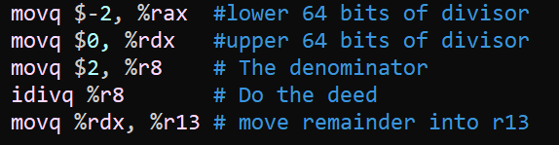
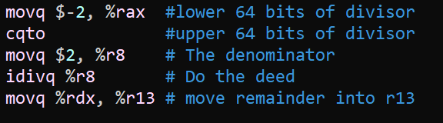
Using idivq and cqto
x64 Practice – Basic instruction use
30

