Slide 1
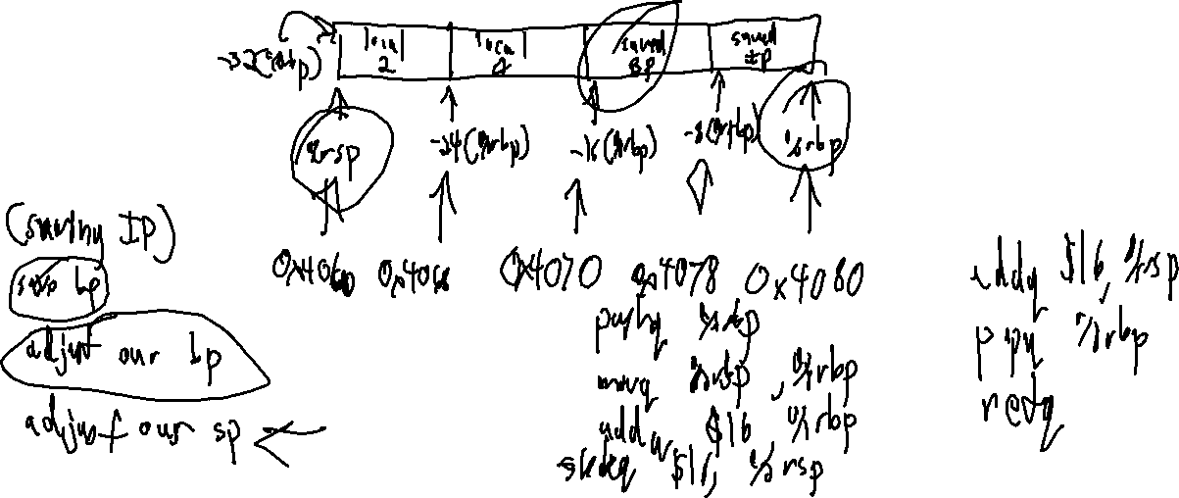
Checkin 27
Show the layout of an activation record with two 64-bit locals. Write the function prologue and epilogue corresponding to that function

Slide 2

Announcements
Administrivia
P6 is out
Q3 imminent!

Slide 3

Statement Code Generation
University of Kansas | Drew Davidson

Slide 4

Last Lecture
Activation Records
Managing the Stack
Managing data
Managing control
You Should Know
How to code up stack frames
The function prologue
The function epilogue
Architecture

Slide 5
Call Stack Bookkeeping
Review: Stack Frames
We need to store (on the stack):
The call site to resume execution after call
The base pointer to restore the old stack frame after call
bookkeeping space at the beginning of the AR
caller
%rsp
caller
%rbp
%rsp
%rbp
Program memory
Address
Address
Address
Address
Address
Address
Address
Address
Address
Address
Address
Address
Address
0x0000
0x0001
0x0002
0x0003
0x0004
0x0005
0x0006
0x0007
0x0008
0x0009
0x000A
0x000B
0x000C
…
…
…
…
…
(instructions)
int16 g
Malloc
data
int16 v
save BP
save IP
int16 k
save BP
save IP
function
code
global
vars
Current Activation Record
Caller Activation Record
code
data
Heap
<- Stack

Slide 6
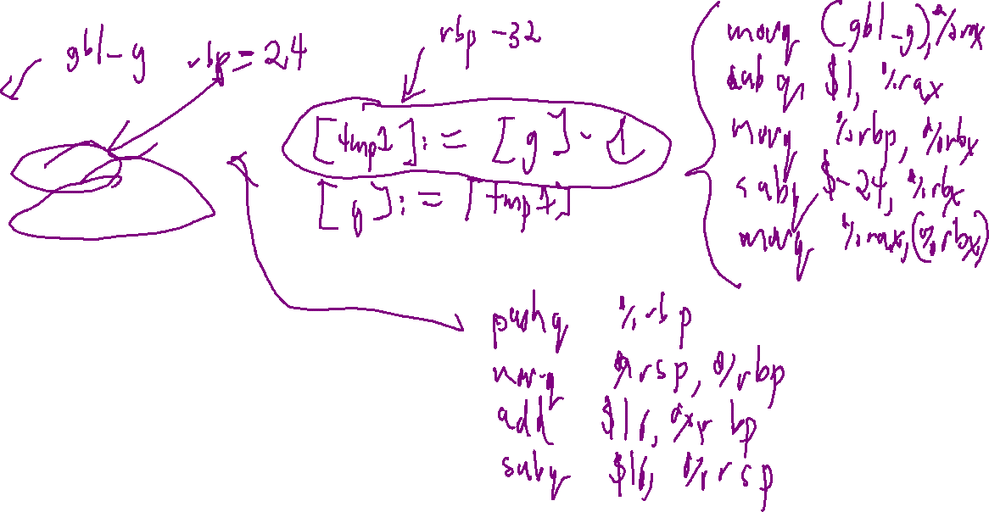
A Less-Trivial x64 Program
Review: Stack Frames
g : int;
v : () void {
local : int;
g = g – 1;
local = g;
out << local;
}
main : ()int {
g = 2;
v();
};

Slide 7
Addressing modes
Toward Local Variables
Some Nice “Shortcuts”
Often want to read memory at a fixed offset from some register
“the memory at 8 bytes before %rbp”
Good news! X64 can do that:
movq -8(%rbp), %rax
This is a very handy addressing mode
leaq -8(%rbp), %rax
movq %rbp, %rdx
subq $8, %rdx
movq (%rdx), %rax
“Move the value AT
%rbp – 8 into %rax”
=
movq %rbp, %rdx
subq $8, %rdx
movq %rdx, %rax
“Move the value OF
%rbp – 8 into %rax”
=

Slide 8

Where We’re At
Progress Pics
Assembled quite a few x64 concepts
Basic data manipulation (movq)
Basic math (addq, idivq, etc)
Global data (.data, .quad, .byte)
Local data
Function calls
You can now hand-code some non-trivial programs

Slide 9

COMPILER
Code Generation
Optimization
Architecture
Semantic Analysis
Runtime Environments
Syntactic
Definition
Parsing
Syntax-Dir
Translation
Regular
Languages
Lexical Analysis
9

Slide 10

Lecture Outline
Statement Code Generation
From Quads to Assembly
Approach Overview
Planning out memory
Writing out x64
Code generation

Slide 11


Representing Abstract Constructs
Statement Code Generation
Combine (simple) target language constructs…
Logical ops
math ops
Stack ops
jumps
…to build (complex) source language constructs
output
program

Slide 12
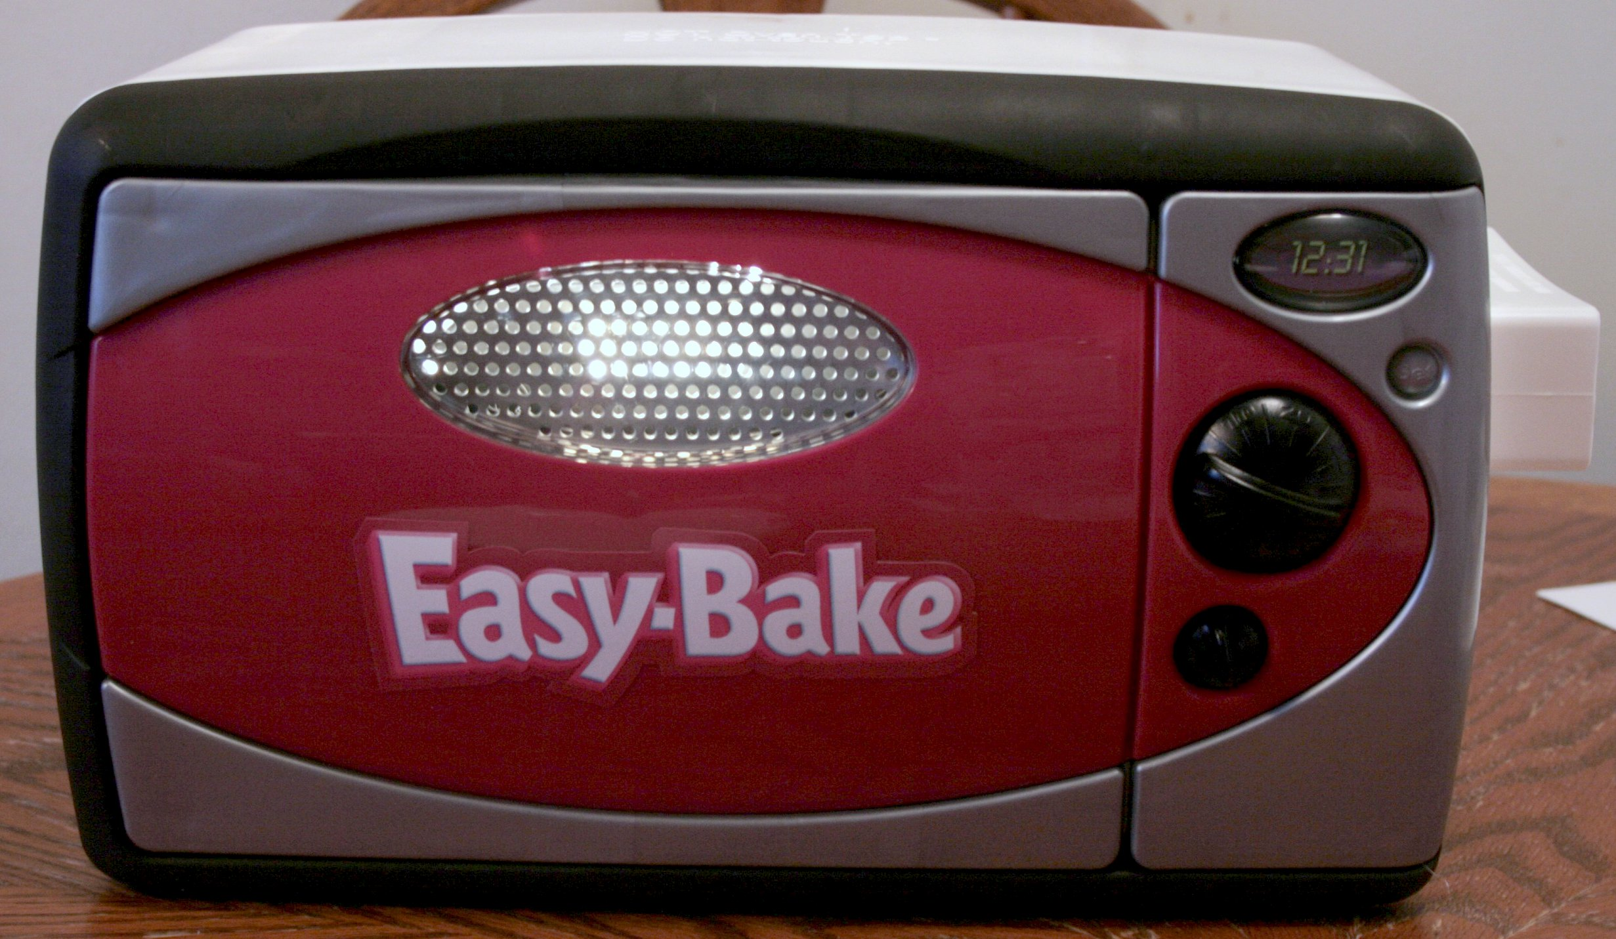
Our Approach: Small Steps
Code Generation
2 passes over IRProgram (like passes over AST)
  Allocate memory for opds (data pass)
  Generate code for quads (code pass)

Slide 13

Code Generation Objectives
Designing Code Generators
Two high level goals:
  Generate correct code
  Generate efficient code
It can be difficult to achieve both at once
  Efficient code can be harder to understand
  Efficient code may have unanticipated side effects
Top priority
Difficult

Slide 14
Our Approach: Small Steps
Code Generation
2 passes over IRProgram (like passes over AST)
  Allocate memory for opds (data pass)
  Generate code for quads (code pass)
Preparing the
3AC memory
layout

Slide 15
Variable Allocation
Code Generation
Big picture:
Every variable needs space in enough space in memory for its type
Every quad using that variable needs to access the same location
Need a mix of static/dynamic allocation
Put globals/strings at fixed addresses in memory (absolute locations)
Put locals/formals at stack offsets in memory (relative locations)
caller
%rsp
caller
%rbp
%rsp
%rbp
Program memory
Address
Address
Address
Address
Address
Address
Address
Address
Address
Address
Address
Address
Address
0x0000
0x0001
0x0002
0x0003
0x0004
0x0005
0x0006
0x0007
0x0008
0x0009
0x000A
0x000B
0x000C
…
…
…
…
…
(instructions)
int16 g
Malloc
data
int16 v
save IP
save BP
int16 k
save IP
save BP
function
code
global
vars
Current Activation Record
Caller Activation Record
code
data
Heap
<- Stack

Slide 16
Allocation: In Code (suggestion)
Code Generation
Add a location field (std::string) to semantic symbols
All related SymOpds have pointers to the same symbol
Location can be a string
For globals, the label that you’ll write
For locals, the stack offset you’ll arrange

Slide 17
Variable Allocation: Globals
Code Generation
3AC Code
X64 Code
… in .data section …
[g] := 4
gbl_g:
.quad 0
location:
At label
gbl_g
Where g is a global int
… somewhere in .text section …
movq $4, (gbl_g)
Compiler Data Structure
SemSymbol
SymOpd
kind: var
type: int
IR
Program
globals
g
location: “gbl_g”
Procs
main
LitOpd
locals
(none)
val: 4
EnterQuad
quads
AssignQuad
dst
src
LeaveQuad

Slide 18
Variable Allocation: Locals
Code Generation
3AC Code
X64 Code
[v] := 7
… assume stack frame setup …
location:
At offset
-24(%rbp)
… somewhere in main’s asm …
Where v is a local int
movq $7, -24(%rbp)
Compiler Data Structure
SemSymbol
kind: var
type: int
IR
Program
globals
(none)
location: “-24(%rbp)”
SymOpd
Procs
main
v
locals
LitOpd
EnterQuad
val: 7
quads
AssignQuad
dst
src
LeaveQuad

Slide 19
Our Approach: Small Steps
Code Generation
2 passes over IRProgram (like passes over AST)
  Allocate memory for opds (data pass)
  Generate code for quads (code pass)
Write the
assembly
file

Slide 20
Assembly Directives/Initialization
Code Generation
We’re gonna write the whole file in one shot
Aided greatly by our preparatory layout pass
Also aided by the assembler
Write out .data section:
.data
.globl: main
<global1_label> : <global1_type> <global1_val>
…
<global1_label> : <global1_type> <global1_val>
Walk each 3AC Procedure, output each quad
enter main

Slide 21

Generating Code for Quads
Code Generation
Compiling

Slide 22
Generating Code for Quads
Code Generation
enter <proc>
leave <proc>
<opd> := <opd>
<opd> := <opr> <opd>
<opd> := <opd> <opr> <opd>
<lbl>: <INSTR>
ifz <opd> goto <lbl>
goto Li
nop
call <name>
setin <int> <operand>
getin <int> <operand>
setout <int> <operand>
getout <int> <operand>

Slide 23
Generating Code for Quads: enter/leave
Code Generation
enter <proc>
leave <proc>
On entry to the function:
Set up the activation record
On exit from the function
Break down the activation record
Prologue
Epilogue
pushq %rbp
movq %rsp, %rbp
addq $16, %rbp
subq $X, %rsp
addq $X, %rsp
popq %rbp
retq
Make function prologue/epilogue
23

Slide 24
Generating Code for Quads: enter/leave
Code Generation
enter <proc>
leave <proc>
Prologue
Epilogue
src code
3ac code
asm code
pushq %rbp
movq %rsp, %rbp
addq $16, %rbp
subq $X, %rsp
addq $X, %rsp
popq %rbp
retq
int main(){
}
enter main
leave main
lbl_main: pushq %rbp
movq %rsp, %rbp
addq $16, %rbp
subq $0, %rsp
addq $0, %rsp
pushq %rbp
retq
24

Slide 25
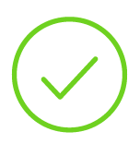
Generating Code for Quads
Code Generation
enter <proc>
leave <proc>
<opd> := <opd>
For assignment-style quads…
<opd> := <opr> <opd>
<opd> := <opd> <opr> <opd>
1) Load operand src locations into registers
<lbl>: <INSTR>
2) Compute a value to register
ifz <opd> goto <lbl>
3) Store result at dst location
goto Li
nop
call <name>
setin <int> <operand>
getin <int> <operand>
setout <int> <operand>
getout <int> <operand>

Slide 26
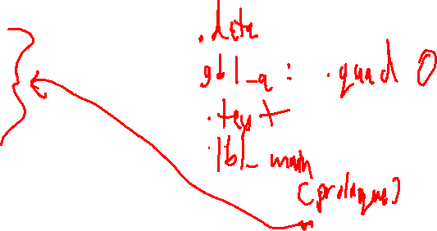
Assignment-Style Quads
Code Generation
SymOpd
Symbol location: “gbl_a”
3AC
For assignment-style quads…
[a] := [b] + 4
SymOpd
Symbol location: “-24(%rbp)
1) Load operand src locations into registers
2) Compute a value to register
3) Store result at dst location
ASM
1)
movq -24(%rbp), %rax
1)
movq $4, %rbx
2)
addq %rbx %rax
3)
movq %rax (gbl_a)

Slide 27
Questions?
Code Generation

