Slide 1

Function Codegen
University of Kansas | Drew Davidson

Slide 2
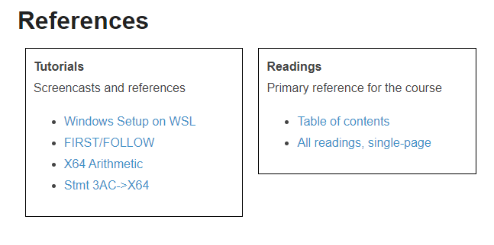

Announcements
Administrivia
In depth 3ac -> x64 statement translation

Slide 3

Last Time
Review: Statement Codegen
From Quads to Assembly
Approach Overview
Planning out memory
Writing out x64
Code generation

Slide 4
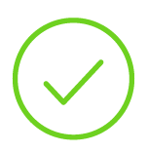
Generating Code for Quads
Review – Statement Code Generation
enter <proc>
leave <proc>
<opd> := <opd>
<opd> := <opr> <opd>
<opd> := <opd> <opr> <opd>
<lbl>: <INSTR>
ifz <opd> goto <lbl>
goto Li
nop
call <name>
setin <int> <operand>
getin <int> <operand>
setret <int> <operand>
getret <int> <operand>

Slide 5
Last Time
Statement Codegen
From Quads to Assembly
Approach Overview
Planning out memory
Writing out x64
You Should Know
How to set up/break down an activation record
The basic formula for turning most quads into x64
Code generation

Slide 6
This Time
Function Codegen
Handling Calls and Returns
Respecting binary code conventions
Translating interprocedural quads
Code generation

Slide 7

Functions are an Illusion!
Function Codegen – Respecting Conventions
Program state is just:
Bytes in registers
Bytes in memory
The compiler must ensure caller-callee interoperability
Make caller places values where callee expects (and vice-versa)

Slide 8

Interoperability Conventions
Function Codegen
The Callee needs to trust that the caller put data where it needs to be
Memory layout
  Stack grows down
  Denoted by %rsp
syscall args
  Which syscall: %rax
  First param: %rdi
  Second param: %rsi
Programs are basically
a series of trust falls

Slide 9

Application Binary Interfaces
Function Codegen
Ensure interoperability between modules
Maybe even between compilers!
Calling conventions
One part of an ABI
Indicate where arguments are passed
Which registers can be changed
Where the AR is restored
Modules all work together to
support programmer “intent”

Slide 10
Application Binary Interfaces
Function Codegen
Ensure interoperability between modules
Maybe even between compilers!
Calling conventions
One part of an ABI
Indicate where arguments are passed
Which registers can be changed
Where the AR is restored
System V AMD 64 Calling convention
1st argument: %rdi
2nd argument: %rsi
3rd argument: %rdx
4th argument: %rcx
5th argument: %r08
6th argument: %r09
7th+ argument: on stack R-to-L

Slide 11
This Time
Function Codegen
Handling Calls and Returns
Respecting binary code conventions
Translating interprocedural quads
setin <int> <operand>
getin <int> <operand>
setret <int> <operand>
getret <int> <operand>
call <name>
Code generation

Slide 12
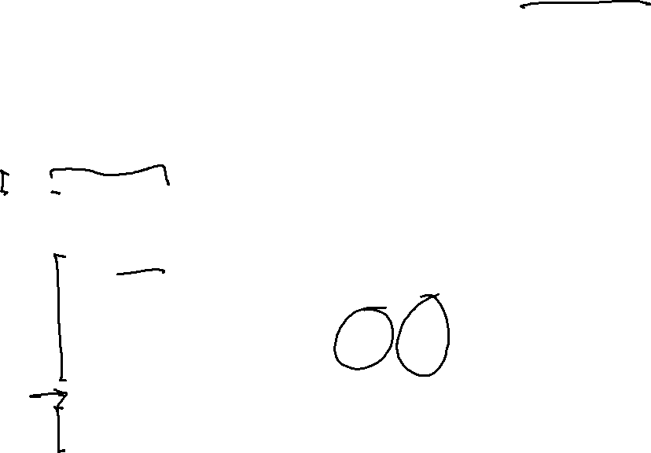
Setting Arguments in Caller
Function Codegen
void bar(int f1, int f2, int f3, int f4, int f5, int f6, int f7, int f8){
int b;
b = f8;
}
void foo(){
int loc;
loc = 8;
bar(1,2,3,4,5,6,7,loc);
}
X64 for call to bar
movq $1, %rdi
%rsp
%rbp
movq $2, %rsi
0x00c0
0x00e8
movq $3, %rdx
0x00b8
0x00c0
0x00c8
0x00d0
0x00d8
0x00e0
0x00e8
movq $4, %rcx
8
7
8
…
…
movq $5, %r8
arg8
arg7
int loc
old RBP
old RIP
movq $6, %r9
pushq $7
free
args
foo AR
movq -24(%rbp), %r12
pushq %r12
callq bar

Slide 13
This Time
Function Codegen
Handling Calls and Returns
Respecting binary code conventions
Translating interprocedural quads
setin <int> <operand>
getin <int> <operand>
setret <int> <operand>
getret <int> <operand>
call <name>
Code generation

Slide 14
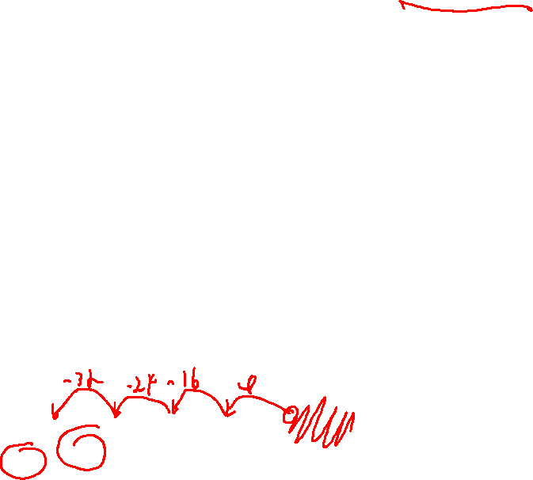
Using Arguments in Callee
Function Codegen
Args 1 – 6
Were passed in register
Should be allocated saved/in current AR
getarg 1, [f1]
movq %rdi, -32(%rbp)
getarg 2, [f2]
movq %rsi, -40(%rbp)
getarg 3, [f3]
movq %rdx, -48(%rbp)
getarg 4, [f4]
getarg 5, [f5]
movq %r08, -56(%rbp)
getarg 6, [f6]
movq %r09, -64(%rbp)
(keeps them from getting clobbered if the callee calls something else)
%rsp
%rbp
0x0068
0x00c0
0x0088
0x0090
0x0098
0x00a0
0x00a8
0x00b0
0x00b8
0x00c0
0x00c8
0x00d0
0x00d8
0x00e0
0x00e8
…
…
8
7
…
…
0x00e8
int f4
int f3
int f2
int f1
int b
old RBP
old RIP
int a8
int a7
int f1
old RBP
old RIP
foo AR
args
foo AR

Slide 15

Using Arguments in Callee
Function Codegen
Args 7+
Were pushed on stack
Offset can be calculated statically - we just need to math it out
Formal position (in callee) = %rbp + 8 * (#args – argIdx)
Arg index 7 (of 8 total) @
%rbp + 8 * (8 – 7)
Arg index 8 (of 8 total) @
%rbp + 8 * (8 – 8)
=
%rbp + 8
=
%rbp + 0
%rsp
%rbp
0x0068
0x00c0
0x0088
0x0090
0x0098
0x00a0
0x00a8
0x00b0
0x00b8
0x00c0
0x00c8
0x00d0
0x00d8
0x00e0
0x00e8
…
…
8
7
…
…
0x00e8
int f4
int f3
int f2
int f1
int b
old RBP
old RIP
int a8
int a7
int f1
old RBP
old RIP
foo AR
args
foo AR

Slide 16
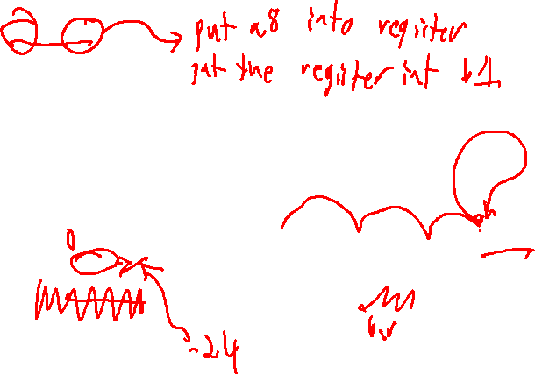
Using Arguments
Function Codegen
void bar(int a1, int a2, int a3, int a4, int a5, int a6, int a7, int a8){
int b1;
b1 = a8;
}
void foo(){
int f1;
f1 = 8;
bar(1,2,3,4,5,6,7,8);
}
%rsp
%rbp
0x00a8
0x00c0
X64 for b1 := a8
0x00a0
0x00a8
0x00b0
0x00b8
0x00c0
0x00c8
0x00d0
0x00d8
0x00e0
0x00e8
movq (%rbp), %r11
…
…
8
7
8
…
…
movq %r11, -12(%rbp)
int b1
old RBP
old RIP
int a8
int a7
int f1
old RBP
old RIP
addq $16, %rbp
free
subq $8, %rsp
foo AR
args
foo AR
%rsp
%rbp
X64 for leave bar
0x00a8
0x00e0
addq $8, %rsp
0x00a0
0x00a8
0x00b0
0x00b8
0x00c0
0x00c8
0x00d0
0x00d8
0x00e0
0x00e8
popq %rbp
0x00e8
…
8
7
8
…
…
retq
int a8
int a7
int f1
old RBP
old RIP
free
args
foo AR

Slide 17
Generating Code for Quads
Code Generation
enter <proc>
leave <proc>
<opd> := <opd>
<opd> := <opr> <opd>
Two things to do with a call
1. Transfer into the callee
callq <LBL_FN>
2. Cleanup the argument stack
addq <X> where <X> is the size of the
actuals pushed on the stack
<opd> := <opd> <opr> <opd>
<lbl>: <INSTR>
nop
goto <lbl>
ifz <opr> goto <lbl>
setarg <idx> <opd>
getarg <idx> <opd>
setret <opd>
getret <opd>
call <name>

Slide 18
Argument Cleanup
Parameters
Note that arguments weren’t removed by the caller
That leaves it up to the caller to clean them off the stack
As part of translating a call quad to assembly, add cleanup AFTER the callq instruction

Slide 19
Argument Cleanup
Finishing off ARs
void bar(int a1, int a2, int a3, int a4, int a5, int a6, int a7, int a8){
int b1;
b1 = a8;
}
void foo(){
int f1;
f1 = 8;
bar(1,2,3,4,5,6,7,8);
}
X64 for call to bar (after call)
movq $1, %rdi
%rsp
%rsp
%rbp
0x00a8
0x00a8
0x00e0
movq $2, %rsi
0x00a8
movq $3, %rdx
0x00a0
0x00b0
0x00b8
0x00c0
0x00c8
0x00d0
0x00d8
0x00e0
0x00e8
0x00e8
…
8
7
8
…
…
movq $4, %rcx
int a8
int a7
int f1
old RBP
old RIP
setins
movq $5, %r8
movq $6, %r9
free
args
foo AR
pushq $7
movq -12(%ebp), %r12
pushq %r12
call
callq bar
addq $16, %rsp

Slide 20
Argument Cleanup
Finishing off ARs
void bar(int a1, int a2, int a3, int a4, int a5, int a6, int a7, int a8){
int b1;
b1 = a8;
}
void foo(){
int f1;
f1 = 8;
bar(1,2,3,4,5,6,7,8);
}
X64 for call to bar (after call)
movq $1, %rdi
%rsp
%rbp
0x00a8
0x00e0
movq $2, %rsi
0x00a8
movq $3, %rdx
0x00a0
0x00b0
0x00b8
0x00c0
0x00c8
0x00d0
0x00d8
0x00e0
0x00e8
0x00e8
…
8
7
8
…
…
movq $4, %rcx
int f1
old RBP
old RIP
movq $5, %r8
movq $6, %r9
free
foo AR
pushq $7
movq -12(%ebp), %r12
pushq %r12
callq bar
addq $16, %rsp

Slide 21
Done For Today!
Code Generation
We’ve basically got the required quads done!
  Next, we’ll look at “advanced” features (some of which we won’t need for the projects)
    Classes/structs
    Pointers
    Arrays
    etc

