Slide 1
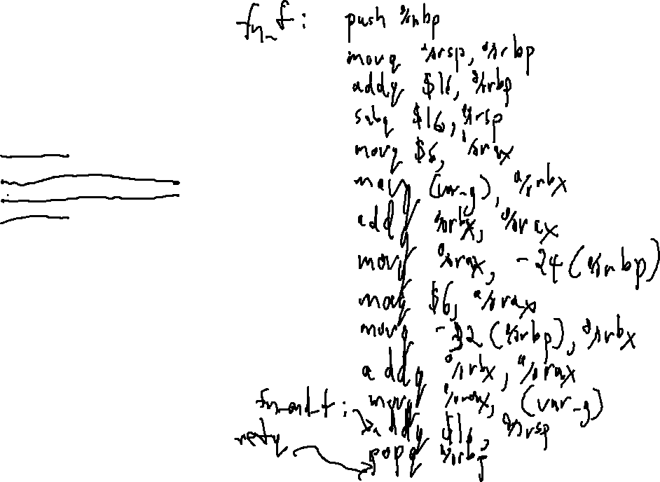
Check-in #28
Write the code that a compiler might output for the following 3AC code:
enter f
[a] := 6 ADD64 [g]
[g] := 6 ADD64 [b]
leave f
Assume: a is the first local in f and occupies 8 bytes
b is the second local in f and occupies 8 bytes
g is a global at label var_g
There are only 2 locals in f

Slide 2

Flipped Wednesday

Slide 3
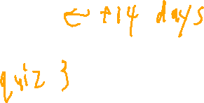
Administrivia
Project 6
Mid-semester review: https://compilers.cool/midpoint

Slide 4
Written Work #8 Topics
Semantics
Starting x64

Slide 5
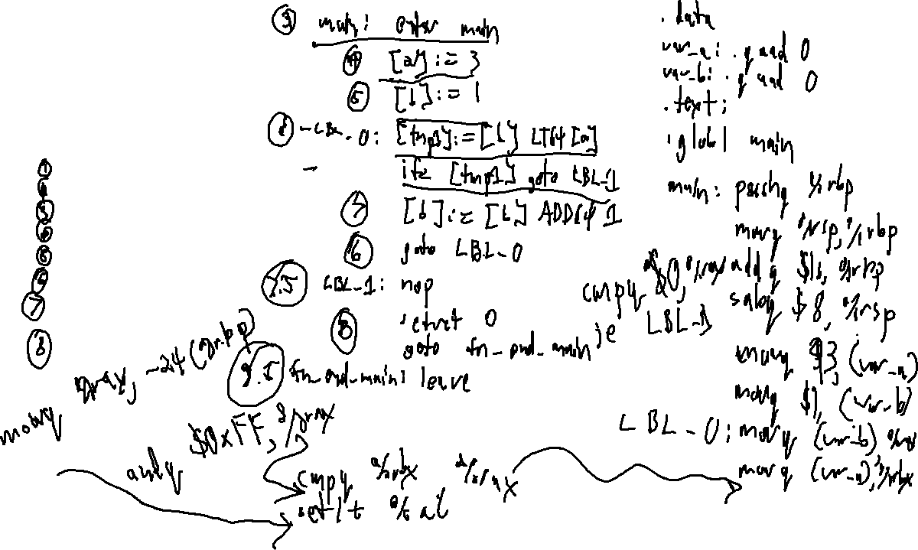
W8 – Question 1
Create x64 code for the following program
int a;
int b;
int main(){
a = 3;
b = 1;
while (b < a){
b = b + 1;
}
return 0;
}

Slide 6
W8 – Question 2
Briefly explain why compilers that use a static allocation scheme have difficulty implementing recursion.

Slide 7
W8 – Question 3
What is a semantic gap?

Slide 8
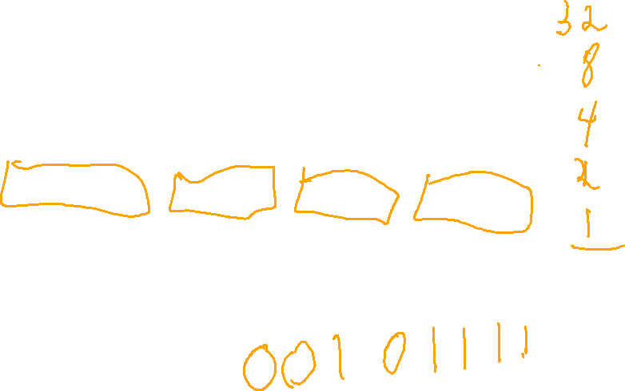
W8 – Question 4
What is the 2s complement, 4-byte representation of the value 47 in MSB and LSB?

