Slide 1

Flowgraphs
Drew Davidson | University of Kansas

Slide 2

Previously…
Machine Code Optimization
Machine code optimization overview
Improving data allocation
Register allocation
Improving Final Code
Peephole optimization
Instruction Pipelines
You should know
Interference graphs
Sharing AR slots / registers for allocation
How/where to apply peephole optimizations
How/where instruction reordering might aid a simple instruction pipeline
Optimization
2

Slide 3

Compiler Construction
Progress Pics
Basic source to target workflow:
Complete
Outputs naïve code
Advanced workflow:
“Postprocess” the output of a naïve phase
Source code
Lexical
analysis
Syntactic
analysis
Semantic analysis
Intermediate code generation
Final code generation
Target code
3

Slide 4
Compiler Construction
Progress Pics
Source code
Basic source to target workflow:
Complete
Outputs naïve code
Advanced workflow:
“Postprocess” the output of a naïve phase
Lexical
analysis
Syntactic
analysis
Semantic analysis
Intermediate code generation
We are here
Intermediate code optimization
  Discussed: final code “cleanup”
  Next up: intermediate code
Final code generation
Final code optimization
Target code
4

Slide 5
Lecture Outline
Flowgraphs
Program analysis:
Goals
Control flow graphs
Local Optimizations
Dead code elimination
Common subexpression elimination
Constant/copy propagation
Optimization

Slide 6

Making faster IR programs
Flowgraphs: Program analysis
General constraints:
We can’t violate program semantics
Minimal architecture details
Constraint-friendly goals:
Don’t do useless computation
Don’t do redundant computation

Slide 7
Simple Example: Constant Folding
Flowgraphs: Program analysis
Statically compute known expressions
Replace the runtime expression with its value
Analysis
Identify constant expressions
Compute known value
Rewrite
Replace expression with value
Before
After
[z] := 1 + 2
[z] := 3

Slide 8

Program Analysis
Flowgraphs: Program analysis
The more we know about the program the more we can improve it
What might we be interested in knowing…?

Slide 9
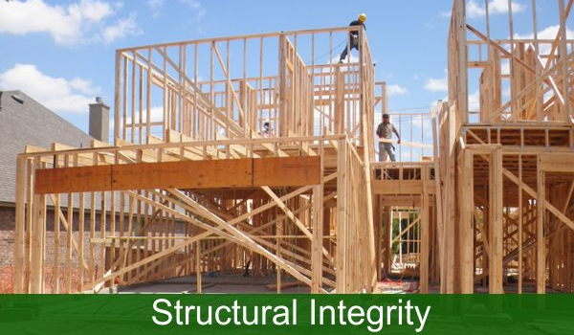
“Structural” Properties of a Program
Flowgraphs: Program analysis
E.g. for a given program point:
What paths lead there?
Is it in a deeply nested loop?
Is it reachable at all?
Knowing the above info supports other analyses
Might a variable be uninitialized?

Slide 10
“Structural” Properties of a Program
Flowgraphs: Program analysis
E.g. for a given program point:
What paths lead there?
Is it in a deeply nested loop?
Is it reachable at all?
Knowing the above info supports other analyses
Might a variable be uninitialized?
We need a program abstraction to capture these details

Slide 11
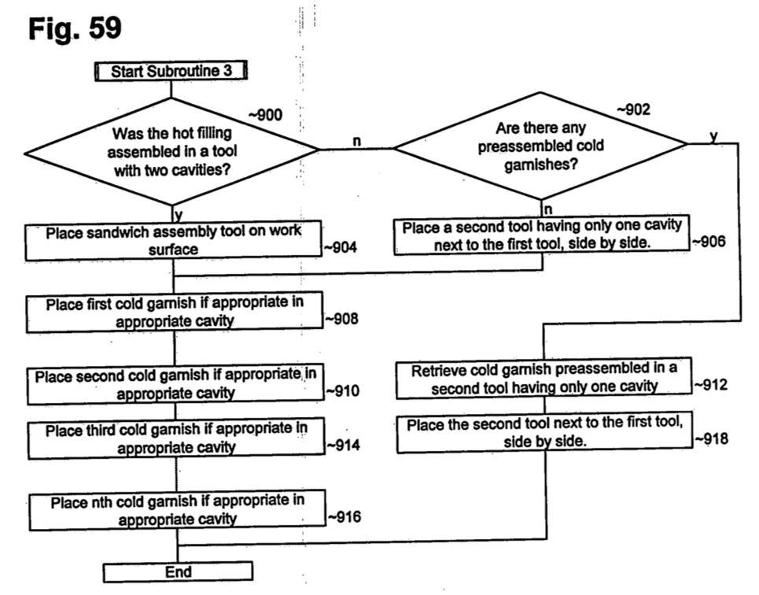
Intuition: Flow charts
Flowgraphs: Program analysis
Notation
Nodes are instructions
Edges go to successor nodes
Operation
Execute current instruction
Proceed to the right successor
Flow chart for building a sandwich,
appearing in a McDonald’s patent

Slide 12
Intuition: Flow charts
Flowgraphs: Program analysis
Notation
Nodes are instructions
Edges go to successor nodes
Operation
Execute current instruction
Proceed to the right successor
Not just for
sandwiches!
Flow chart for building a sandwich,
appearing in a McDonald’s patent

Slide 13
Intuition: Flow Charts … for Code?!
Flowgraphs: Program analysis
Notation
Nodes are instructions
Edges go to successor nodes
Operation
Execute current instruction
Proceed to the right successor
src code
3AC code
Instruction Flowgraph
a = 7;
if (a < 4){
a = 4;
}
a += 2;
1. [a] := 7
2. [t1] := [a] < 4
3. ifz [t1] goto L5
4. [a] := 4
L5: 5. [a] := [a] + 2
[a] := 7
[t1] := [a] < 4
ifz [t1] goto L5
[a] := 4
[a] := [a] + 2
L5:

Slide 14
Intuition: Flow Charts … FROM Code?!
Flowgraphs: Program analysis
enter funk
getin 1 [a]
void funk(int a, int b){
if (a < b){
if (a < 10){
a = a + b;
}
}
if (b < 3){
a = 1;
}
}
getin 2 [b]
[t1] := [a] < [b]
ifz [t1] goto L_a
[t2] := [a] < 10
ifz [t2] goto L_b
[a] := [a] + [b]
L_b:
nop
L_a:
nop
[t3] := [b] < 3
ifz [t3] goto L_c
[a] := 1
L_c:
nop
leave funk

Slide 15
Intuition: Flow Charts … FROM Code?!
Flowgraphs: Program analysis
enter funk
getin 1 [a]
getin 2 [b]
void funk(int a, int b){
if (a < b){
if (a < 10){
a = a + b;
}
}
if (b < 3){
a = 1;
}
}
[t1] := [a] < [b]
ifz [t1] goto L_a
[t2] := [a] < 10
jmp
ifz [t2] goto L_b
jmp
[a] := [a] + [b]
L_b:
nop
L_a:
nop
[t3] := [b] < 3
ifFalse tmpC3 goto L_c
jmp
a := 1
L_c:
nop
leave funk

Slide 16

Code Flowcharts: Seem Familiar?
Flowgraphs: Program analysis
Maybe this is how you learned to think about code!
It’s a nice way to visualize the control flow of the program
We can extend this intuition for program analysis

Slide 17
Lecture Outline
Flowgraphs
Program analysis:
Goals
Control flow graphs
Local Optimizations
Dead code elimination
Common subexpression elimination
Constant/copy propagation
Optimization

Slide 18

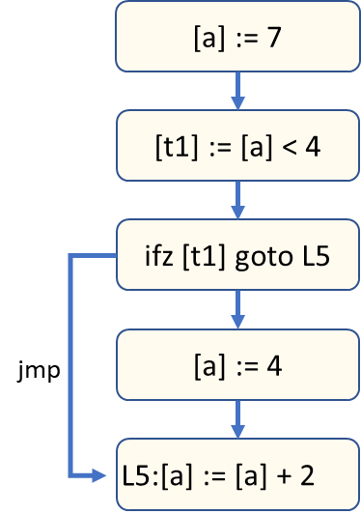
Intuition
Flowgraphs: Control flow graphs
A more compact version of the instruction flow chart
But still preserves the way in which control passes through the program

Slide 19
Compacting the Flowchart Concept
Flowgraphs: Control flow graphs
enter funk
getarg 1 [a]
The flowchart is needlessly verbose
We could put multiple instructions in a node
Group the instructions that always execute together
getarg 2 [b]
[tmpC1] := [a] < [b]
ifz [tmpC1] goto L_a
[tmpC2] := [a] < 10
ifz [tmpC2] goto L_b
jmp
jmp
[a] := [a] + [b]
L_b:
nop
L_a:
nop
[tmpC3] := [b] < 3
ifz [tmpC3] goto L_c
jmp
a := 1
L_c:
nop
leave funk

Slide 20

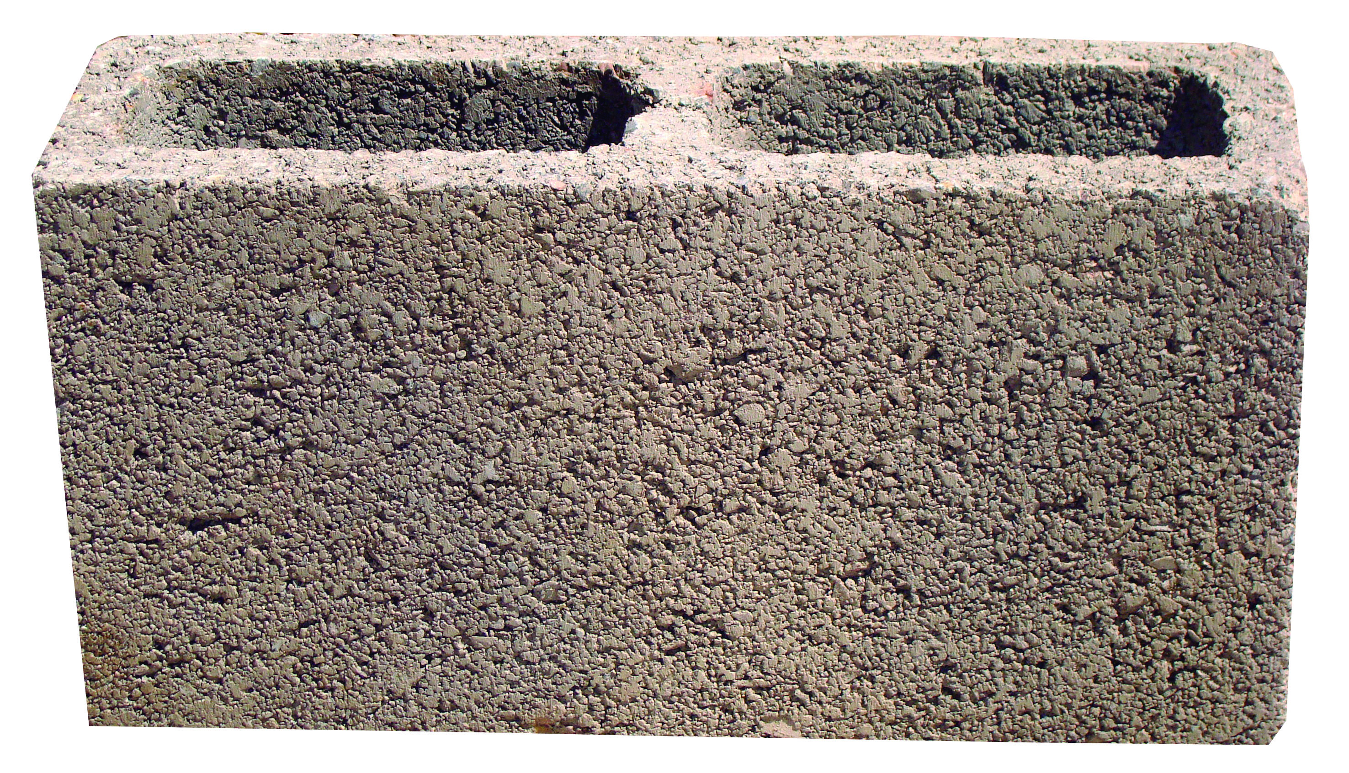
Basic Blocks
Flowgraphs: Control flow graphs
Definition: Sequence of instructions guaranteed to execute without interruption

Slide 21

Basic Blocks Boundaries
Flowgraphs: Control flow graphs
“Terminator” – An instruction that ends a basic block
“Leader” – An instruction that begins a block

Slide 22
Basic Blocks
Flowgraphs: Control flow graphs
Sequence of instructions guaranteed to execute without interruption
Terminology:
  “Leader” – An instruction that begins a block
  “Terminator” – An instruction that ends a basic block
The first instruction in the procedure
The target of a jump
The instruction after an terminator
The last instruction of the procedure
A jump (ifz, goto)
A call (We’ll use a special LINK edge)

Slide 23
Basic Blocks
Flowgraphs: Control flow graphs
Leaders
The first instruction in the procedure
The target of a jump
[a] := 7
The instruction after an terminator
[t1] := [a] < 4
Terminators
The last instruction in the procedure
A jump (ifz, goto)
ifz [t1] goto L5
A call (We’ll use a special LINK edge to successor)
Next instruction is a leader
[a] := 4
jmp
Construction algorithm
foreach instr i in procedure:
if i is a leader, begin a new BBL
if i is a terminator, end current BBL
[a] := [a] + 2
L5:

Slide 24

Building Basic Blocks
Flowgraphs: Control flow graphs
Leaders
The first instruction in the procedure
The target of a jump
The instruction after an terminator
Terminators
The last instruction in the procedure
A jump (ifz, goto)
This algorithm isn’t optimal,
but we’ll go with it
A call (We’ll use a special LINK edge to successor)
Next instruction is a leader
example
Construction algorithm
foreach instr i in procedure:
if i is a leader, begin a new BBL
if i is a terminator, end current BBL
jmp L1
L1: nop

Slide 25

The Control Flow Graph: Summary
Flowgraphs: Control flow graphs
A graph of basic blocks
One graph per procedure
  Exactly one entry block
  Exactly one exit block
Distinguished edge types:
  Back edges – an edge to a previously-encountered node
  Call edge – Connects a call site to the called function
  Link edge – Connects a function call to it’s return point
CFGs

Slide 26
Benefits of Basic Blocks
Flowgraphs: Control flow graphs
Makes CFGs a more manageable data structure
Zoom out and observe procedure structure
Loops
If-stmt
If-else
(head)
(head)
(head)
jmp
jmp
(True branch)
jmp
(body)
jmp
(True branch)
(False branch)
(after)
jmp
(after)
(after)

Slide 27
Benefits of Basic Blocks
Flowgraphs: Control flow graphs
Makes CFGs a more manageable data structure
Zoom out and observe procedure structure
Zoom in to a BBL’s “uninterrupted sequences”
Simplifies analysis:
Many properties we want to know are trivial to compute within a BBL

Slide 28
Types of CFG Analysis
Control Flow Graphs: Representation
Modularizes analysis:
Analysis within a single basic block
Analysis between multiple basic blocks in a function
What about analysis between multiple functions?
Traditionally called “Local” analysis
Traditionally called “Global” analysis
We’ll come back to this one

Slide 29
Lecture Outline
Flowgraphs
Program analysis:
Goals
Control flow graphs
Local Optimizations
Dead code elimination
Common subexpression elimination
Constant/copy propagation
Optimization

Slide 30
Dead Code Elimination
Flowgraphs: Local Optimizations
Remove “useless” instructions (those with no effect)
Analysis: live variable analysis
This definition does not reach the end of the block nor any use in the block!
[x] := 1
[x] := 2
[x] := 2
[y] := 3
[y] := 3
[z] := [x] * [y]
[z] := [x] * [y]
write [z]
write [z]

Slide 31
Constant/Copy Propagation
Flowgraphs: Local Optimizations
Replace a variable use with its definition
Analysis: “copy identification” (doesn’t really have a name)
Propagate x’s value
This assignment is
now dead code!
[y] := [x]
[y] := [x]
[z] := [x] * [y]
[z] := [x] * [x]
[y] := 1
[y] := 1
write [z]
write [z]
When propagating constant values, can aid in constant folding
[x] := 1
[x] := 1
Fold to 3
[y] := 2
[y] := 2
[z] := [x] + [y]
[z] := 1 + 2

Slide 32
Common Subexpression Elimination
Flowgraphs: Local Optimizations
Reuse already-computed expressions
Analysis: available expression analysis
[t] := [x] * [y]
[a] := [x] * [y]
[a] := [t]
[b] := [x] * [y]
[b] := [t]
[c] := [x] * [y]
[c] := [t]

Slide 33
Lecture End
Flowgraphs
Summary
Control Flow Graphs serve as an abstraction of the routes through the program
Basic blocks summarize guaranteed sequences and enable local optimizations (DCE, CP, CSE)
Next Time
Global optimizations – extending optimization across multiple basic blocks

