Slide 1
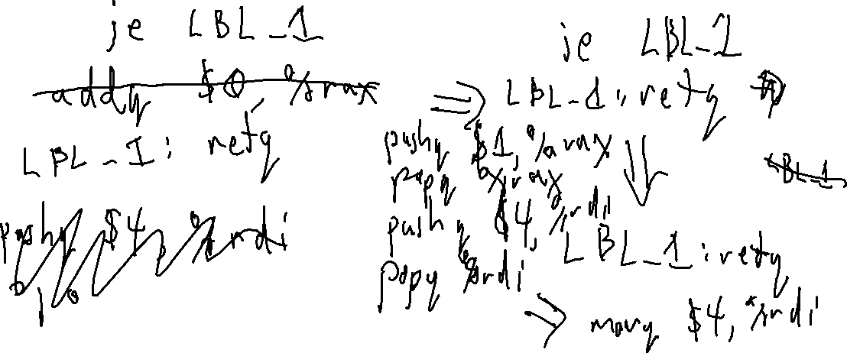
Check-in #33
Give an example of a snippet of x64 code that benefits from two peephole optimizations

Slide 2

Flipped Wednesday

Slide 3
Quiz 3

Slide 4
Quiz 3 – Question 1
Many compilers, including levic, uses multiple intermediate representations. Describe why each of these IRs are used.

Slide 5
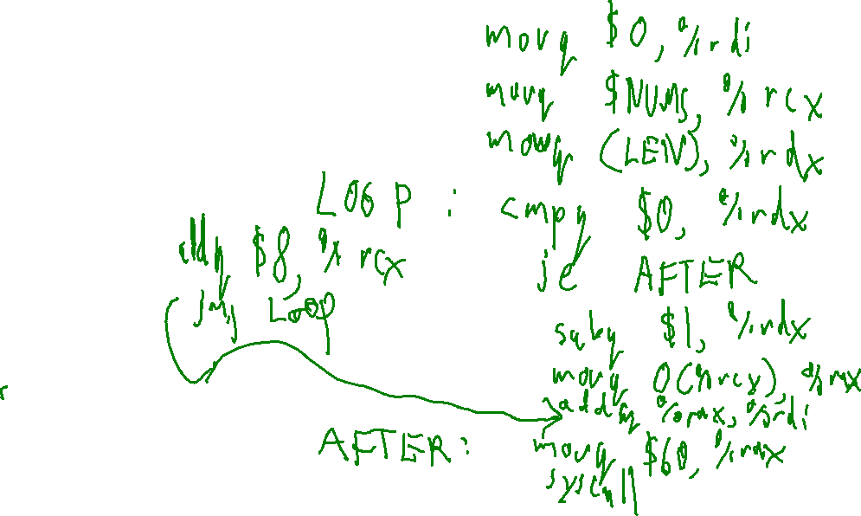
Quiz 3 – Question 2
Write x64 code to compute the sum of an array NUMS and exit the program with the sum as the exit value. You may assume that the length of the array is stored in LEN. That is, complete the following assembly program:
.globl _start
.data
NUMS: .quad 6, 3, 2, ...
LEN: .quad ?
.text
_start :
( your code here)

Slide 6
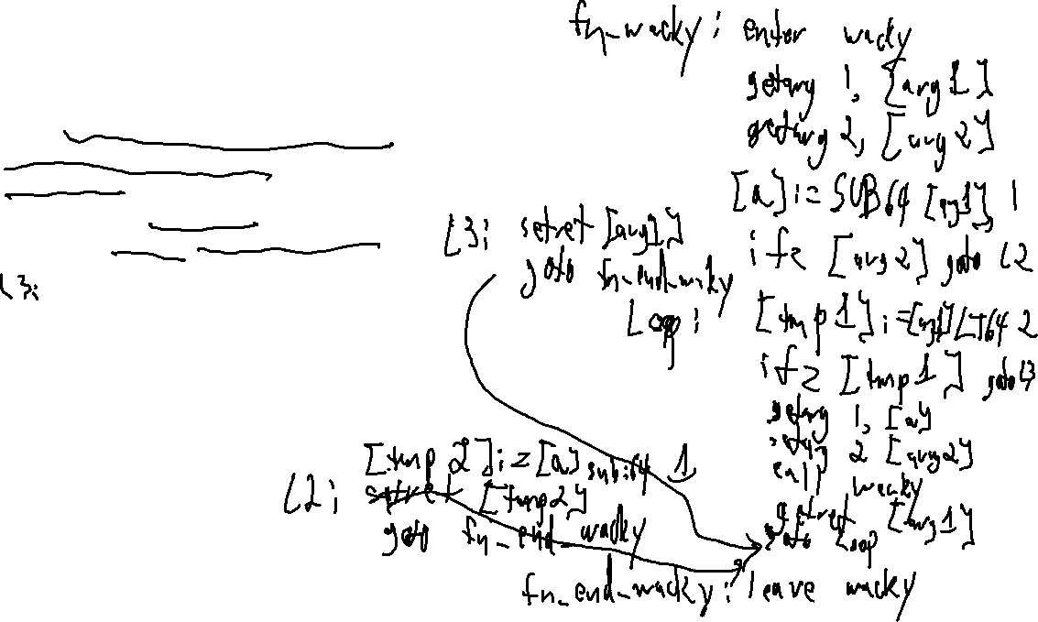
Quiz 3 – Question 3
wacky : (arg1 : int , arg2 : bool) int {
a : int = arg1 − 1;
if (arg2){
while (arg1 < 2){
arg1 = wacky(a, arg2 );
}
return arg1 ;
}
return a − 1;
}
Convert the above code to 3AC in the manner that a non-optimizing compiler would do, in the fashion discussed in class.

Slide 7
Quiz 3 – Question 4
What is a runtime environment?
What is the runtime environment for the Levi language?

Slide 8
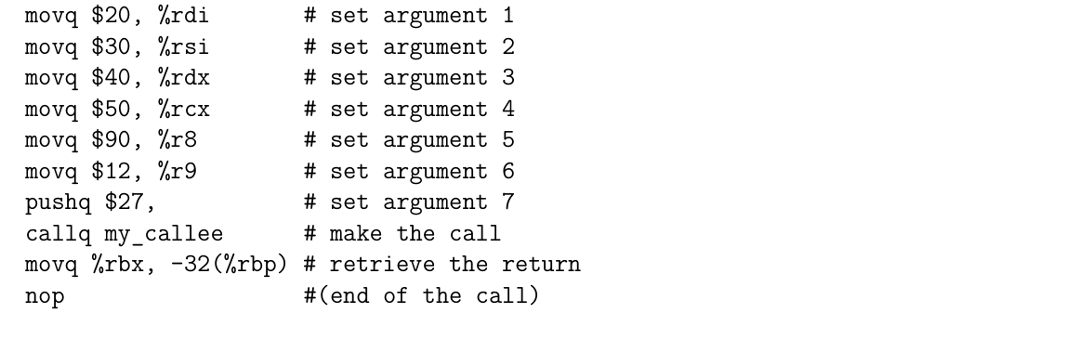
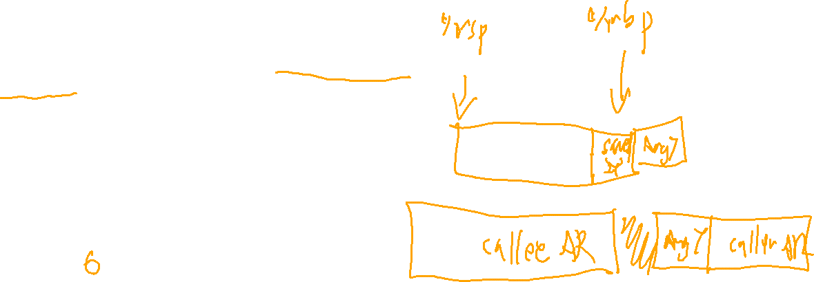
Quiz 3 – Question 5
Imagine the following code is intended to represent an x64 function call. It violates the System V ABI in (at least two ways). Point out two violations

Slide 9
W7 – Question 2
fn_v:
enter v
Convert the following function into 3AC
getarg 1, [a]
LBL_1:
[tmp1] := [a] LT64 2
int v(int a){
while (a < 2){
while (a < 3){
a++;
}
a++;
}
return a;
}
ifz [tmp1] goto LBL_2
LBL_3:
[tmp2] := [a] LT64 3
ifz [tmp2] goto LBL_4
[a] := [a] ADD64 1
goto LBL_3
LBL_4:
nop
[a] := [a] ADD64 1
LBL_2:
nop
setret [a]
goto end_fn_v
end_fn_a:
leave v

Slide 10
W7 – Question 3
Convert the 3AC procedure into source code
fn_k: enter k
getarg 1, [b]
[i] = [b]
lbl_1: [t] = [i] LT64 10
ifz [t] goto lbl_2
[i] = [i] ADD64 1
WRITE [i]
goto lbl_1
lbl_2: nop
fn_end_k: leave k
k : void {
(b : int)
i : int;
i = b;
while (i < 10){
i++;
out << I;
}
}

Slide 11
W7 – Question 4
Assume a language that allows for pass-by-reference or pass-by-value parameters. What would the 3AC code look like for a pass-by-reference call? Illustrate with an example.
Don’t use the brackets around the variable (which indicate a memory lookup) in the generated setarg / getarg
void foo(int& arg){
arg = 3;
}
int main(){
int p;
foo(p);
}
fn_foo: enter foo
getarg 1, arg
end_fn_foo:
leave foo
fn_main: enter main
setarg 1, p
end_fn_main:
leave main

