Slide 1
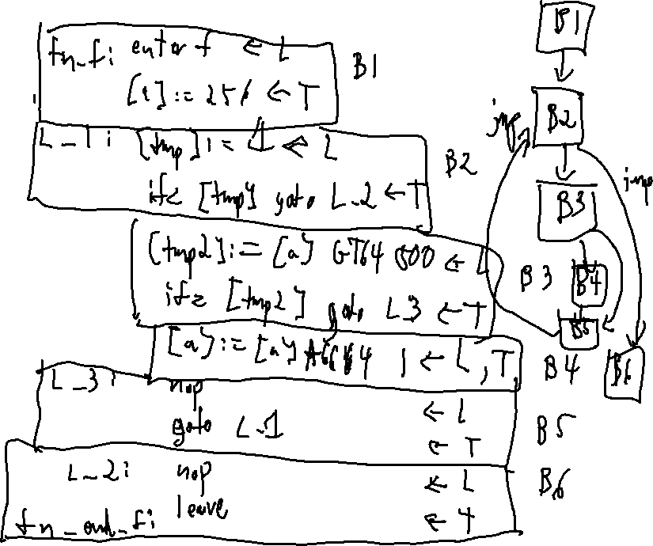
Checkin 34
Draw the CFG of this procedure
f: () void{
a:int;
a = 256;
while(true){
if (a > 500){
a = a++;
}
}
}

Slide 2
Announcements
Administrivia
P7 out tonight

Slide 3

Dataflow
Drew Davidson | University of Kansas

Slide 4

Previously…
Review Lecture: Flowgraphs
You should know
Basic Blocks
How to build a CFG
The idea of some local optimizations
  Dead Code Elimination
  Common Subexpression Elimination
  Constant/Copy Propagation
Control flow graphs:
A hybrid IR/ a structural overlay
Rationale
Useful for visualizing program flow
Construction
Identify basic blocks (BBLs)
Connect edges on control transfer
Uses
Program understanding
Optimization

Slide 5
Recall: Some Local Optimizations
Review - Basic Block Optimization
Dead Code Elimination: Guaranteed no future use
of this definition (the assignment is not “live”)
[x] := 1
[x] := 2
2
Constant Propagation: Guaranteed
previous static definition of this use
OUTPUT [x]
Is this definition live?
Without knowing x’s use
outside this block
We have to keep it
¯\_(ツ)_/¯

Slide 6
Today’s Outline
Dataflow
Dataflow analysis
Intuition
Concepts
Dataflow frameworks
Optimization

Slide 7
Consider What Info We Know
Basic Block Optimization
(DCE) x: 💀
(CP) x: 🤷
Dead Code Elimination: Guaranteed no future use
of this definition (the assignment is not “live”)
[x] := 1
(DCE) x: 💀
(CP) x: 1
[x] := 2
Constant Propagation: Guaranteed
previous static definition of this use
(DCE) x: 😊
(CP) x: 2
OUTPUT [x]
(DCE) x: 🤷
(CP) x: 2
For Dead Code Elimination,
definition could be marked
For Constant Propagation,
use could be marked
Known Live | Known Dead | Not Enough Info
Guaranteed Constant | Guaranteed Non-Constant | Not Enough Info
😊
💀
🤷
<value>
> 1 value or
⚡
🤷

Slide 8
Consider Where We Learn Info
Basic Block Optimization
Backwards
analysis
(DCE) x: 💀
(CP) x: 🤷
Dead Code Elimination: Guaranteed no future use
of this definition (the assignment is not “live”)
[x] := 1
(DCE) x: 💀
(CP) x: 1
[x] := 2
Constant Propagation: Guaranteed
previous static definition of this use
(DCE) x: 😊
(CP) x: 2
OUTPUT [x]
(DCE) x: 🤷
(CP) x: 2
Forwards
analysis
For Dead Code Elimination,
definition could be marked
For Constant Propagation,
use could be marked
Known Live | Known Dead | Not Enough Info
Guaranteed Constant | Guaranteed Non-Constant | Not Enough Info
😊
💀
🤷
<value>
> 1 value or
⚡
🤷

Slide 9

Beyond Local Optimization
Dataflow
One possible CFG
L1:
enter
L2:
getarg 1, [x]
L3:
ifz [x] goto L7
L4:
[x] := 2
jmp
L5:
[y] := 3
L6:
[z] := [x] * [y]
L7:
nop
L8:
leave
L6 is dead!
(causes L4 and L5 to be dead)

Slide 10
Beyond Local Optimization
Dataflow
One possible CFG
Another possible CFG
L1:
enter
L1:
enter
L2:
getarg 1, [x]
L2:
getarg 1, [x]
L3:
ifz [x] goto L7
L3:
ifz [x] goto L7
L4:
[x] := 2
L4:
[x] := 2
jmp
L5:
[y] := 3
jmp
L5:
[y] := 3
L6:
[z] := [x] * [y]
L6:
[z] := [x] * [y]
L7:
nop
L7:
OUTPUT [z]
L8:
leave
L8:
leave
L6 is dead!
L6 is live!
(causes L4 and L5 to be dead)
Cannot be removed

Slide 11
Today’s Outline
Dataflow
Dataflow analysis
Intuition
Concepts
Dataflow frameworks
Optimization

Slide 12


Generalizing Dataflow Intuition
Dataflow Intuition
Let’s revisit the example, and ask some leading questions
One possible CFG
Why is L6 dead?
$$≡$$
Why isn’t L6 live?
L1:
enter
L2:
getarg 1, [x]
L3:
ifz [x] goto L7
L4:
[x] := 2
jmp
L5:
[y] := 3
L6:
[z] := [x] * [y]
L7:
nop
Returning to the scene of the crime
L8:
leave

Slide 13
Generalizing Dataflow Intuition
Dataflow Intuition
Let’s revisit the example, and ask some leading questions
One possible CFG
Why is L6 dead?
$$≡$$
Why isn’t L6 live?
L1:
enter
The thing defined was no longer useful
L2:
getarg 1, [x]
“died of natural causes”
L3:
ifz [x] goto L7
L4:
[x] := 2
jmp
L5:
[y] := 3
L6:
[z] := [x] * [y]
L7:
nop
L8:
leave

Slide 14
Generalizing Dataflow Intuition
Dataflow Intuition
Let’s revisit the example, and ask some leading questions
One possible CFG
Why is L6 dead?
$$≡$$
Why isn’t L6 live?
L1:
enter
The thing defined was no longer useful
L2:
getarg 1, [x]
“died of natural causes”
L3:
ifz [x] goto L7
The thing defined was redefined before use
“it was killed!”
L4:
[x] := 2
Need to gather some facts to
tell if a statement is dead
jmp
L5:
[y] := 3
L6:
[z] := [x] * [y]
What variables are useful
at each program point?
L7:
[z] := 3
What variables are killed
at each program point?
L8:
write [z]
L9:
leave

Slide 15
Generalizing Dataflow Intuition
Dataflow Intuition
One possible CFG
Need to gather some facts to
tell if a statement is dead
L1:
enter
L2:
getarg 1, [x]
What things are useful
at each program point?
L3:
ifz [x] goto L7
What things are killed
at each program point?
L4:
[x] := 2
jmp
L5:
[y] := 3
L6:
[z] := [x] * [y]
x: 💀, y: 💀, z: 💀 nothing live at end of block, because nothing live at entry to successors
L7:
[z] := 3
x: 💀, y: 💀, z: 💀 Previous definitions of z are not useful, because L7 killed them
L8:
write [z]
x: 💀, y: 💀, z: 😊 z is useful, because it’s used later on (in L8)
L9:
leave
x: 💀, y: 💀, z: 💀 nothing is used by leave
x: 💀, y: 💀, z: 💀 (no more code to use anything)

Slide 16
Generalizing Dataflow Intuition
Dataflow Intuition
One possible CFG
L1:
enter
x: 💀, y: 💀, z: 💀 enter doesn’t use any variables
x: 💀, y: 💀, z: 💀 x is clobbered
L2:
getarg 1, [x]
x: 😊, y: 💀, z: 💀 x gets used in the predicate
L3:
ifz [x] goto L7
x: 💀, y: 💀, z: 💀 nothing live at end of block, because nothing live at entry to EITHER successor
x: 💀, y: 💀, z: 💀 x was killed, previous definitions of x would not be useful past this point
L4:
[x] := 2
x: 😊, y: 💀, z: 💀 y was killed but a definition of x will still be used later
jmp
L5:
[y] := 3
x: 😊, y: 😊, z: 💀 Both x and y have been found to be used
L6:
[z] := [x] * [y]
x: 💀, y: 💀, z: 💀 nothing live at end of block, because nothing live at entry to successor
L7:
[z] := 3
x: 💀, y: 💀, z: 💀 Previous definitions of z are not useful, because L7 killed them
L8:
write [z]
x: 💀, y: 💀, z: 😊 z is useful, because it’s used later on (in L8)
L9:
leave
x: 💀, y: 💀, z: 💀 nothing is used by leave
x: 💀, y: 💀, z: 💀 (no more code to use anything)

Slide 17
Generalizing Dataflow Intuition
Dataflow Intuition
We call these sets
“dataflow fact sets”
One possible CFG
L1:
enter
x: 💀, y: 💀, z: 💀
x: 💀, y: 💀, z: 💀
L2:
getarg 1, [x]
x: 😊, y: 💀, z: 💀
L3:
ifz [x] goto L7
x: 💀, y: 💀, z: 💀
x: 💀, y: 💀, z: 💀
L4:
[x] := 2
x: 😊, y: 💀, z: 💀
jmp
L5:
[y] := 3
x: 😊, y: 😊, z: 💀
L6:
[z] := [x] * [y]
x: 💀, y: 💀, z: 💀
L7:
[z] := 3
x: 💀, y: 💀, z: 💀
L8:
write [z]
x: 💀, y: 💀, z: 😊
L9:
leave
x: 💀, y: 💀, z: 💀
x: 💀, y: 💀, z: 💀

Slide 18
Initializing Fact Sets
Dataflow Intuition
Technically, we should start all fact sets as “Not enough info” (🤷). This will matter later
One possible CFG
After Analysis
Before Analysis
L1:
enter
x: 💀, y: 💀, z: 💀
x: 🤷, y: 🤷, z: 🤷
x: 💀, y: 💀, z: 💀
x: 🤷, y: 🤷, z: 🤷
L2:
getarg 1, [x]
x: 😊, y: 💀, z: 💀
x: 🤷, y: 🤷, z: 🤷
L3:
ifz [x] goto L7
x: 💀, y: 💀, z: 💀
x: 🤷, y: 🤷, z: 🤷
x: 💀, y: 💀, z: 💀
x: 🤷, y: 🤷, z: 🤷
L4:
[x] := 2
x: 😊, y: 💀, z: 💀
x: 🤷, y: 🤷, z: 🤷
jmp
L5:
[y] := 3
x: 😊, y: 😊, z: 💀
x: 🤷, y: 🤷, z: 🤷
L6:
[z] := [x] * [y]
x: 💀, y: 💀, z: 💀
x: 🤷, y: 🤷, z: 🤷
L7:
[z] := 3
x: 💀, y: 💀, z: 💀
x: 🤷, y: 🤷, z: 🤷
L8:
write [z]
x: 💀, y: 💀, z: 😊
x: 🤷, y: 🤷, z: 🤷
L9:
leave
x: 💀, y: 💀, z: 💀
x: 🤷, y: 🤷, z: 🤷
x: 💀, y: 💀, z: 💀
x: 🤷, y: 🤷, z: 🤷

Slide 19
Merging Fact Sets
Dataflow Intuition
Fact sets may be different when multiple successors/predecessors join
Need to merge incoming fact sets
Merge as conservatively as possible
Don’t do anything without a guarantee!
Plan for all possible flows
Example: is L3 live? (consider both block paths)
L3 definition clobbered on the fallthrough branch (at L5)
L3 definition not clobbered on the jump branch
L1:
enter
a: 💀, b: 💀
getarg 1, [a]
a: 💀, b: 💀
L2:
getarg 2, [b]
a: 😊, b: 💀
L3:
a: 😊, b: 😊
L4:
ifz [a] goto L7
a: 😊, b: 😊
a: 😊, b: 💀
L5:
[b] := 4 * [a]
jmp
a: 💀, b: 😊
L8:
OUTPUT [b]
a: 💀, b: 😊
L9:
leave
a: 💀, b: 💀
a: 💀, b: 💀

Slide 20
Today’s Outline
Dataflow
Dataflow analysis
Intuition
Dataflow frameworks
Abstract Interpretation
Optimization

Slide 21
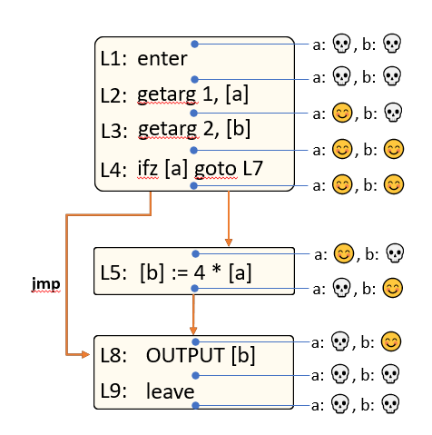
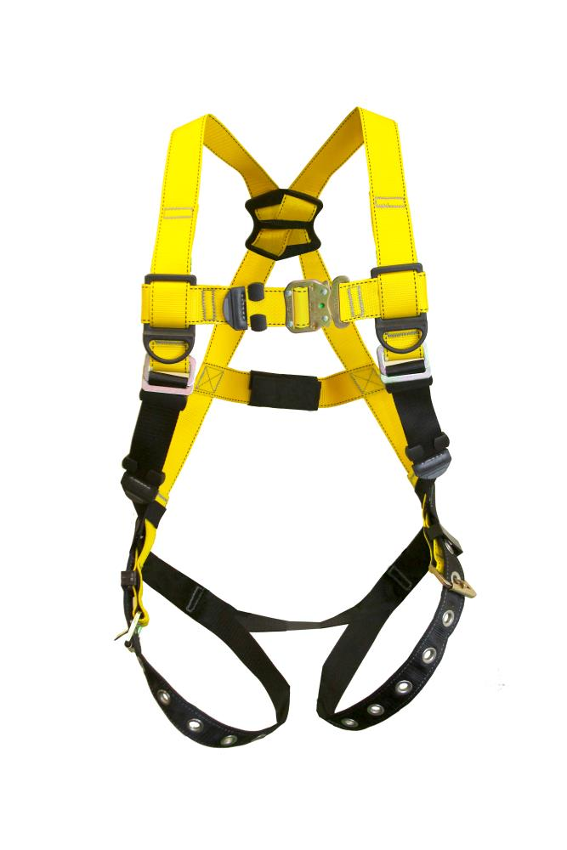
Harnessing Commonalities of Dataflow Analyses
Dataflow Frameworks
Basic algorithms for many dataflow analyses follow a common template with minor variations
Idea: restate each analysis in terms of its variations
Profit: reuse the same algorithm to get results
$$$

Slide 22
Harnessing Commonalities of Dataflow Analyses
Dataflow Frameworks
Basic algorithms for many dataflow analyses follow a common template with minor variations
Idea: restate each analysis in terms of its variations
Profit: reuse the same algorithm to get results
Variations
What information is tracked
How fact sets are merged
The direction of the analysis

Slide 23

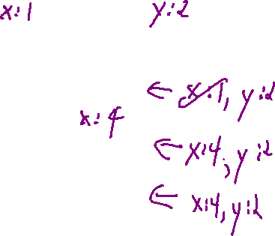

Templated Information Tracking
Dataflow Frameworks
Framework tracks the “interplay between data” at basic blocks boundaries
B1:
…
B2:
…
For a given basic block b:
IN(b): facts true on entry to b
OUT(b): facts true on exit from b
GEN(b): facts created in b
KILL(b): facts removed in b
For a backwards analysis
IN is at the bottom of the block
OUT is at the top of the block
B3:
…
B4:
…
$$IN\left(B\right)= \bigcup_{p in pred(b)}{OUT(p)}$$
OUT$\left(b\right)=GEN(b) ∪(IN\left(b\right)−KILL\left(b\right))$

Slide 24


Dataflow Sets: Example
Dataflow: Formalization
IN(b): facts true on entry to b
OUT(b): facts true on exit from b
GEN(b): facts created in b
KILL(b): facts removed in b
B1:
…
B2:
…
x = 4, y = 0
x = 5, y = 0
x = {4,5}, y = 0
B3:
[x] := 2
[x] := [y]
goto B6
$$IN\left(B\right)= \bigcup_{p in pred(b)}{OUT(p)}$$
x = 0, y = 0
B4:
…
OUT$\left(b\right)=GEN(b) ∪(IN\left(b\right)−KILL\left(b\right))$

Slide 25
Benefits of the Framework
Dataflow Frameworks
When set up properly…
Safety of the analysis is guaranteed
Termination of the analysis is guaranteed
Order of analysis (which block you process) is unimportant

Slide 26
Compute Live Variables
Dataflow: Formalization - Example
B1:
{t5,t2,t1}
[y] := 0
ifz [t1] goto B2
{t5, y, t2}
Dead!
jmp
B3:
[x] := 2
[x] := 0 goto B6
{ }
B2:
{t5, y, t2}
[x] := 2
ifz [t2] goto B4
{t5, y}
x
jmp
{t5, y}
B5:
[x] := [y]
ifz [t5] goto B6
{x}
jmp
{ }
B4:
[x] := 0
jmp
{x}
{x}
B6:
[z] := [x]
OUTPUT [z]
{ }
What values are live at B6?

Slide 27
Example Analyses
Dataflow: Formalization
Let’s do some examples in this light
A slightly bigger dead code elimination example
Constant propagation
  Recall: replace a variable with it’s known constant value
  Forward analysis
  Fact sets: variable to (sets of) known values

Slide 28
Refresh Constant/Copy Propagation
Dataflow: Formalization
Copy Propagation
x := 1
x := 1
Replace RHS of simple assigns with value of assign (if known)
y := x
y := 1
Forward analysis
z := x + y
z := 1 + 1
x := 3
x := 3
Constant folding
Replace constant RHS expressions with value
Traversal order isn’t important
x := 1
x := 1
y := 1
y := 1
z := 1 + 1
z := 2
x := 3
x := 3

Slide 29
Example Constant Propagation
Dataflow: Formalization - Example
{ }
B1:
[y] := 0
ifz [t1] goto B2
{y = 0}
jmp
{y = 0}
{y = 0}
B2:
[x] := 2
ifz [t2] goto B4
B3:
x := 2
x := 0
goto B6
{y = 0, x = 2}
{y = 0, x = 2}
jmp
B5:
[x] := [y]
ifz [t5] goto B6
{y = 0, x = 0}
{y = 0, x = 0}
jmp
{ y = 0, x = {0,2} }
B4:
[x] := 0
jmp
{y = 0, x = 0}
{y = 0, x = 0}
B6:
[z] := [x]
0
{y = 0, x = 0, z = 0}
What values can x take on at B6?

Slide 30
Handling Practical Data Abstractions
Global Dataflow: Formalization
Global variables
We only have visibility into 1 procedure
Be conservative about the effect of other procedures
  Reset fact sets across a call
  Consider global variables live at function end

Slide 31

Analysis Termination
Dataflow: Formalization
In the previous examples, we completed in one pass over the CFG
This won’t always be the case, due to a fundamental construct…

Slide 32
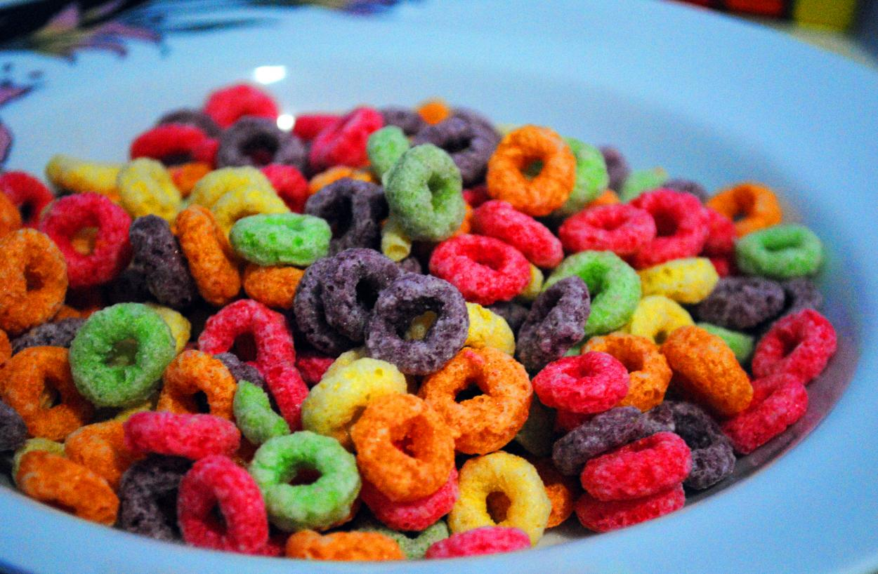
Loops
Dataflow: Formalization
Loops complicate dataflow analysis
Create cyclic dependencies
Complicate fact sets
Oh bröther, you might have some lööps

Slide 33
Loops: Dependency cycles
Dataflow: Formalization
Constant propagation
IN(B2) requires knowing OUT(B2)
Solution: Saturate fact sets
Start sets “TBD” (🤷) value
Run the algorithm until sets don’t change
We’ve seen the saturation approach before
(FIRST and FOLLOW sets)
OUT(B2) requires knowing IN(B2)
IN(B1):
{x=🤷,y=🤷}
B1: enter
[x] := 3
OUT(B1):
{x=3,y=🤷}
IN(B2):
{x=🤷,y=🤷}
ifz rand() goto B2
B2:
[y] := [x]
{x= 3, y=🤷}
jmp
[x] := 3
OUT(B2):
{x=3, y=🤷}
{x=3, y= 3 }
IN(B3):
{x=3,y=🤷}
B3: leave
{x=3, y= 3 }
OUT(B3):
{x=3,y=🤷}
{x=3, y= 3 }

Slide 34
Loops
Dataflow: Formalization
Loops complicate dataflow analysis
Create cyclic dependencies
Complicate fact sets
Oh bröther, you might have some lööps

Slide 35
Dealing with Loops
Dataflow: Formalization
Complicate fact sets
Can get out of hand quickly
We need a way to keep analysis manageable
Only gather useful fact sets
Not get into super-long loops
y :=
2,3,4,5,…
x :=
x := 2
3,4,5,…
iftrue random() goto B2
B2:
y := x
x := x + 1
jmp
y :=
2,3,4,5,…
x :=
3,4,5,…
,INT_MAX
,INT_MAX
…,INT_MIN
…,INT_MIN
…,INT_MIN+1
…,0,1
…,INT_MIN+1
…,0,1

Slide 36


Abstract Interpretation
Detour – Dataflow Frameworks
Consider Constant Propagation
We only care if a variable has 1 unique value
More than 1 value – it doesn’t matter what the values are
$$⊥$$
…
{ -2 }
{ -1 }
{ 0 }
{ 1 }
{ 2 }
…
{ }

Slide 37

Reaching a Fixpoint
Detour – Abstract Interpretation
$$⊥$$
L0: enter
L1: getarg 1, [x]
L2: getarg 2, [y]
…
{ -2 }
{ -1 }
{ 0 }
{ 1 }
{ 2 }
…
L3: ifz [x] LT64 7 goto L6
{ }
jmp
L4: [x] := [x] + [y]
L5: jmp L3
L6: write [x]

Slide 38
Summary
Underview
Covered some key optimization concepts
Inter-block (global) analysis
Dataflow frameworks:
  Define fact sets and how they interact
Next Time – Static Single Assignment (SSA)
A program form that eases and enhances optimization

